Slide 1

NASA-HDBK-8739.21
Workmanship Manual for Electrostatic Discharge Control
(Excluding Electrically Initiated Explosive Devices)
OVERVIEW

Slide 2
FOREWORD – PAGE 5
This NASA-Handbook is published by NASA to provide standardized guidance for implementing ANSI/ESD S20.20 requirements.
This document:
Describes basic considerations necessary to ensure ESD protection in work areas to be used with ESD-sensitive items.
Reinforces rigorous operator training best practice.
May be used by suppliers performing work for NASA to satisfy ANSI/ESD S20.20 ESD implementation plan requirements.

Slide 3

Scope: Page 11
1.1: Purpose
To present a standardized administrative and technical baseline for development of an ORGANIZATION’s ESD Control Program Plan required by ANSI/ESD S20.20.
Note: Uses of the word “shall” herein indicate a requirement that is traceable to ANSI/ESD S20.20.
1.2 Applicability
1.2.1: This publication is provided as a resource for all organizations that handle ESD-sensitive (ESDS) items for NASA projects and are subject to the requirements of ANSI/ESD S20.20.
1.2.2: Agency-level ESD safety and control requirements are intended to apply to all ESDS devices applied on projects where NASA high reliability aircraft or space flight hardware will be processed. This baseline should also be applied to hardware production where the end item may not be mission-critical yet is expensive to replace, or is a long-lead item.
1.2.3: Practices described are generally suitable for the ESD sensitivity levels of the Human Body Model (HBM) Classes 0 and 1A and Machine Model (MM) Class M1. For special instances where the Charge Device Model (CDM) applies, additional precautions and practices beyond those described may be necessary.
ESD
Control
Plan

Slide 4
Applicable Documents: Page 12
ANSI/ESD S20.20: Protection of Electrical and Electronic Parts, Assemblies and Equipment (Excluding Electrically Initiated Explosive Devices)
ANSI/ESD S541: Packaging Classification & Technical Requirements
ANSI/ESD S6.1: Grounding
ANSI/ESD TR20.20: Control Program Handbook, Technical Requirements
ESD ADV1.0: ESDA Glossary of Terms
ESD SP3.3: Periodic Verification of Air Ionizers
ESD S4.1-1997 Worksurfaces-Resistance Measurements
ESD STM2.1 Protection of ESD Sensitive Items-Garments
ESD STM5.1 Human Body Model (HBM)-Component Level
ESD STM5.2 Machine Model (MM)-Component Level
ESD STM5.3-1 Charged Device Model (CDM)-Component Level
ESD STM7.1 Resistive Characterization of Materials-Floor Materials
ESD STM12.1 Seating Resistive Measurements
ESD STM13.1 Electrical Soldering/De-Soldering of ESD Protective Equipment and Materials
ESD TR53-01-06 Compliance Verification of ESD Protective Equipment and Materials
NPD 8730.5 NASA Quality Policy
Proprietary
documents
except for
NPD 8730.5

Slide 5
GENERAL: Page 16
4.1: Configuration Control
4.1.1: Document controlled by NASA Headquarters OSSMA configuration management procedures.
4.1.2: Requests for technical changes are processed per NASA Headquarters OSMA configuration management procedures.
4.2 Implementation
4.2.1: ESD Control Program Plans which conform to the recommendations in this handbook include requirements related to:
facility preparation and certification
records management, assignment of responsible personnel, manager and operator training
assessment of the sensitivity of the hardware to be handled
declaration and use of special processes and criteria as applicable.
It is intended that recommendations made using language such as “is”, “are”, “should”, and “will”, will be converted to “shall” statements in the local ESD Control Plans.

Slide 6
4.2.2: Suppliers should provide a central ESD Point of Contact (POC) that can advise and assist operators, Program Monitors, contractors, subcontractors and other authorized personnel in the proper and effective implementation of this handbook. This person can be the ESD Control Program Manager that is required by ANSI/ESD S20.20-2007.
4.2.3; Methods described in this handbook for developing an ESD Control Program Plan are implemented directly by operators, Program Monitors, Audit Teams, Audit Coordinators, and Program Managers.
4.2.4: ESD Protected Area (EPA) certification level and associated ESD event model are determined by the hardware designer based on the most sensitive piece-part to be handled.
The recommended default EPA certification level is Human Body Model (HBM) Class 1A (see Table 5-1). Where HBM does not provide sufficient protection for the hardware, the Machine Model (MM) or the charged Device Model (CDM) should be considered when designing the EPA. (For areas required to protect extremely sensitive devices see Paragraph 8.2, “Special Requirements for Highly Sensitive Items.”)
4.2.5: Use of these guidelines facilitates compliance to NASA Agency-level ESD requirements, however, it does not supersede or preclude Project review and approval of suppliers’ ANSI/ESD S20.20-compliant ESD Control Program Plans.
It is the Project’s responsibility for assuring that local ESD Control Program Plans meet ANSI/ESD S20.20 as well as Project-specific requirements.
It is recommended that Projects utilize this document as a benchmark against which suppliers’ plans are evaluated.
ESD POC

Slide 7
4.3 RECORDS
Records required by the processes should be retained per Table 4-1.
Record Title | Record Custodian | Retention
Training Records | Office of Human Resources and/or Supervisor | NRRS 3/33G1* Destroy 5 years after employee discontinues or completes training.
ESD workstation records | Laboratory Manager or owning project manager when there is no Program Manager. | NRRS 8/109* - Temporary– Destroy/delete when between 1 & 15 years old. Do not retain longer than life of program/project plus 5 years.
Temporary/ Intermittent workstation records | Project Manager | NRRS 9/109*
*NRRS – NASA Records Retention Schedules (NPR 1441.1)

Slide 8
5 ESD CONTROL PROGRAM
5.1 General
5.1.1 The intent of this ESD Control Program Guide is to meet or exceed the requirements of ANSI/ESD S20.20 as well as the NASA ESD Workmanship requirements for processing ESD sensitive equipment.
5.1.2 Proper control of ESD is critical at every step that an electronic part may see, from part manufacturing through testing and shipment, to incorporation on printed wiring boards, electronic modules, and directly into boxes.
5.2 ELECTROSTATIC DISCHARGE (ESD) TECHNICAL OVERVIEW
5.2.1 ESD is the sudden transfer of electrical charge between two objects at different potentials.
5.2.2 The human body or other conductive objects can become electrostatically charged if not properly grounded. If this charge is given the opportunity to discharge without a current limit or the charge effectively lowers a threshold voltage ESD damage can occur.
Charge is not localized on the surface of a conductor, but is spread out uniformly over the conductor’s surface. Thus, very low voltages are capable of damaging ESDS devices.

Slide 9

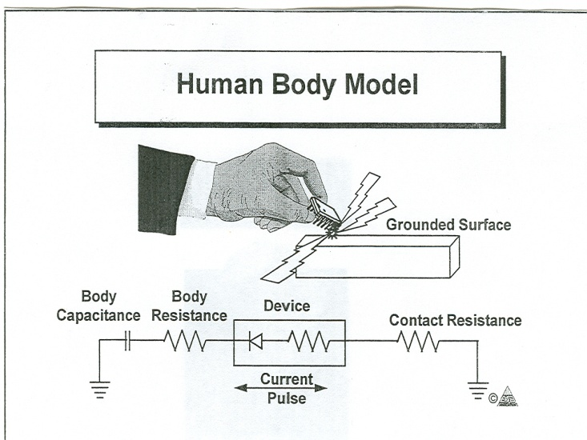
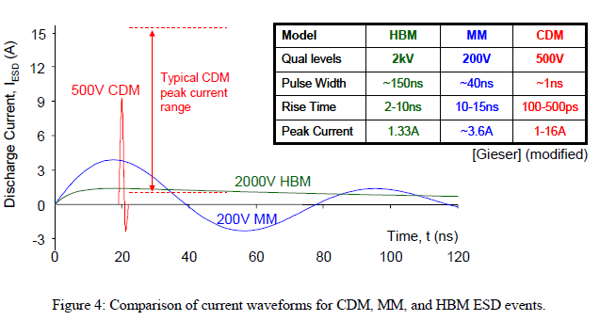
5.3 ESD SENSITIVITY LEVELS
5.3.1 ESD sensitivity of devices is determined using three different electrical models:
Human Body Levl (HBM): Simulates the discharge from the fingertip of an operator to an electronic component.
Table 5-1: HBM
Class | Voltage Range
0 | < 250 v
1A | 250 to <500 v
1B | 500 to <1000 v
1C | 1000 to <2000 v
2 | 2000 to <4000 v
3A | 4000 to <8000 v
3B | ≥8000 v
Charged person
b. Machine Model (MM): Originated in Japan as a worst-case HBM. It is a faster discharge model, designed to simulate ESD events in automatic handling and testing equipment.
Table 5-2: MM
Class | Voltage Range
M1 | < 100 v
M2 | 100 to < 200 v
M3 | 200 to < 400 v
M4 | ≥ 400 v
White Paper 2: A Case for Lowering Component Level CDM ESD Specifications and Requirements, Industry Council on ESD Target Levels, March 2009

Slide 10
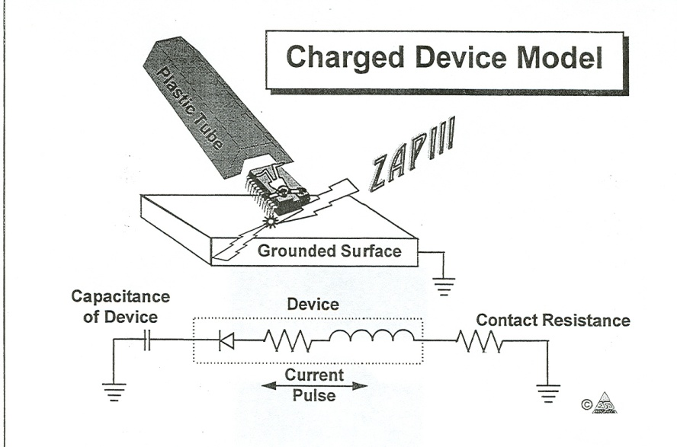
Charged Device Model (CDM): Model considers the situation where a device is charged and discharged to ground through one pin or connector. CDM sensitivity of a given device may be package dependent.
Table 5-3 CDM
Class | Voltage Range
C1 | < 125 v
C2 | 125 to < 250 v
C3 | 250 to < 500 v
C4 | 500 to < 1000 v
C5 | 1000 to < 1500 v
C6 | 1500 to < 2000 v
C7 | ≥ 2000 v
IC slides down plastic tube
Triboelectric charging
IC is now charged
5.5 DECLARING THE MODEL & CLASS REQUIRED
5.4.1: The applicable ESD model and Class level is specified in the engineering documentation.
5.4.2: The ESD program manager certifies the EPA based on the ESD model and Class level reported by the ESD program monitor.
5.4.3: The most sensitive device to be handled during processing dictates the minimum protection afforded by the EPA. The recommended default EPA certification level is HBM Class 1A.
5.4.4: Design maintenance, and certification of HBM Class 0 EPAs can be costly. Use of HBM Class 0 level should only be done as dictated by the sensitivity of the hardware being processed.

Slide 11
5.5 PERSONNEL SAFETY
5.5.1: Procedures and equipment described in this document may expose personnel to hazardous electrical conditions.
Users of this document are responsible for complying with applicable laws, regulatory codes, and both external and internal safety policy.
This document cannot replace or supersede any requirement for personnel safety.
5.6 ESD CONTROL PROGRAM MANAGER / COORDINATOR (Required by ANSI/ESD S20.20)
5.6.1: ESD Control Program Manager or Coordinator acts as the primary point of contact and is responsible for ESD plan implementation.
5.6.2: Program Manager duties are:
a. Issue and control the ESD Control Plan traceable to the requirements of ANSI/ESD S20.20.
b. Verify organization’s compliance with the published ESD control Plan.
c. Certify new ESD Protected Areas (EPAs).
d. Recertify expired or failed EPAs.
e. Maintain Records of EPA certification.
f. Periodically audit certified EPAs.
g. Maintain a record of audits performed.
h. Report results of certifications and audits to ESD Program Monitor/s.
i. Report results of certifications and audits to upper management.
This EPA is verified compliant to:
XYZ ESD Control Plan HBM Class 1A
Workstation ID: 1234
Certified by: R2D2
Date: July 4,2010
ESD Program Manager

Slide 12

5.7 ESD PROGRAM MONITOR
5.7.1: The organization responsible for an ESD Protected Area (EPA) shall designate an ESD Program Monitor (PM) for that area. Monitors may be responsible for more than one EPA.
5.7.2: ESD Program Monitor is responsible for:
ESD Protected Area (EPA) maintenance
ESD signage in the area.
Scheduled EPA verifications.
Random inspections and audits of EPAs.
Up-to-date verification records (logs) and maintenance records.
Reactivation of EPAs with less than six months of inactivity.
Transfer of records during project transitions.
Monitoring and maintenance of additional protective measures when needed to meet specialty certification requirements for handling highly sensitive devices.
Authorization to use EPAs (except Class 0 rated EPAs) for non-ESD sensitive work.
Verification and reactivation of EPA after it was used for non-ESD sensitive work.
Notifying ESD Program Manager of any deviations sought against the organization’s ESD Control Plan
ESD Program Monitor

Slide 13

5.8 ESD PROTECTED AREAS (EPA)
5.8.1: An EPA may be a single workstation, laboratory, room, or building, or any area with pre-defined boundaries, that is designed to limit damage to electrical hardware by electrostatic discharge events. EPAs may be permanent or temporary.
5.8.2: When an EPA is not maintained, the ESD Program Monitor decommissions it by marking the area as not approved for use.
5.8.3: An EPA not maintained for a period exceeding six months is considered “Abandoned.” Reactivation is accomplished via certification by the ESD Control Program Manager. The ESD Program Monitor is responsible for marking the status of abandoned workstations.
5.8.5: ESD Program Control Manager initially certifies all EPAs and recertifies them as needed. Prerequisites for EPA certification:
Personnel carry current certification.
A control program for verification records is instituted.
EPA environment measurements are up to date and meet Class level requirements.
ESD workstation measurements are up to date and meet Class level requirements.
5.8.6: Causes which require EPA recertification:
Rewiring of the area has occurred.
New work areas are added or moved.
New features are added (e.g., new conductive floor, upgrade to CMS, etc.)
An abandoned EPA is reactivated
An ESD failure is traced to the particular ESD protected workstation.
This ESD Protected Area is
OUT OF SERVICE
It is
NOT APPROVED FOR ESD WORK
Failed by: R2D2
Date: July 4,2010

Slide 14
5.8.8: Certification of an EPA is maintained via scheduled inspections performed by the assigned ESD Program Monitor.
EPA certification is voided if the scheduled verification is not performed for more than six (6) consecutive months or if any of the conditions in paragraph 5.8.6 have been encountered.
5.8.9: Calibration of verification equipment is essential to a properly executed EPA certification.
5.9 TEMPORARY, PROVISIONAL & INTERMITTENT- USE EPAs
5.9.1: Temporary EPAs are areas created for use while working on a specific project for a continuous period of < three (3) months (one month if Class 0).
5.9.2: Provisional EPAs are areas created for a one-time use only and where it is not practical to set up a temporary EPA.
5.9.4: Intermittent-use of EPAs is defined as the use of a permanent EPA for periods < one month at a time, with longer periods of idle time.
When not in use, intermittent-use EPAs are considered temporarily OUT-OF-SERVICE.
During idle periods, the ESD Program Monitor ensures that intermittent-use HBM Class 0 EPAs are not used for any other purpose and they are kept clean.
Caution: EPAs should not be rated for Class 0 use if this level of control is not required. Rating for Class 0 prevents use of the EPA for any other operations. Doing so invalidates the EPA’s Class 0 certification.

Slide 15
5.10 ESD CONTROL PROGRAM
5.10.1: An effective ANSI/ESD S20.20-traceable ESD Control implementation plan requires internal procedures to accomplish the following:
EPAs conform to limits described in Table-1 prior to use
Use of protective personnel clothing and proper personnel grounding.
All personnel handling ESDS items have received the necessary training.
Performance of audits and inspections to ensure the integrity of EPAs and equipment per Table 7-1
Inspection of documentation for ESD markings, precautions and handling procedures
Proper identification of ESDS items i.e. use of labels, stamps, etc.
Handling of ESDS items only at approved EPAs
Description of field operations and precautionary procedures to prevent ESD damage.
Maintenance of auditable records and documentation required in Table 7-1
Limit the use of materials within EPAs to those recognized by the ESDA as ESD-protective

Slide 16

5.11 AUDITS & INSPECTIONS
5.11.1 General: The ESD Program Monitor is responsible for the following activities related to records:
Maintain records regarding the ESD protected area at the site
Creating area test log (see Appendix B-2) and recording data related to deficiencies, corrective actions and related verification and validation
5.11.2 Audits: EPA certifications are achieved through audits performed by the ESD Program Manager or by an Audit Team or Audit Coordinator.
Certification is based on a yearly EPA audits.
ESD Program Monitor may perform a self-audit of an EPA and provide the data to the ESD Program Manager to meet requirements.
5.11.3 Inspections/Verifications:
Inspections are the responsibility of the EPA Program Monitors.
Inspections may be carried out any time the ESD Program Monitor deems them necessary.
As a minimum, it is recommended that inspections be done concurrently with the verification tests (Table 7-1).
5.11.4 New Projects: If a new Project takes over the EPA the ESD Lab Monitor is responsible for performing a re-verification of the EPA.

Slide 17
TRAINING
AND
CERTIFICATION PROGRAM
Chapter 6, page 26

Slide 18
6 TRAINING and CERTIFICATION PROGRAM
6.1 GENERAL
6.1.1 Training and certification is applicable to all personnel who perform or supervise any of the following ESD-related functions:
Design
Production
Inspection and test
Procurement (only if handling, purchasing or specifying ESDS materials)
Storage, shipping and receiving
6.1.3 ESD Control Plan will document the prerequisites for personnel certification and will identify the certifying authority.
6.1.4 The certifying authority acts as the guarantor that certified individuals will correctly implement the organization’s ESD Control Plan.
Certification is awarded by the operator’s, program monitor’s or trainer’s supervisor.
6.1.5 ESD training instructors are certified based on their competency as instructors and their knowledge of the ESD Control Plan they are teaching.
6.1.6 “Master” or “ Level A” instructors are certified by the assignee who has overall responsibility for the ORGANIZATION’S ESD Control program.
The Organization certifies the competency of its trainers, program monitors and operators

Slide 19
6.2 TRAINING PROGRAM
6.2.1 The local ESD Control plan requires the ORGANIZATION to define and document the following training requirements, rules, and procedures:
Procedures for training
Training levels
Lesson plan(s) / student manuals
Special topics and local rules beyond the scope of ANSI/ESD S20.20
Hours of instruction
Procedures for recording of training, recertification and methods of identifying/recalling trained personnel
6.2.2 Training shall include as a minimum:
ESD Control Program policies, procedures and practices
Principles of static electricity and methods of ESD control
Identification of ESD-sensitive (ESDS) items
Protective materials and equipment
Protective areas and workstations
Handling of ESDS items
Packaging, marking and shipping of ESDS items
Performance of ESD audits
Administration and record keeping
Class preparation, presentation and test administration
Demonstration of ability to teach a class
Lesson plan

Slide 20
6.2.3 Use of outside or generic commercially available ANSI/ESD S20.20 training programs will not meet the ESD control plan’s training requirements.
6.2.4 NASA Centers who are maintaining their own ANSI/ESD S20.20-traceable implementation plans also have associated ESD training programs. Civil servant personnel performing work in a NASA facility should contact their local ESD specialist about their local ESD Control implementation plan.
6.2.5 Organizations who choose to model their ESD Control Plan after this handbook may use training available at NMTTC Eastern Region.
6.3 CERTIFICATION OF TRAINING LEVELS
6.3.1 A four-level training program can be used to address training needs: Master or Level A instructors, Level B instructors, program monitors, and operators who work in ESD controlled areas.
6.3.2 Master / Level A Instructors have the authority to train:
Level B instructors
ESD program monitors
Operators
6.3.3 Level B instructors have the authority to train :
ESD program monitors
Operators /inspectors

Slide 21


6.3.4 ESD Program monitor: Directly responsible for compliance of ESD safe areas to the ESD Control Plan. Training includes:
Grounding and charge retention verification methods
Sources of electrical charge
EPA design
Compliant equipment, furniture, fixtures, tools and materials
Monitoring responsibilities and associated record-keeping
EPA certification process
6.3.5 Operator level: Technical personnel performing work on or with ESDS items, such as:
assembly
soldering
conformal coating
cleaning
inspections
testing
packaging
shipping
ESD Program Monitor

Slide 22

6.4 RECORD MAINTENANCE
6.4.1 Records retention requirements apply to training records.
A retention duration of 5 years minimum is recommended.
Federal Acquisition Regulations and/or other Project- level requirements may specify longer retention periods.
Training records include:
The applicable standard (ANSI/ESD S20.20) and ESD Control Plan.
Name of trainee
Name of organization which employs the trainee
Level of training completed
Date of completion of training
Name of instructor and organization providing the training
Traceability number of the completion record or training certificate
Test score
6.4.2 Evidence of successful completion of training is provided to students for submission to the personnel certifying authority. See Appendix C for training certificate example.
Training Records

Slide 23
6.5 MAINTENANCE OF TRAINING AND CERTIFICATION
6.5.1 Level B instructors, ESD program monitors and operators will require periodic retraining and recertification under the following conditions:
New ESD control techniques have been approved that require different skills.
Two (2) years have elapsed since last certification (biennial retraining schedule is recommended).
Job performance indicates inadequate understanding of ESD controls.
Evidence of successful completion of training is not available to the certifying authority.
6.5.2 Evidence of successful training is valid for the certification process regardless of the employee’s department within the larger organization.
Certification authorities are required to certify or recertify all personnel under their jurisdiction regardless of prior ESD certifications issued by other departments.

Slide 24
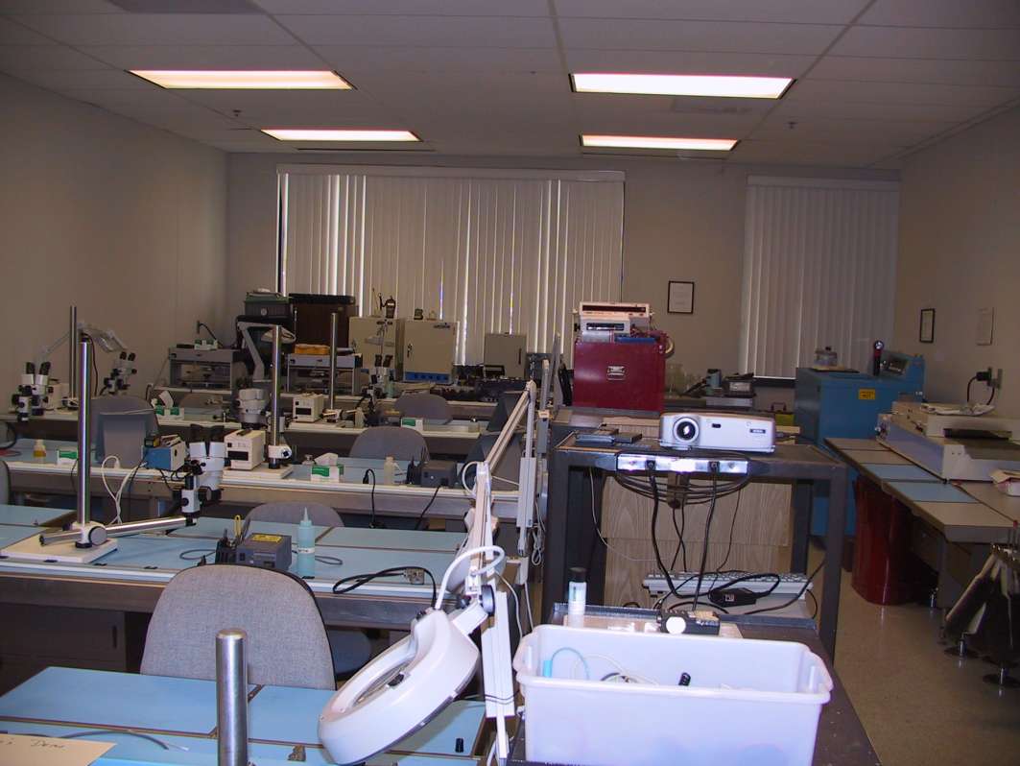
ESD CONTROL REQUIREMENTS FOR FACILITIES
Chapter 7, page 30

Slide 25
7 ESD CONTROL REQUIREMENTS FOR FACILITIES
7.1 General
7.1.1 Instructions and recommendations in this section include specific inspection methods used by ESD program monitors and ESD program managers in periodic verifications and certification audits.
7.1.2 Recommended default EPA certification level is HBM Class 1A. HBM Class 0 applies when handling parts sensitive to < 250 volts. Additional protective measures may be required when HBM Class 0 applies.
7.1.3 Where an ESD protection level applies that is more restrictive than HBM class 1A, signage is used to clearly mark and communicate to personnel the boundaries and class level of the EPA.
7.1.4 Measurements of Table 7-1 (page 31)
Operators at the EPA perform tests # 1,7,8,11 and 13.
Area ESD program monitor verifies test # 1, 2,3,4,6,8,9,10,11, and 12.
7.2 Compliance
The ESD program monitor is responsible for:
Identifying non-conformances
implementing corrective actions
ensuring that “unusable” areas and equipment are not used with ESDS items.
ESD program monitor

Slide 26
7.3 Traceability
ESD program monitor verification records, especially those related to table 7-1, are kept in the proximity of the associated EPA.
Records pass between program monitors if benches or spaces transfer between departments or projects.
7.4 Identification and Access-ESD Areas
prominently placed signs and a partition, rope guards, or similar barrier are used to prevent unauthorized and untrained personnel from entering the EPA
Escorts are required for access to the EPA by uncertified personnel
7.5 Temporary Use of ESD Benches for Non-ESDS Work
ESD program monitor is responsible for ensuring that non-ESDS work perform at EPAs does not cause ESD Control Plan non-conformance or lead to damage to ESDS items.
Recommendations:
Permission from the ESD program monitor before work is started.
ESD program monitor clearly marks area as “Non-ESD Protected Area” if used for non-ESDS work.
ESD program monitor verifies the EPA before ESDS items are handled in that area.
7.5.2 ESD workstations designated as Class 0 or higher sensitivity are never used for Non-ESD work. Recertification is necessary if any of these areas are used for non-allowed material handling.

Slide 27
7.6 Prohibited Materials and Activities
Smoking, eating and drinking in EPAs are not allowed.
Materials unessential to the work being done are not allowed.
Clipboards, books, notebooks, loose leaf sheets of paper. Etc., used to read or record data or follow instructions (including this manual), are kept at least 1 meter (3.3 feet) from ESDS items or placed in ESD-safe bags or notes. Materials verified to be safe in an ESD area are exempt from this requirement.
Floors or mats are kept free of dust, dirt and other contaminants.
7.6.2 A 1-meter minimum separation is recommended between the location where ESDS items are handled and “tacky mats” used at the entrance to clean rooms, CRT displays, and other equipment, which generate a static charge.
7.6.3 Place ESDS items on ESD protective surface and wrapping or covering then with static shielding material when they must be left unattended for short periods of time.

Slide 28

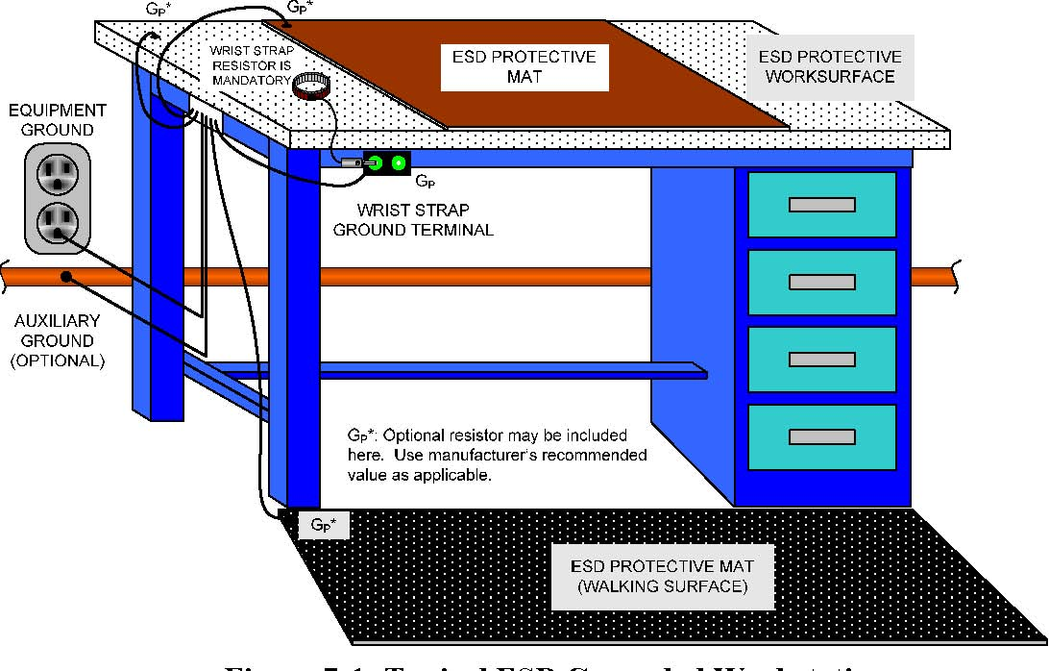
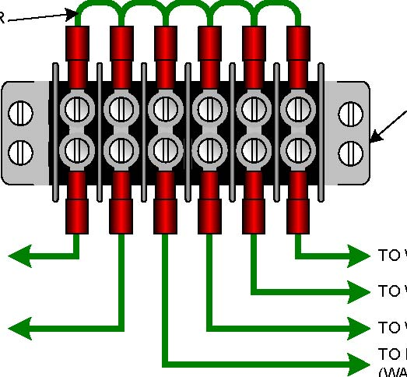

Figure 7-1 Typical ESD Grounded Workstation
jumper
Equipment ground
To wrist strap
To worksurface
To worksurface (table mat)
To ESD protective mat (walking surface)
Auxiliary ground

Slide 29
7.7 ESD PROTECTIVE WORK SURFACES
7.7.1 Recommended default for the conductivity for work surfaces in an EPA is static dissipative ( > 10⁵ to <10⁹ Ω for surface resistance).
Some work in EPAs requires conductive surface (< 10⁵ Ω – e.g., optical benches).
7.7.2 ESD – safe surfaces shall be electrically connected to Common Point Ground (CPG).
7.7.3 When conductive surfaces are used, a one megohm (1 MΩ) optional resistor may be needed to provide a soft ground between the work surface and the common point ground.

Slide 30
7.7.4 Extreme Care when using conductive work surface
To eliminate the safety hazard associated with a high current event, work surfaces must be either soft grounded (> 800 kΩ) or in series with a Ground Fault Circuit Interrupt (GFCI).
7.7.5 Selection of the protective work surface will ensure that:
It does not release particle contaminants.
It will resist attack by common solvents or cleaners (see Section 7.15.1).
Sufficiently large to accommodate the resting of common hand tools.
7.7.6 Soft grounding of dissipative work surfaces shall measure <10⁹ Ω
7.8 ESD PROTECTIVE FLOOR SURFACES
7.8.1 Conductive or dissipative floors and/or grounded conductive / dissipative floor mats are used in EPAs where personnel are not wearing wrist straps. The use of leg straps, heel straps or conductive shoes are required. Conductive/dissipative flooring combined with ESD chairs are strongly recommended in HBM Class 0 EPAs.
7.8.2 ESD flooring is not effective if it is not grounded.
7.8.3 After each cleaning, floor resistance is verified per para. 7.8.2. Vacuuming or dry sweeping the floor does not require a subsequent check.
7.8.4 Use of conductive waxes requires compliance with manufacturing recommendations. Floor resistance is always verified and results recorded.
7.8.5 Conductive wax on non-conductive floor is not considered an effective method of ESD control.

Slide 31
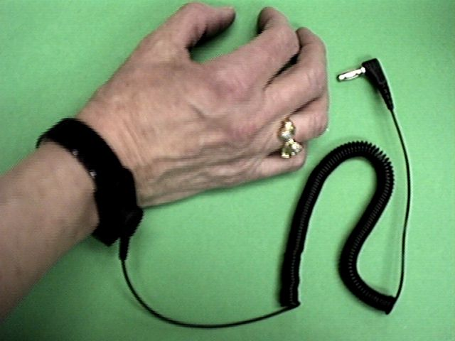
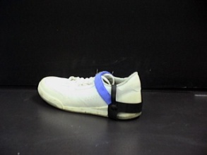

7.9 PERSONAL GROUNDING DEVICES
7.9.1 As a minimum it is recommended that the ESD control plan requires all personnel working with ESDS items are issued and use Personnel Grounding Devices.
It is strongly recommended that all personnel coming within 1 meter (3.3 feet) of any ESDS item be required to wear a personal grounding device.
7.7.2 Wrist Strap: Preferred means for ESD protection
a. Lead: Only the lead supplied with the wrist strap should be used, as it may contain the safety resistor
b. Cuff metallic cuffs preferred over plastic or fabric cuffs Bead type chains are normally prohibited Breakaway force between 1 and 5 pounds
c. Safety resistor: Current limiting safety resistor (1 megohm ± 20%)
d. Ground termination: Must ensure a positive and durable connection between lead and CPG
7.9.3 Foot Grounding: Leg, toe or heel straps, or conductive shoes worn in conjunction with a conductive floor and/or floor mats are acceptable alternatives to wrist straps.
ESD program monitor is responsible for setting up a footwear checker and log.

Slide 32
7.10 INTEGRITY TESTING OF PERSONAL GROUNDING DEVICES
7.10.1 The integrity of the connection between operator, personal grounding devices, and ground connection is CRITICAL to proper ESD protection.
Periodic, scheduled verification of personal grounding device performance will identify non-compliant units.
Typically, damaged or worn units are not repairable and must be replaced.
7.10.2 Wrist straps are either continuously monitored (CMS) or checked each time the wearer enters the EPA.
7.10.3 Foot grounding devices are checked and logged each time the wearer enters the EPA. Worn on both feet and checked one foot at a time.
7.10.4 Workstation Real Time Continuous Monitoring Devices are checked to ensure functionality just before handling ESDS items.
7.10.5 If one of the checks in par 7.10.2 through 7.10.4 fails, corrective action is taken before work is performed and a subsequent re-check is used before work resumes.
7.10.6 If it is found that an ESDS item was handled in an EPA with faulty ESD protection that item will carry a risk lien that must be retired by the affected Project.
Failure of the ESD protection is recorded by the ESD program monitor.

Slide 33

7.11 EQUIPMENT AND FACILITIES
7.11.1 Facilities Grounding: Preferred practice is to use the third wire AC line grounding for grounding all items at the EPA.
When a separate grounding line is present or used in addition to equipment ground, it should be electrically BONDED to the equipment ground at each ESD protected work station to MINIMIZE the difference in voltage potential.
7.11.2 Stool, chairs and Carts
ESD program monitor is responsible for certification and proper use in EPAs.
Certification: Table 7-1, page 31 cites the recommended verification levels and intervals.
Grounding: For handling Class 0 sensitive items a positive electrical contact between CPG and chair or stool is recommended. Contact may be through an ESD floor or floor mat.
7.11.3 Mobile Equipment Carts:
Where arts, wagons, trams, or other mobile equipment are used, they are required to be grounded while in use in EPA.
When other tabletop equipment such as microscopes or lead bending equipment is used within an EPA, it should be ESD grounded.

Slide 34
7.11.4 Humidity
RH target range for EPAs is 30% to 70% when monitored near ESDS items. For Class 0, RH is 40% to 70%.
At levels below 30% require the use of additional precautions such as turning on a humidifier or an air ionizer. If additional precautionary methods are not available it is recommended that work is halted until the required humidity level is obtained.
Check RH level in each EPA at the start of the workday and logged. Data loggers with an integral alarm system are suitable substitutes for the daily check.
Maximum RH depends on the equipment and device under test to be protected as condensation due to temperature variations can cause corrosion, short circuits or moisture contamination.
7.11.5 Air Ionizers
Air ionization is a technique used to neutralize charges on insulators and ungrounded conductors. Ionizers are necessary when handling Class 0 sensitive parts or RH < 30%.
Consult ionizer’s manufacturer’s documentation for operating instructions.
Ionizers require routine maintenance and testing per manufacturer’s recommendations.
Presence of ionized air creates an increased risk for corona discharge in the presence of “powered-up” high-voltage or RF sensitive equipment. Use of ionizers is not recommended in those environments. Keep flammable materials away from air ionizers.

Slide 35
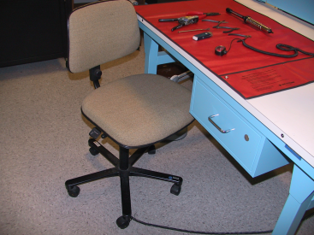
7.12 HAND TOOLS, EQUIPMENT, AND FIXTURES
7.12.1 ESD program monitor is responsible for approving the use of all tools in the EPA.
7.12.2 Tools designed for ESD areas, such as static dissipative cushioned tools or un- insulated metal hand tools such as pliers, cutters, tweezers and wire strippers, are preferred in EPAs.
7.12.3 Hand tools should be kept on grounded work surface when not in use.
7.12.4 Recommend only antistatic solder extractors made of metal, or having a metalized plastic barrel and tip in EPAs.
7.12.5 Recommended criteria for electrical tools used in EPAs:
Employ a three-wire grounded power cord
Static dissipative handle grips
Tool’s contact point (e.g., soldering iron tip) which touches the work piece has a resistance < 20 Ω and potential difference ≤ 2 millivolts RMS.
Motor driven tools are not recommended for use near ESDS items due to inductive charging in the ESDS devices.
7.12.6 Digital Multimeters (DMMs) may introduce voltage spikes when changing scales and/or have high voltages when measuring resistance. Ensure that the measuring equipment is compatible with the hardware being measured.
7.12.8 Properly discharged (ground) measuring equipment, breakout boxes, harnesses, etc., before making connection to flight hardware.

Slide 36
7.13 PROTECTIVE PACKAGING
7.13.1 Electrostatic protective packaging must prevent charge generation (triboelectric) and protect from external electrostatic field. Static dissipative materials used in packaging are considered to provide both properties.
7.13.2 Protective bags and packaging are considered ESD protective based on the following application methods:
Materials used in protective bags and pouches shall satisfy the resistance requirements to avoid triboelectric charge buildup.
Bags and pouches for electrostatic shielding are constructed from a single folded piece of material. Two-piece construction is not considered ESD-safe.
Materials in contact with the protected hardware shall have a dissipative surface.
Neither static dissipative impregnated nor topically treated plastics provide electrostatic shielding. Both types need to be enclosed in an outer container which will provide shielding to the contents during shipping.
7.13.3 Compliant shipping packaging for all integrated circuits used by NASA is non-metallic conductive or static dissipative magazines, chutes and dip tubes.
7.13.4 ESD-safe tote boxes shall be made of conductive or static dissipative material.

Slide 37
7.14 TEMPERATURE CHAMBERS AND COOLING AGENTS
7.14.1 ESD program monitors are responsible for taking appropriate precautions when gas flow is utilized in the area of ESDS items.
Particles in the gas can be a significant generator of electrostatic charges.
7.14.2 To ensure the safety of ESDS items in cold chambers, conductive baffles and shelves within the chamber must be grounded.
7.14.3 ESD program monitors are responsible for taking appropriate ESD precautions when pressurized cryogenic cooling agents are used for localized cooling, such as in troubleshooting.
7.14.4 The stability of ESD-protective materials used in temperature chambers must be suitable for the test temperature and humidity ranges present in those chambers.
7.14.5 Resistance checks should be sufficient for normal test chamber environments.
For extremely sensitive parts, the use of electrostatic survey meters may be required.
Survey meters can provide information on stray fields harmful to the hardware being tested.

Slide 38
7.15 CLEANING AND CLEANING AGENTS
7.15.1 Cleaning agents and methods used on ESD-protective items (e.g., work surfaces and floor coverings) should be selected and applied so that they do not reduce the effectiveness of these items, cause leaching, or leave insulating residues.
7.15.2 Cleaning agents used directly on ESDS items should be selected for low dielectric charging propensity and must be approved for use in flight hardware.
7.15.3 Only natural bristle or static dissipative brush materials are considered safe for use on ESDS items.
7.16 ELECTROSTATIC SURVEY METER, VOLTMETERS, AND MONITORS
7.16.1 Electrostatic survey meters are used to detect the presence of electrostatic charges. The types which read the electrostatic charge on a surface area without requiring contact should be used in NASA EPAs.
7.16.2 Use of electrostatic monitors designed to actuate an alarm when an electrostatic field reaches a preset level is recommended in an EPA handling ultra sensitive hardware.
Note: These systems require careful calibration to avoid excessive false alarms which can result in reduced staff vigilance.
7.16.3 Wrist strap testers and recording logs must be made available in all areas where ESDS items are handled, unless the EPA exclusively uses a CMS.

Slide 39
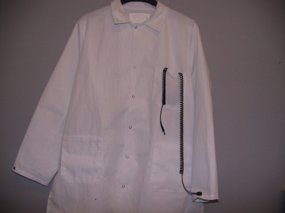
7.17 CLOTHING REQUIREMENTS
7.17.1 Static dissipative outer garments (smocks) must be worn at all times when in EPAs. Smock will cover all personal garments above the neck area and make intimate contact with the skin. Smock must be fully sipped/buttoned all the time they are worn.
7.17.2 Garments properly checked after laundering. Use approved cleaning facility for ESD garments.
7.17.3 When handling Class 0 sensitive parts (HBM / < 250 V), the smock must be connected to CPG or wrist strap.
7.17.4 When cuff-to-cuff resistance of the garment is < 3.5 x 10⁷ Ω, the garment can be grounded using a single wire wrist strap cord.
7.17.5 For less sensitive areas (Class 1A and above), smocks may be used over cotton shirts or short-sleeved shirts w/o the extra connection.
This configuration permits slow static charge dissipation acquired by the garment ( wrist straps shall be worn).
7.17.6 ESD program monitors are responsible for ensuring that finger cots and gloves, when worn in an EPA, are made of static dissipative materials.

Slide 40

ORBIT REPLACEABLE UNITS (ORU) REQUIREMENTS
ESD – Safe Handling of ORUs
Go to page 42 and 43 and review at your leisure

Slide 41
ESDS ITEM HANDLING
Chapter 8
Page 44

Slide 42
8.1 GENERAL
8.1.1 ESDS items must be handled ONLY in EPAs. Outside of EPAs, ESDS items must be completely enclosed inside ESD-protective packaging in a ESD protective container (tote or box).
8.1.2 Paperwork accompanying an ESD item (e.g., QA records, routings, and instructions) must be in static dissipative bags or envelopes.
Paperwork must never come in physical contact with ESDS items.
Materials verified to be safe in an EPA are exempt from this requirement.
8.1.3 Shunts such as bars, clips, or conductive coverings, are used to protect ESDS item when it is not being tested or worked on (at equal potential).
Process-essential insulators (e.g., Kapton tape) must be neutralized with an ionizer before they are moved within 12 inches of ESDS items.
8.1.4 All containers, tools, test equipment, and fixtures used in EPAs must be grounded before and during use.
Before connecting or disconnecting test cables, a common soft ground between an ESDS item and any test equipment is to be established.
8.1.5 While in the vicinity of ESDS items, personnel handling ESDS items must avoid physical activities that produce static charges (e.g., wiping feet, or adding or removing items of clothing – triboelectric charging).

Slide 43
8.2 SPECIAL REQUIREMENTS FOR HIGHLY SENSITIVE ITEMS
8.2.1 Table 8-1 summarizes recommendations made throughout this document which are particular to HBM Class 0 (< 250 volts) and MM Class M1 (< 100 volts) only.
Topic | Recommendation
Chairs & tools | Ground & periodically verify as ESD protective See Table 7-1 for intervals
Conductive or dissipative floors or floor mats | Use them in area in front of the EPA or in the designated EPA floor space.
Relative humidity | Kept > 40%, monitor & record just before work starts. Additional precautions must be used to operate < 40%.
Ionizers | Keep them in place & working properly See Table 7-2. It is recommended a survey meter be used to check area before work starts.
Smocks | Must be discharged to CPG or through a wrist strap. The CMS, if used, must not interfere with grounding of the smock or vice versa.
Mating and De-mating cables and harnesses | Must be discharged to ground through an approved method prior to mating and de-mating to ESD sensitive assemblies.
Soldering irons | Check for proper ESD operation before start of operation.
Signage | Display them, describing the Class sensitivity level for the area.
Table 8-1
For higher sensitivity levels, for devices sensitive to CDM events, or for other special cases, the Project engineers should partner with the ESD Program Manager to determine suitable ESD Control Program requirements.

Slide 44

8.2.2 When assembling parts sensitive to high current/very low pulse time events, the measures prescribed for HBM and MM models do not provide sufficient component protection.
This section provides guidance for handling components sensitive to breakdown voltages as low as 2 volts and energies as low as 0.3μJ.
(Review this section, par 8.2.2, at your leisure)
8.3 RECEIVING, INTERNAL HANDLING, AND SHIPPING
8.3.1 Incoming inspection includes examining all ESDS items for proper ESDS precautionary marking and ESD-protective packaging.
Inadequate precautionary markings must be corrected and handling history investigated prior to further processing.
8.3.2 When an item is received that has not been protected during shipment or internal transfer, it should be:
Rejected as defective
Processed as non-conforming material
Package should be labeled as FAILED ESDS material and the incident reported
8.3.3 When a kit is assembled that includes ESDS items, the entire kit and accompanying documentation must be packaged and marked as ESDS.
8.3.4 ESDS items packaged for shipping must be packaged and marked per contract and per special instructions defined in these ESD implementation plan.

Slide 45
8.4 EQUIPMENT LEVEL TEST, MAINTENANCE, AND INSTALLATION
8.4.1 The following practices apply within a facility and in the field when equipment being serviced contains ESDS items.
Personnel must be properly grounded.
Protective packaging of a replacement ESDS item is to be grounded to the equipment to dissipate any static charge before the package is opened.
As ESDS item is installed, contact with parts, electrical terminals, and circuitry is to be kept to a minimum.
Failed ESDS items are placed in protective packaging to facilitate root cause analysis.
Probing ESDS items with test leads is to be conducted only in certified EPA.
8.4.2 ESD-protective covering or protective caps on external terminals, interconnecting cables, and connector assemblies are never removed until it is necessary to permit the installation.
8.4.3 Cable connector pins and cable shield (connector outer shell) must be grounded prior to engaging a de-energized connector and cable with a mating receptacle which is connected to an ESDS item. Soft grounding (addition of a resistor) is used to avoid rapid discharge.

Slide 46



8.5 IDENTIFICATION AND MARKING
8.5.1 ESDS items, equipment, and assemblies must be identified in order to warn personnel before any potentially ESD-damaging procedure can be performed.
Note:
If the class sensitivity level is not specified within the symbol, or is other than Classes 0, M1, or C1, it defaults to HBM Class 1A.
Sensitivity with class level HBM -1B
Sensitivity without class level
ESD Common Point Ground (CPG) indicates the location of an acceptable CPG

Slide 47



ESD Protective Item Symbol
arc
This ESD Symbol identifies items that are designed to provide ESD protection for ESD assemblies and devices
ESD Protective Item Symbol
ESD bag with arc
Smock with arc

Slide 48
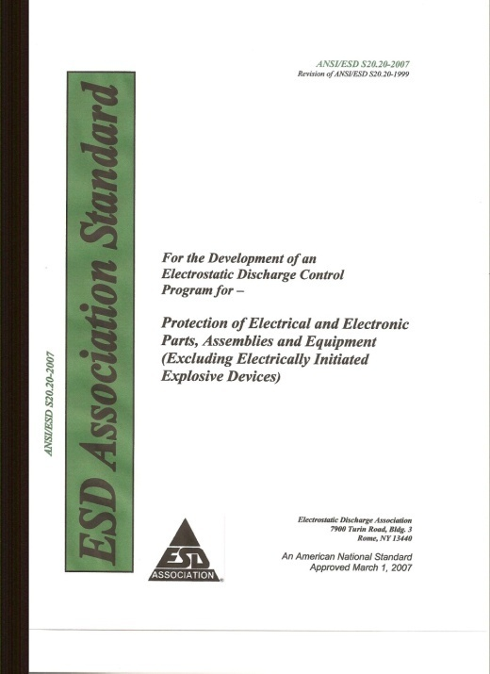
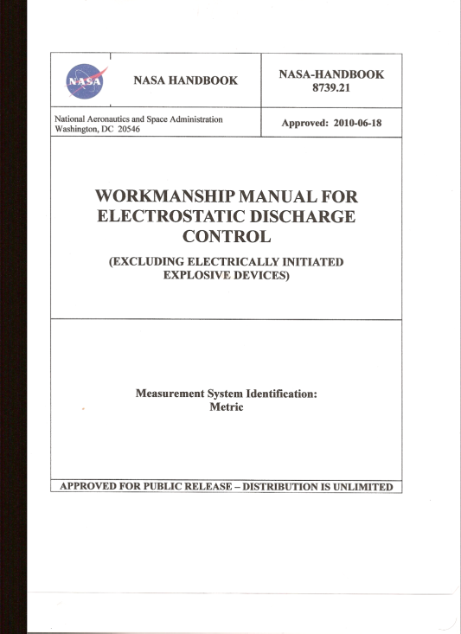
Summarizing
ANSI/ESD S20.20 is the primary document in developing your organization’s ESD Control Plan.
NASA-HDBK 8739.21 is a generic plan and may be used to develop the ESD control plan.
Organization’s ESD Control Plan
ANSI/ESD S20.20
NASA-HDBK 8739.21

Slide 49
THE END
The next presentation is NASA-HDBK 8739.21 Appendix B Hands-on Exercises

