Slide 1
Packaging Concerns/Techniques for Large Devices
National Aeronautics and Space Administration
Seminar Topic
Presentation Military and Aerospace Programmable Logic Devices (MAPLD)
NASA Goddard Space Flight Center
August 31, 2009
Kenneth A. LaBel
Co-Manager NASA Electronic Parts and Packaging Program (NEPP)
301-286-9936 kenneth.a.label@nasa.gov
Michael J. Sampson,
Co-Manager, NASA Electronic Parts and Packaging Program (NEPP)
301-614-6233 michael.j.sampson@nasa.gov
www.nasa.gov

Slide 2
FPGAs- A Sampling of Challenges
Can we “qualify” without breaking the bank?
New Connectors
-higher-speed, lower noise
-serial/parallel
New Silicon
-90nm CMOS
-new materials
New Board Material
-thermal coefficients
-material interfaces
New Architectures
-new interconnects
-new power distribution
-new frequencies
New Workmanship
-inspection, lead free
-stacking, double-sided
-signal integrity
New Design Flows/Tools
-programming algorithms, application
-design rules, tools, simulation, layout
-hard/soft IP instantiation
New Package
-Inspection
-Lead free
Where we were ©2006

Slide 3
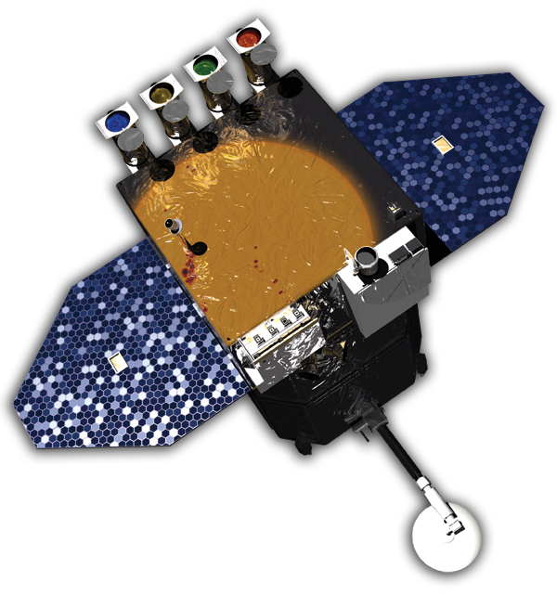
Overview
Solar Dynamics Observatory (SDO). Awaiting Launch
Packaging Challenges
Packaging Options
Components of All Packages
Commercial, Non-hermetic Packages
Space Challenges to Packages
A Non-hermetic, Complex Package for Space
Hermeticity, Why Space Users Like It
Non-hermetic, Complex Package Variations
Class X
Summary

Slide 4
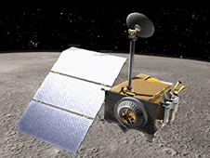
Packaging Challenges
I/O s, increasing number, decreasing pitch
Heat Dissipation, especially in space
Manufacturability
Materials
Mechanical
Installation
Testability
Inspectability
Space Environment
RoHS (Pb-free)
Lunar Reconnaissance Orbiter (LRO), Built at GSFC, Launched with LCROSS, June 18,2009

Slide 5
Package Options – Hermetic?
Driven by consumer products
  Low cost
  High volume
  Rapid turnover
  “Green”
  Minimized size
Once, hermetic options existed for most package types
  Now, few hermetic options for latest package technologies
  Development of new hermetic options unattractive
    Very high NRE
    Very high technical difficulty
    Very low volume
    Demanding customers

Slide 6
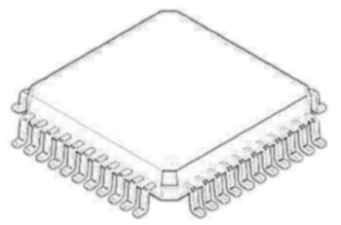
The “General” Package
Typically, packages consist of the same basic features but achieve them in many ways:
  Functional elements - active die, passives etc.
  Interconnects between elements (2 or more elements)
  A substrate
  Interconnects to the external I/O of the package
  A protective package
  Interconnects to the next higher level of assembly

Slide 7

Commercial, Non-hermetic Package (PBGA)
Substrate
Multi-layer
Encapsulation
Flip Chip Die Bump
Capacitor, Resistor etc.
Die
Pb-free Ball
Underfill
Design Drivers:
High I/O count
Large die
Environmental protection
Performance/Speed
Ancillary parts
Commercial Drivers:
Low cost
High volume
Limited life
Automated installation
Compact

Slide 8
Space Challenges for Complex
Non-hermetic Packages
Vacuum:
  Outgassing, offgassing, property deterioration
Foreign Object Debris (FOD)
  From the package threat to the system, or a threat to the package
Shock and vibration
  During launch, deployments and operation
Thermal cycling
  Usually small range; high number of cycles in Low Earth Orbit (LEO)
Thermal management
  Only conduction and radiation transfer heat
Thousands of interconnects
  Opportunities for opens, intermittent - possibly latent
Low volume assembly
  Limited automation, lots of rework
Long life
  Costs for space are high, make the most of the investment
Novel hardware
  Lots of “one offs”
Rigorous test and inspection
  To try to find the latent threats to reliability
ONE STRIKE AND YOU’RE OUT!

Slide 9
Non-hermetic Package, With”Space” Features
(CCGA?)
Substrate and Sn/Pb Column Grid Array
Flip Chip Die Bump
Cover
Die
“Enclosed” Package Option
Capacitor, Resistor etc.
Underfill
Space Challenge | Some Defenses
Vacuum | Low out/off-gassing materials. Ceramics vs polymers.
Shock and vibration | Compliant / robust interconnects - wire bonds, solder balls, columns, conductive polymer
Thermal cycling | Compliant/robust interconnects, matched thermal expansion coefficients
Thermal management | Heat spreader in the lid and/or substrate, thermally conductive materials
Thousands of interconnects | Process control, planarity, solderability, substrate design
Low volume assembly | Remains a challenge
Long life | Good design, materials, parts and process control
Novel hardware | Test, test, test
Rigorous test and inspection | Testability and inspectability will always be challenges

Slide 10
Hermeticity
NASA prefers hermetic packages for critical applications
Hermeticity is measureable, assuring package integrity
Only 3 tests provide assurance for hermetic package integrity:
  Hermeticity – nothing bad can get in
  Residual or Internal gas analysis – nothing bad is inside
  Particle Impact Noise Detection – no FOD inside
Non-hermetic package integrity IS hard to assess - no 3 basic tests

Slide 11
Non-hermetic Package Variations
Current and future package options mix and match elements in almost infinite combinations
Elements include:
  Wire bonds
  Ball interconnects
  Solder joints
  Conductive epoxies
  Vias
  Multi-layer substrates
  Multiple chips, active and passive (hybrid?)
  Stacking of components
  Embedded actives and passives
  Polymers
  Ceramics
  Enclosures/encapsulants
  Thermal control features

Slide 12

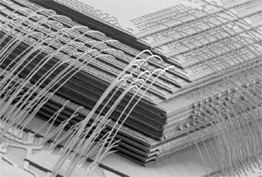
Some Large Device Package Options
Embedded Capacitor
AMKOR

Slide 13
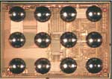
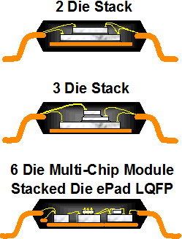
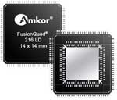
Some Large Device Package Options
From Amkor’s Website http://www.amkor.com/go/packaging

Slide 14

Why MIL Spec. for Space ?
Space users like MIL spec. parts because:
  There are technical “rules” that apply equally to all suppliers
  Qualification to recognized requirements
  Visibility of change control
  Required tests and inspections reduce or eliminate the need for the space user to do post-procurement tests
  Transparent government process for reacting to performance issues
  Space level participation provides an opportunity to do continuous improvement of the MIL supply chain for Class S (space grade) microelectronics
  Our experience says They Work

Slide 15
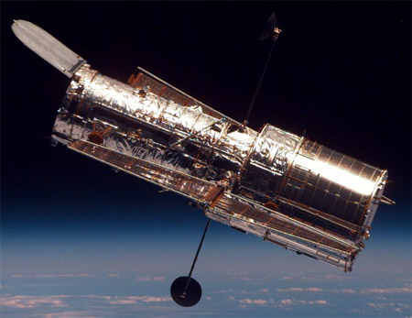
Class X
Proposed new class for MIL-PRF-38535
Class X will be for Space level non-hermetic
Class V will be defined as hermetic only
Addition to Appendix B, “Space Application”
Package-specific “package integrity” test requirements proposed by manufacturer, approved by DSCC and government space
The Package Integrity Test Plan must address:
  Potential materials degradation
  Interconnect reliability
  Thermal management
  Resistance to processing stresses
  Thermo-mechanical stresses

Slide 16
Summary
NASA is going to have to accept the use of non-hermetic packages for complex devices
There are a large number of packaging options available
Space application subjects the packages to stresses that they were probably not designed for (vacuum for instance)
NASA has to find a way of having assurance in the integrity of the packages
There are manufacturers interested in qualifying non-hermetic packages to MIL-PRF-38535 Class V
Government space users are agreed that Class V should be for hermetic packages only
NASA is working on a new Class for non-hermetic packages for M38535 Appendix B, “Class X”
Testing for package integrity will be required but can be package specific as described by a Package Integrity Test Plan
The plan is developed by the manufacturer and approved by DSCC and government space

Slide 17
SignOffPage
http://nepp.nasa.gov
Notes:
NASA Presentation Sign-Off Page

