Slide 1
Application of SpaceCube in a Space Flight System
Dave Petrick
NASA/GSFC
Code 587
9/1/2009
Note: This is the HANDOUT version of this presentation

Slide 2
SpaceCube Development Team
Mike Lin
Walt Bradley
Dave Petrick
Gordon Seagrave
John Godfrey
Beverly Settles
Tracy Price
Gary Crum
Robin Ripley
Dan Espinosa
Alessandro Geist
Dorian Seagrave
Wayne Greenwood
Frank Cepollina
Tom Flatley
Giri Nadendla
Madhu Kadari
Bo Naasz
Will Clement
Steve Queen
John Vaneepoel
Dwaine Molock
Jane Marquart
Dan Grogan
Clara Hollenhorst
Terecita Mayorga
Varsha Patel
Krystal Kennedy
Miles Newman
Jack Lorenz
Quang Nguyen
Matt Owens
Pietro Sparacino
Darryl Younger
Richard Hicks
Ed Hicks
Steve Judy
GSFC Radiation Group
GSFC Parts Group
Orbital Sciences
Northrup Grumman
Jackson and Tull
Advanced Optical Systems
SEAKR
CRI

Slide 3
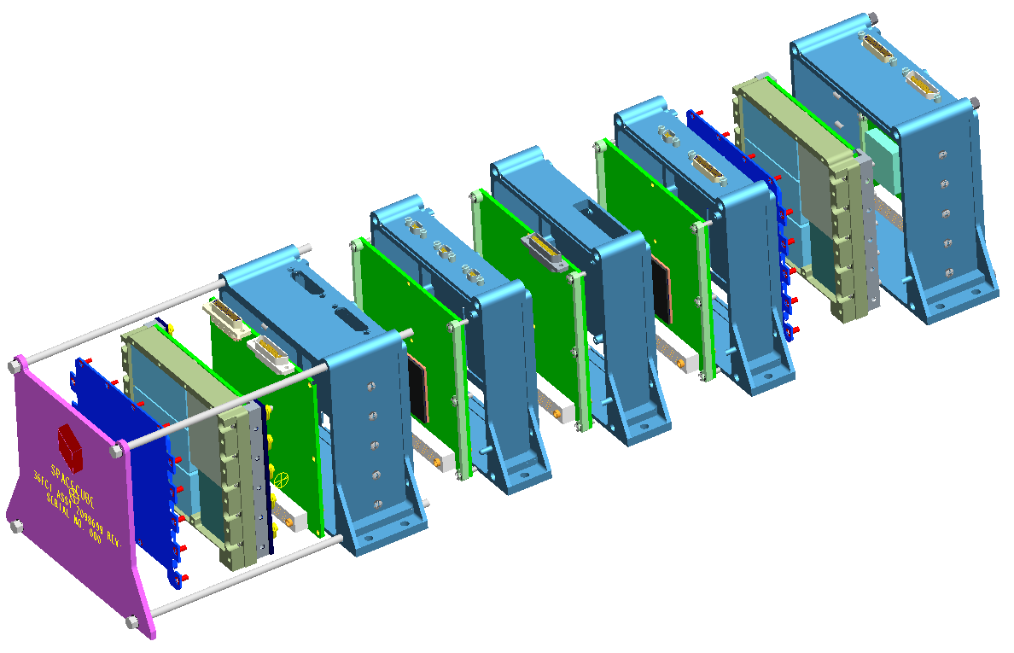
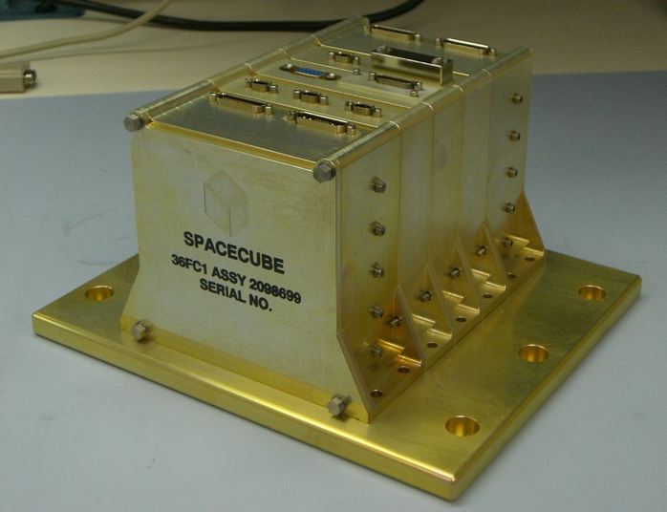
GSFC SpaceCube
Small, light-weight, reconfigurable multi-processor platform for space flight applications demanding extreme processing capabilities
Based on Xilinx Virtex 4 FX60 FPGAs, 2 per processor card
Stackable architecture
Flight Box
Mechanical: 7.5-lbs, 5”x5”x7”
Power: 37W (HST Application)
Notes:
card. Stackable → make custom cards → VIM

Slide 4
SpaceCube Processor Card
General: 4”x4” card, Back-to-Back FPGAs (x2), 7W typical power
Memory: 1GB SDRAM, 1GB Flash, 16KB SRAM, 16KB PROM
Interfaces: 20 bi-dir differential signals, JTAG
Backplane: Power, 42 single-ended, 8 LVDM, 2 I2C, POR
SDRAM
Diff RX
SDRAM
Diff RX
256MB SDRAM
QuadRX
512MB
FLASH
QuadTX
LVDM
Xilinx
V4FX60
Aeroflex UT6325
LVDM
Xilinx
V4FX60
Aeroflex UT6325
QuadTX
Stacking Connector (122 pin)
LVDM
QuadRX
LVDM
SDRAM
Diff RX
16K
PROM
16KB
SRAM
Diff RX
256MB
SDRAM
QuadRX
QuadTX

Slide 5
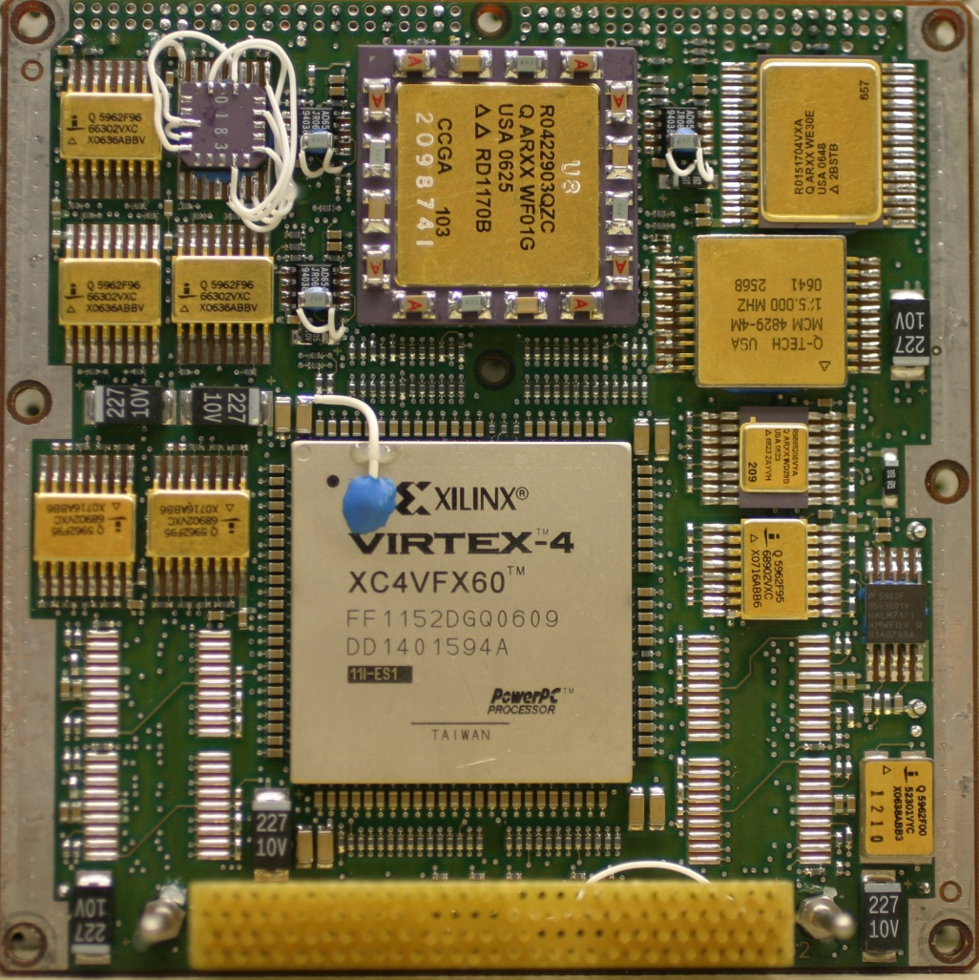
SpaceCube Processor Card
Top Side
Bottom Side

Slide 6
Hubble Servicing Mission 4 (STS-125)
Relative Navigation Sensors (RNS) – HST Payload
Record images of HST during docking and release, in particular the Soft Capture Mechanism
Perform on-orbit position and attitude estimation (Pose)
RNS SpaceCube: Main Avionics Box
Controlled 3 cameras, GPS, 960GB memory, telemetry module, shuttle Ku downlink
Hosted Linux, VxWorks, C&DH, Automatic Gain and Integration Control, 2 pose image processing algorithms, TMR’d self-configuration scrubber using ICAP
Recorded GPS/AGC/POSE flight logs to flash
Consisted of 2 processors, 2 low-voltage power cards, 2 digital control cards, 1 JPEG2000 compression card

Slide 7
Relative Navigation Sensors
RNS originated from HST robotic service mission
RNS Hardware
3 1024x1024 cameras
GPS Navigator
SpaceCube
Telemetry Module
Recorder (8 120GB hard drives)
Power Module
Ground Terminal
RNS operations conducted from JSC Space Shuttle Mission Control Center, Houston TX
FPGAs
3
4
11
4
2
0
4
Xilinx | 11
Actel | 11
Aeroflex | 6
TOTAL: 28

Slide 8
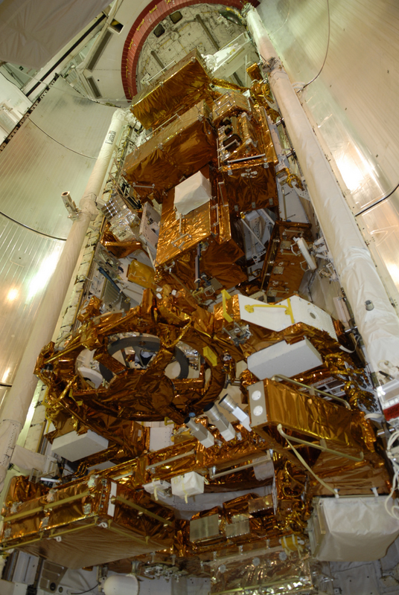
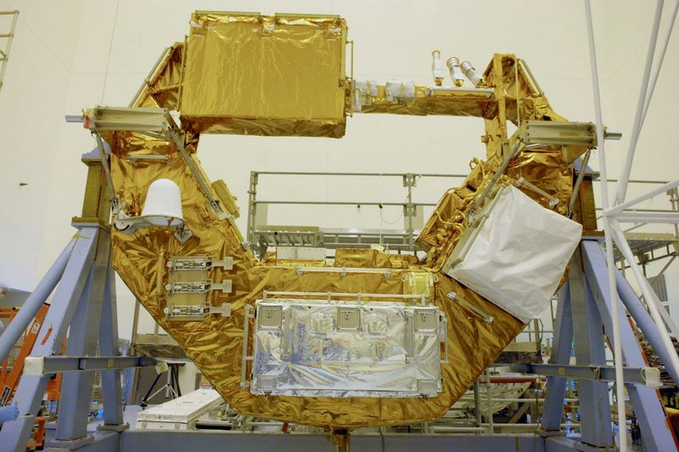
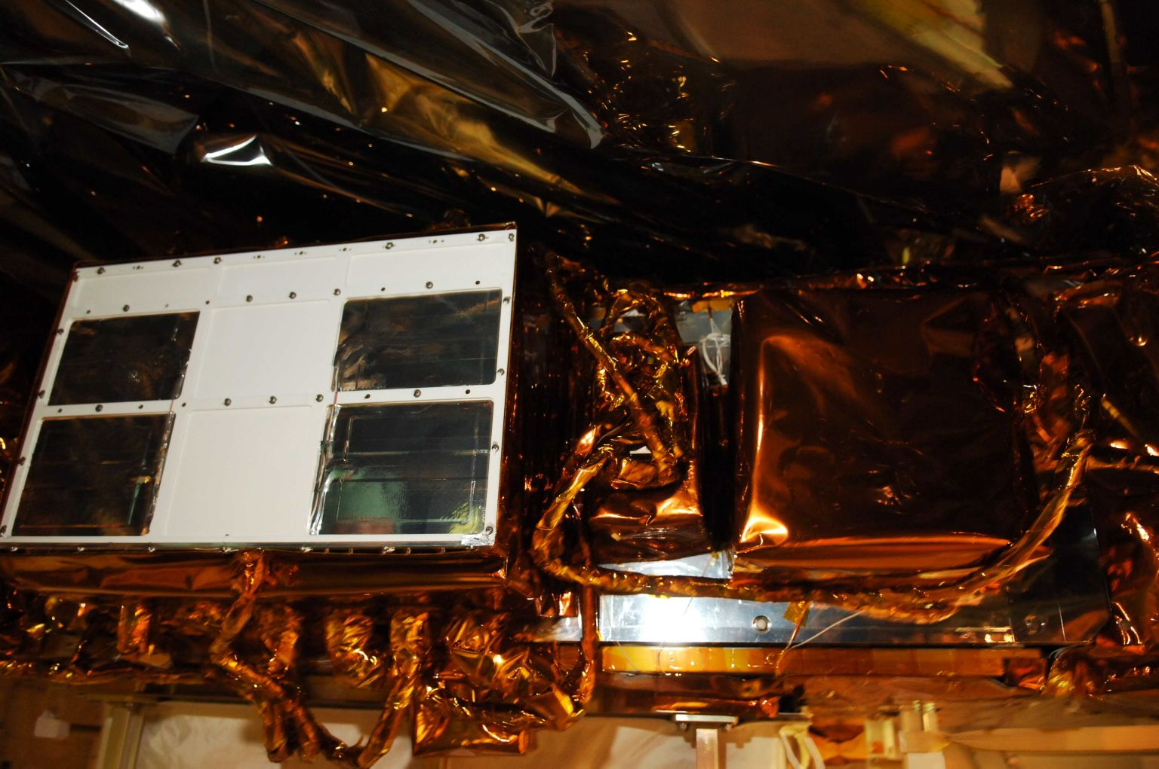
RNS Hardware
MULE Carrier
RNS Avionics Panel
STS-125 Payload Bay

Slide 9
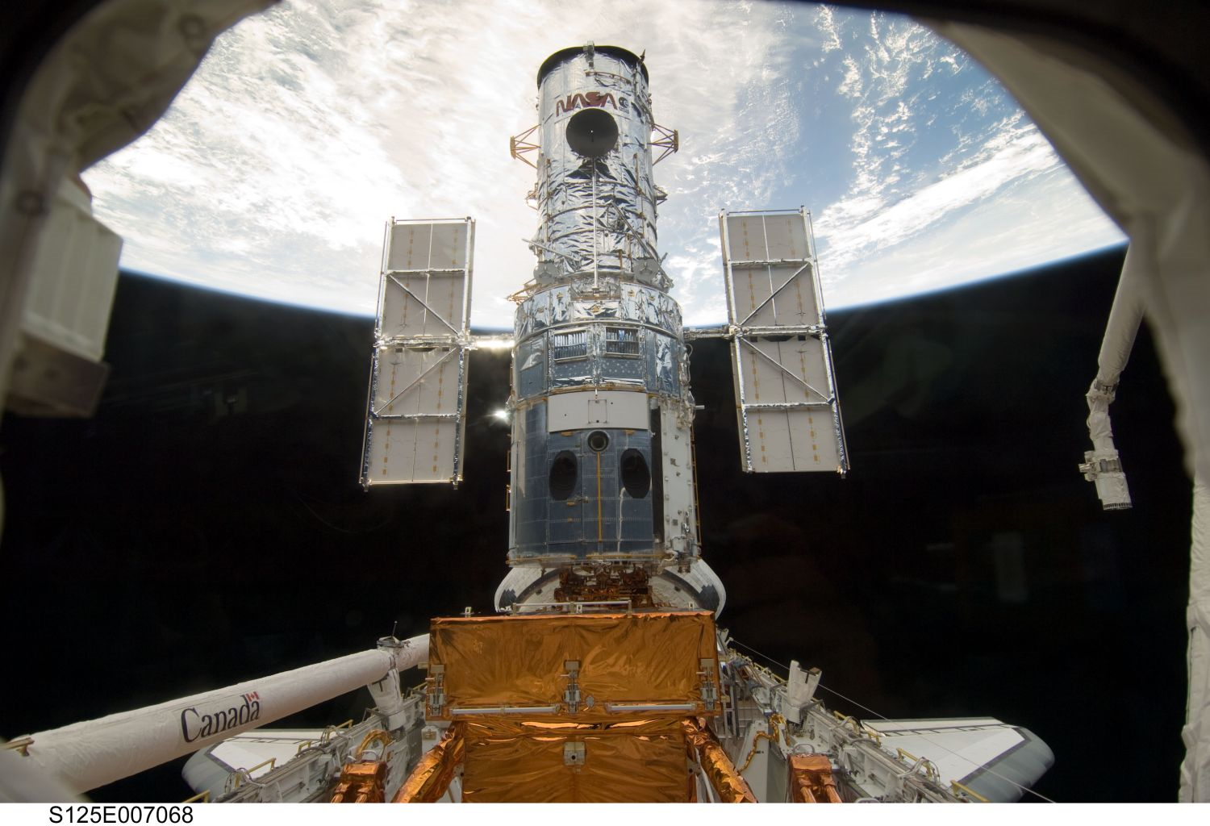
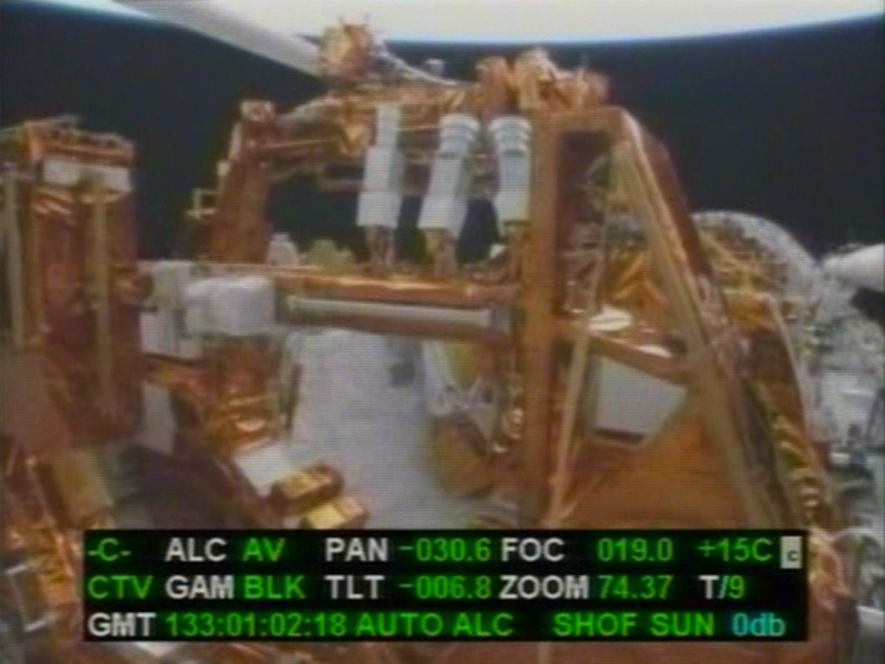
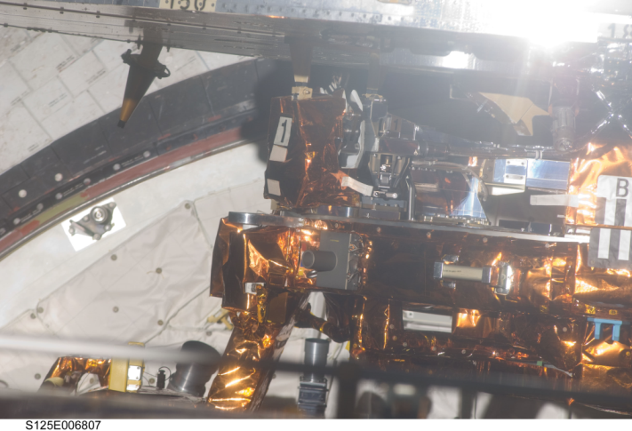
On Orbit
RNS Cameras
Tough to see, but our cameras and SpaceCube are watching

Slide 10
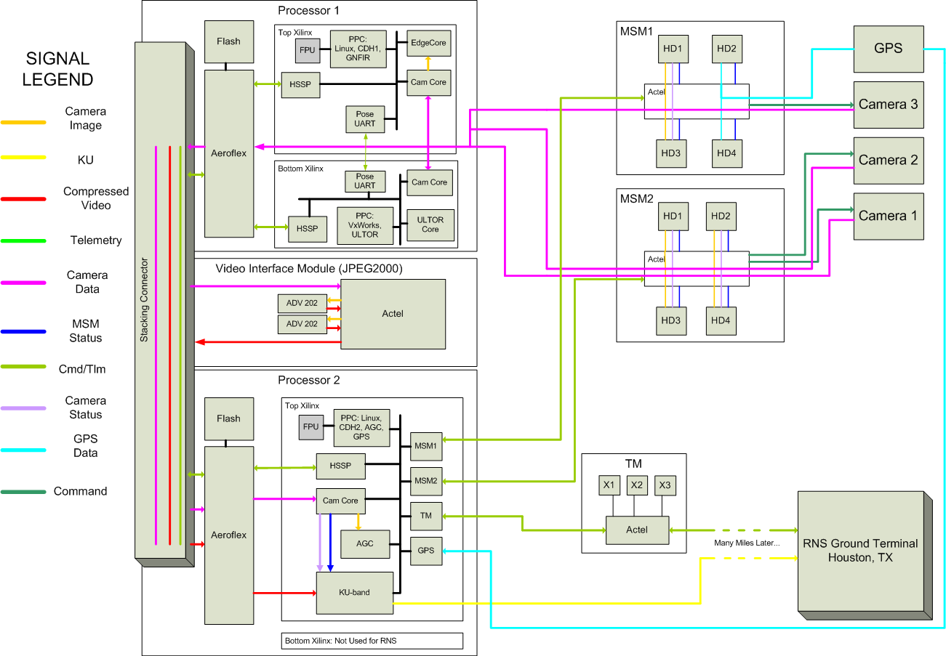
SpaceCube Functional Block Diagram

Slide 11
Xilinx FPGA Design(s)
Heavy PowerPC usage
Logic: 62.5-125MHz, Processor: 250MHz
Used 3 of 4 Xilinxs at 60-80% resource utilization
High-Level Example Xilinx Design (POSE #1 FPGA on Processor Card 1)
OPB
FPU
FCB
PowerPC
INTC
POSE UART
Debug UART
62.5-MHz USRT
PLB
Self-Scrubber
(XTMR)
Clock/Reset Manager
Camera Core
Edge Core
BRAM
SDRAM

Slide 12
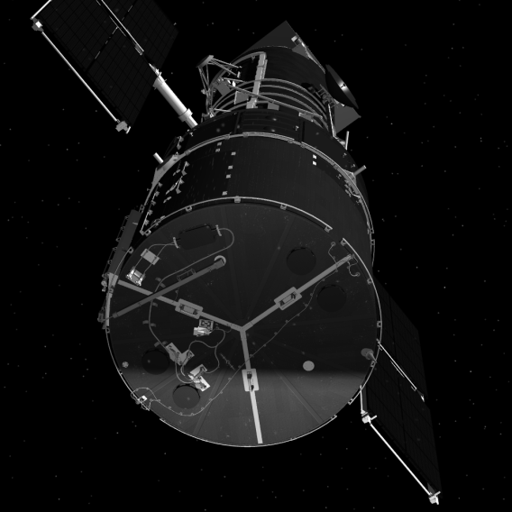
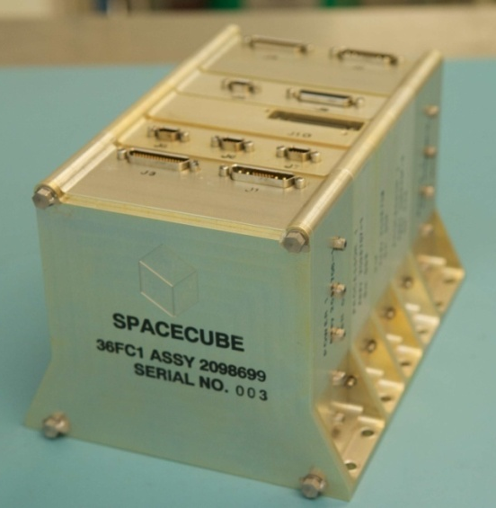
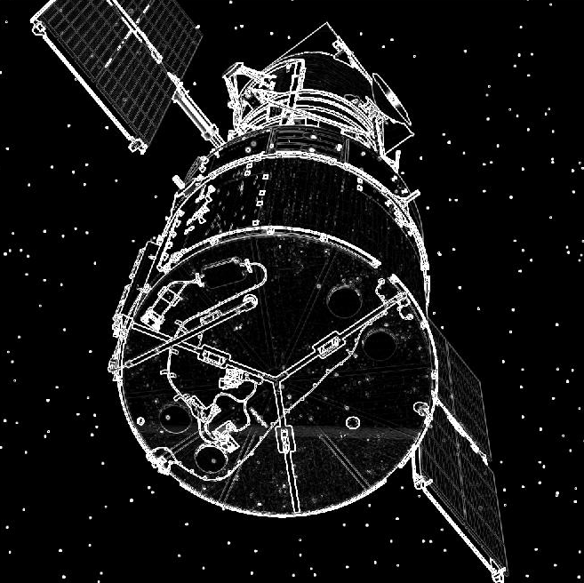
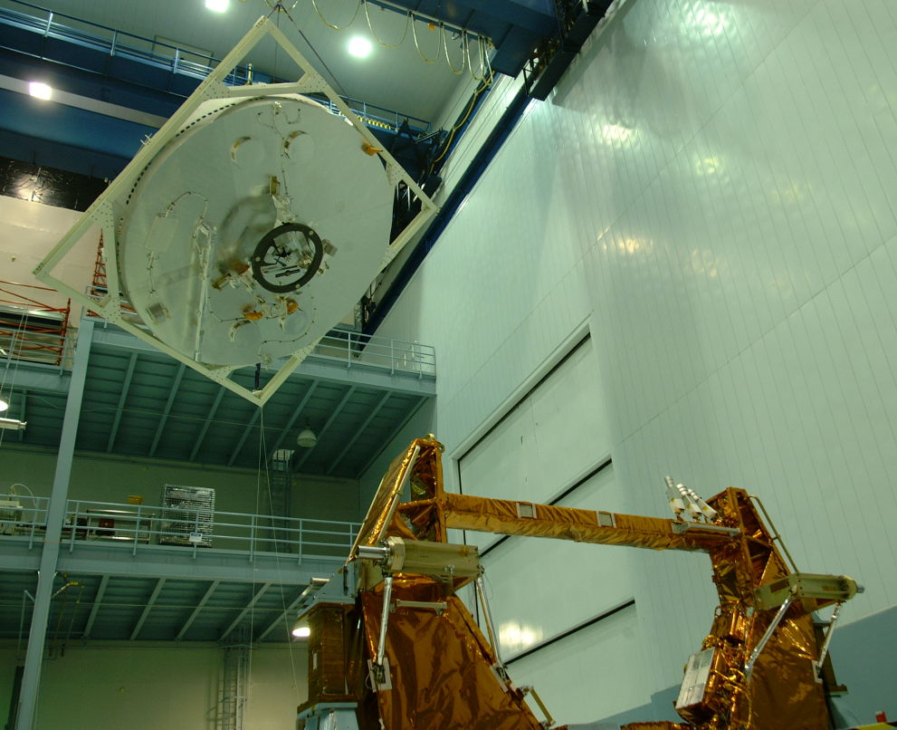
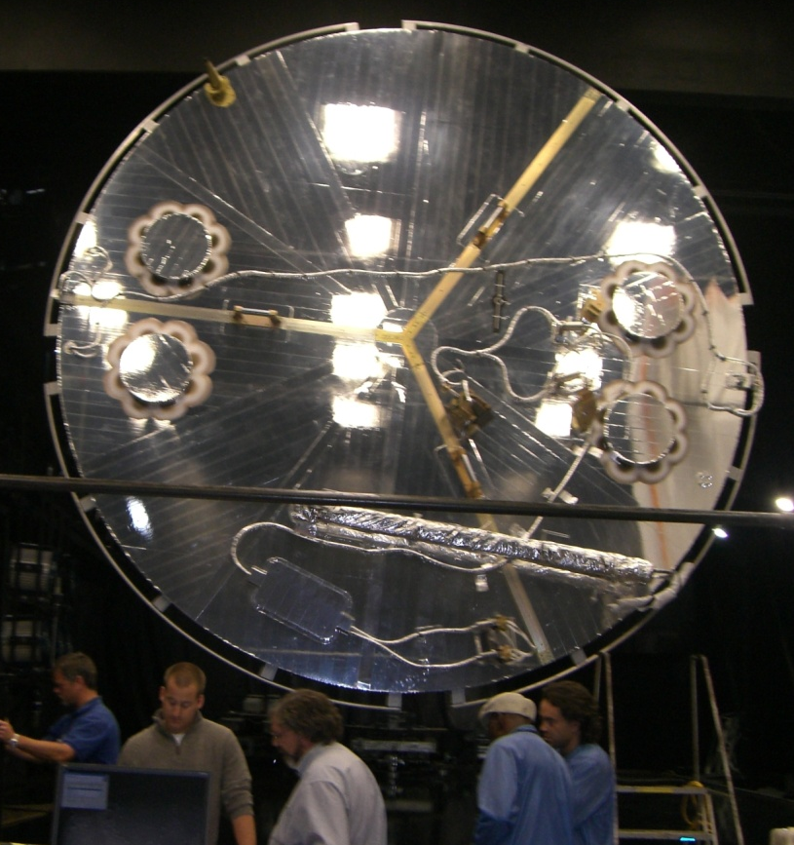
Barrage of System Testing
Simulation
Testing
MSFC Flight Robotics Lab Testing
High Bay Testing

Slide 13
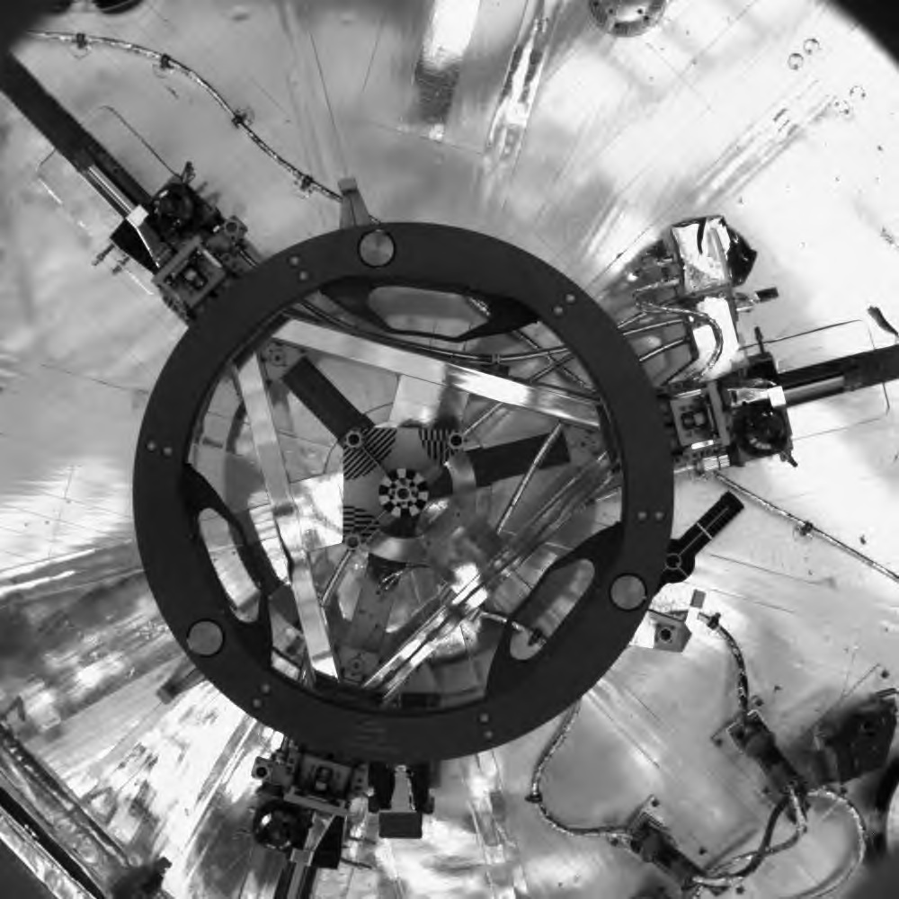
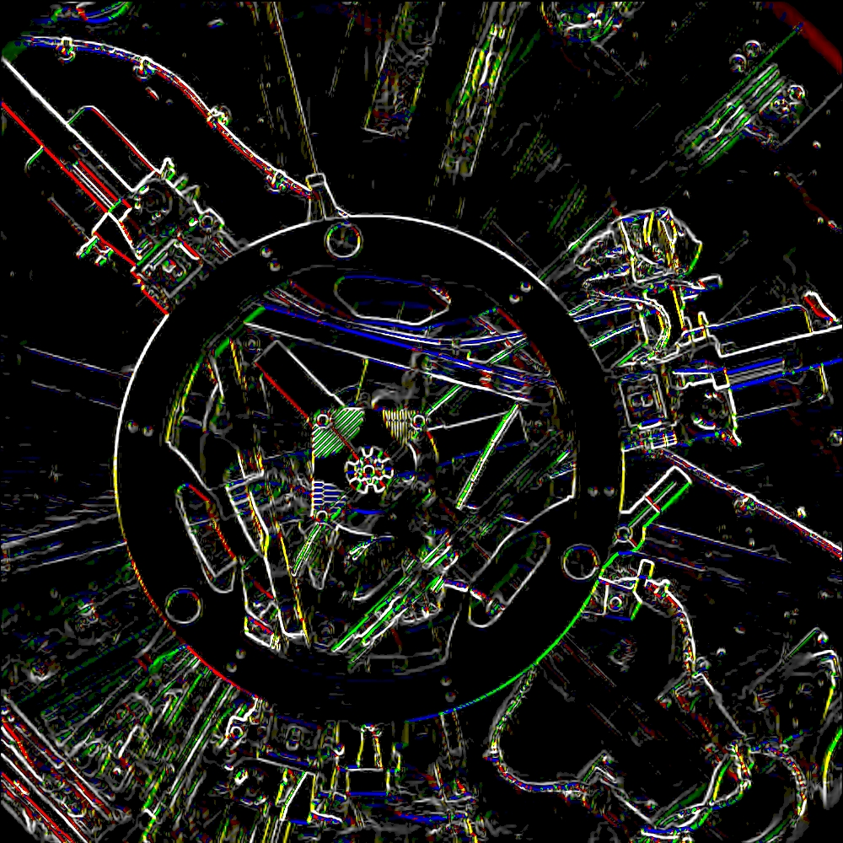
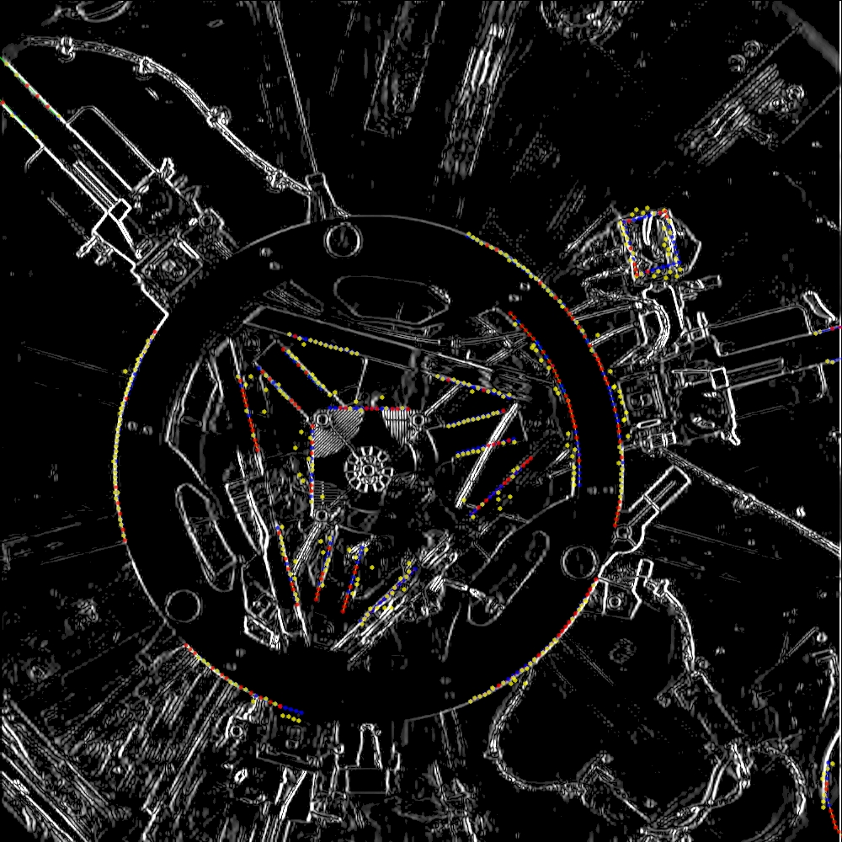
Tracking Algorithms on SpaceCube
Flight Image
Hardware Edge Detection
PPC Search for Features

Slide 14
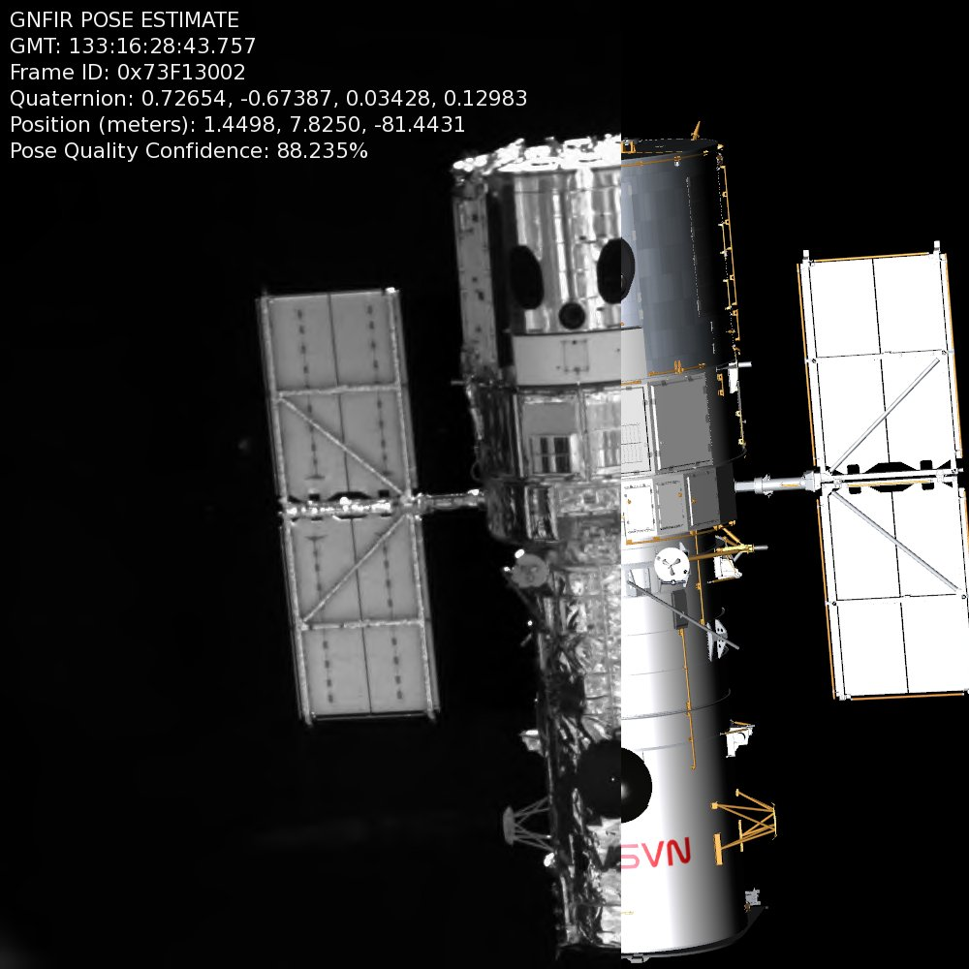
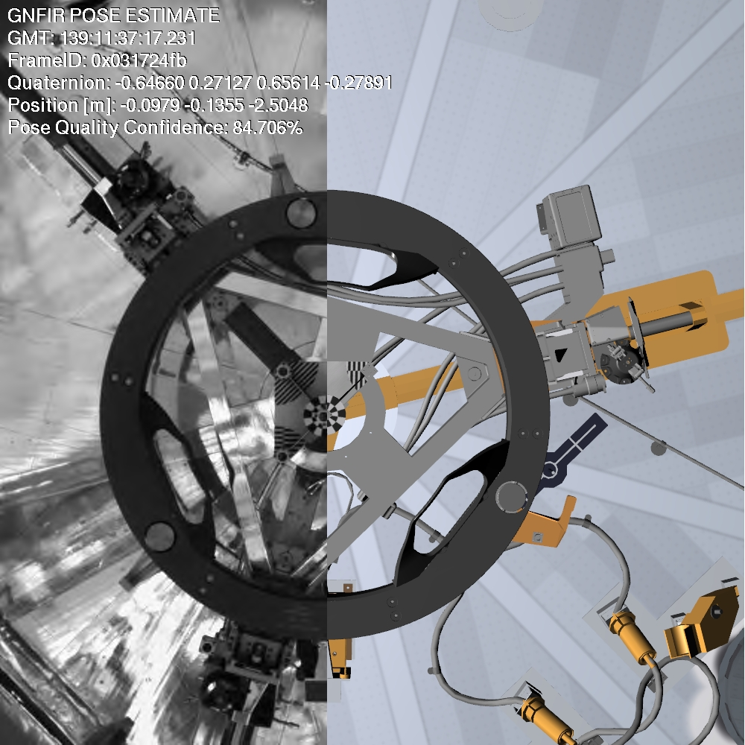
Tracking Algorithms on SpaceCube
Long Range Camera on Rendezvous
Short Range Camera on Deploy
Flight Image
RNS Tracking Solution
Flight Image
RNS Tracking Solution

Slide 15
RNS Results Summary
SpaceCube enabled RNS to meet all objectives
Recorded 6 hours of camera and GPS data
Successfully tracked HST during rendezvous for 21 minutes and deploy for 15 minutes
Sent 100,000+ compressed images to ground
SpaceCube powered for 60 hours (8 in SAA)
2 configuration SEUs in SAA scrubbed out
1 PowerPC SEE that watchdog repaired

Slide 16
HST Tracking
Note: This is the HANDOUT version of this presentation, actual version contains movies
Rendezvous
Deploy

Slide 17
What’s Next?
Just completed raw imagery downloads at GSFC
Looking for another flight for RNS hardware
Possible ISS flight for robotic demonstration
Hubble Robotic De-orbit Mission?
Flight spare SpaceCube going to ISS (STS-129)
Serve as NASA test bed for radiation mitigation
Building two new versions of SpaceCube
Covered in Session E presentation

Slide 18
Questions?
Note: This is the HANDOUT version of this presentation, actual version contains movie

Slide 19
Acronyms
FPGA: Field Programmable Gate Array
I2C: Inter-Integrated Circuit
ICAP: Internal Configuration Access Port
ISS: International Space Station
LVDM: Low Voltage Differential Multi-drop
MULE: Multi-Use Logistics Equipment
POR: Power On Reset
PPC: PowerPC
SEE: Single Event Effect
SEU: Single Event Upset
TMR: Triple Module Redundancy

