Slide 1
A Single Event Transient Resistant Majority Voter
John Cochran COSMIAC, AFRL
Steve Suddarth Director COSMIAC

Slide 2
Single Event Transients (SETs)
Temporary Radiation Effects in Electronic Circuits
Usually Caused by Heavy Ion Strikes
Manifest as Positive or Negative Spikes in Voltage
Can Cause Glitches in Operation of Space Electronics

Slide 3
SETs and Majority Voters
Triple Module Redundancy and Other Fault Remediation Schemes Require Voting on the Majority of Inputs from Replicated Signals
Any Circuit Implementing a Majority Voter Using Truth Functional Gates is Susceptible to SETs (Thompson 2006)
State Holding Elements and Feedback are not Truth Functional

Slide 4
SET Resistant Majority Voter
Regular Majority Gate with Hysteresis
Hysteresis Implemented by only Allowing Change in Output Going in Opposite Direction from Last Consensus State until a New Consensus State is Reached
Latches or Generalized C-Elements used for State Holding Elements

Slide 5
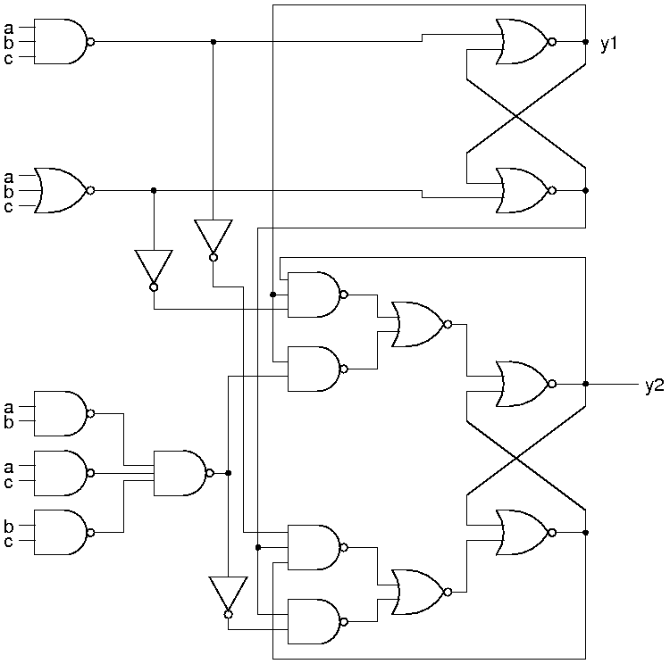
New Circuit using Latches

Slide 6
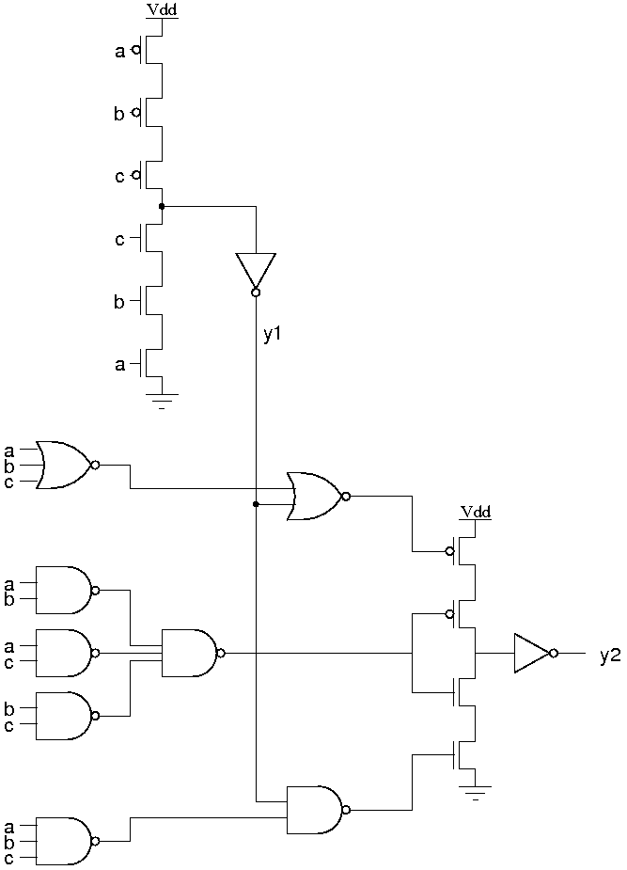
New Circuit Using C-Elements

Slide 7
Assessment of Latch Version
Standard Latches Leave it Badly Vulnerable to SETs
SET/SEU Immune Latches Make it Immune to SETs
SET/SEU Immune Latches are Immune to SETs so why Bother with Rest of Circuit
Large Size Especially with SET/SEU Immune Latches

Slide 8
Assessment of C-Element Version
Immune to Most SETs
Smaller then Latch Version
Requires Timing Constraints
Possible Problem with Stuck-at-Faults and First C-Element Fixed at One Value that Might Dissipate
Problem at Consensus States with Both Arms of Final C-Element Open

Slide 9
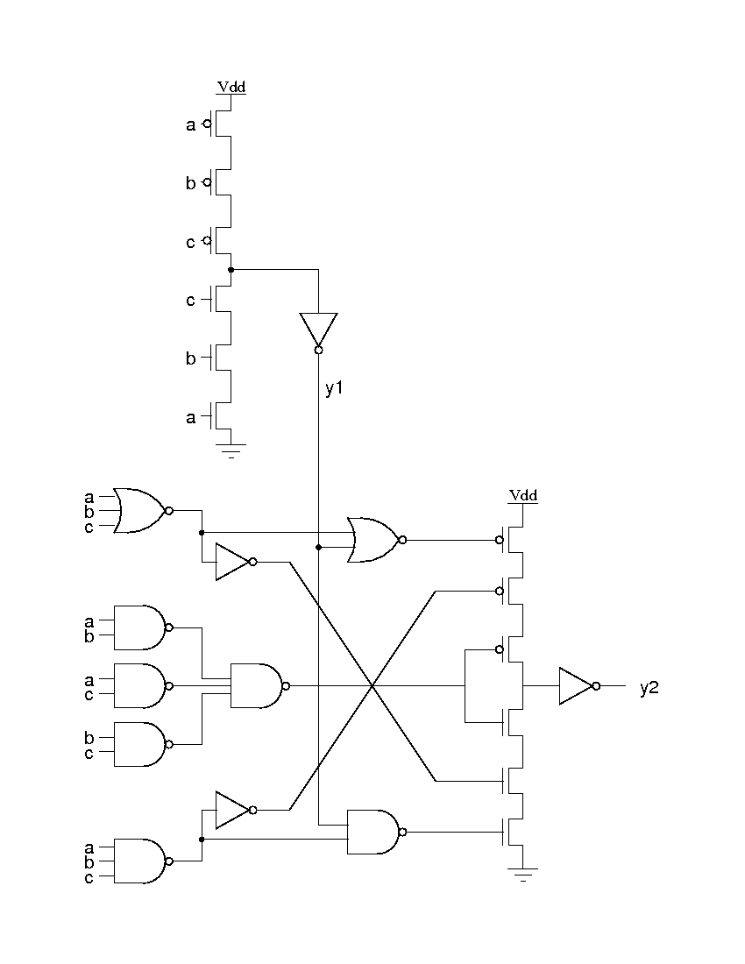
Another C-Element Version

Slide 10
Further Directions
Generalization to Redundancies Greater than Three
Temporal Redundancy
Combinations of Temporal and Spatial Redundancy
Reconfigurable Majority Voter Circuits

Slide 11
References
Sarah Thompson, "On the Application of Program Analysis and Transformation to High Reliability Electronics," Ph.D. Thesis, St Edmund's College, University of Cambridge, United Kingdom, Apr. 2006

