Slide 1
Fault Tolerant Techniques for System on a Chip Devices
Matthew French and J.P. Walters
University of Southern California’s
Information Sciences Institute
MAPLD September 3rd, 2009

Slide 2
Outline
Motivation
Limitation of existing approaches
Requirements analysis
SoC Fault Tolerant Architecture Overview
SpaceCube
Summary and Next Steps

Slide 3
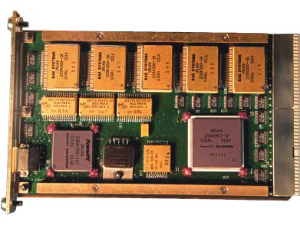
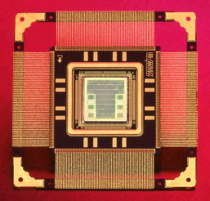
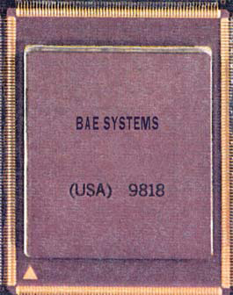
Motivation
General trend well established
COTS well outpacing RHBP technology while able to provide some of the radiation tolerance
Trend well established for FPGAs
Starting to see in RISC processors as well
Already flying FPGAs, FX family provides PowerPC for ‘free’
Processor | Dhrystone MIPs
Mongoose V | 8
RAD6000 | 35
RAD750 | 260
Virtex 4 PowerPCs (2) only | 900
Virtex 5 FX (2) PowerPC 440 | 2,200
Mongoose V - 1997
RAD6000 - 1996
RAD750 - 2001

Slide 4
Processing Performance
PowerPC
MicroBlaze
Hard Core
1,100 DMIPs @550MHz (V5)
5-stage pipeline
16 KB Inst, data cache
2 per chip
Strong name recognition, legacy tools, libraries etc
Does not consume many configurable logic resources
Soft Core
280 DMIPs @235MHz (V5)
5-stage pipeline
2-64 KB cache
Variable per chip
Debug module (MDM) limited to 8
Over 70 configuration option
Configurable logic consumption highly variable

Slide 5
Chip Level Fault Tolerance
V4FX and V5FX are heterogeneous System on a Chip architectures
Embedded PowerPCs
Multi-gigabit transceivers
Tri-mode Ethernet MACs
State of new components not fully visible from the bitstream
Configurable attributes of primitives present
Much internal circuitry not visible
Configuration scrubbing
Minimal protection
Triple Modular Redundancy
Not feasible, < 3 of these components
Bitstream Fault Injection
Can’t reach large numbers of important registers

Slide 6
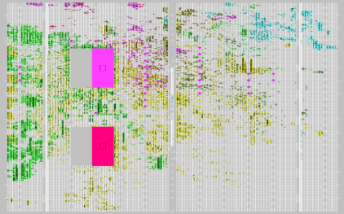
Existing Embedded PPC Fault Tolerance Approaches
Quadruple Modular Redundancy
2 Devices = 4 PowerPCs
Vote on result every clock cycle
Fault detection and correction
~300% Overhead
Voter
Dual Processor Lock Step
Single device solution
Error detection only
Checkpointing and Rollback to return to last known safe state
100% Overhead
Downtime while both processors rolling back
Checkpoint and Rollback Controller
Can we do better traditional redundancy techniques?
New fault tolerance techniques and error insertion methods must be researched.

Slide 7
Mission Analysis
Recent trend at MAPLD in looking at application level fault tolerance
Brian Pratt, “Practical Analysis of SEU-induced Errors in an FPGA-based Digital Communications System”
Met with NASA GSFC to analyze application and mission needs
In depth analysis of 2 representative applications
Synthetic Aperture Radar
Hyperspectral Imaging
Focus on scientific applications, not mission critical
Assumptions
LEO - ~10 Poisson distributed upsets per day
Communication downlink largest bottleneck
Ground corrections can mitigate obvious, small errors

Slide 8
Upset Rate vs Overhead
Redundancy schemes add tremendous amount of overhead for non-critical applications
Assume 10 errors per day (high)
PowerPC 405 – 3.888 x 10^13 clock cycles per day
99.9999999997% of clock cycles with no faults
TMR : 7.7759 x 10^13 wasted cycles
QMR : 1.16639 x 10^14 wasted cycles
DMR : 3.8879 x 10^13 wasted cycles
Processor scaling is leading to TeraMIPs of overhead for traditional fault tolerance methods
Is there a more flexible way to invoke fault tolerance ‘on-demand’?

Slide 9
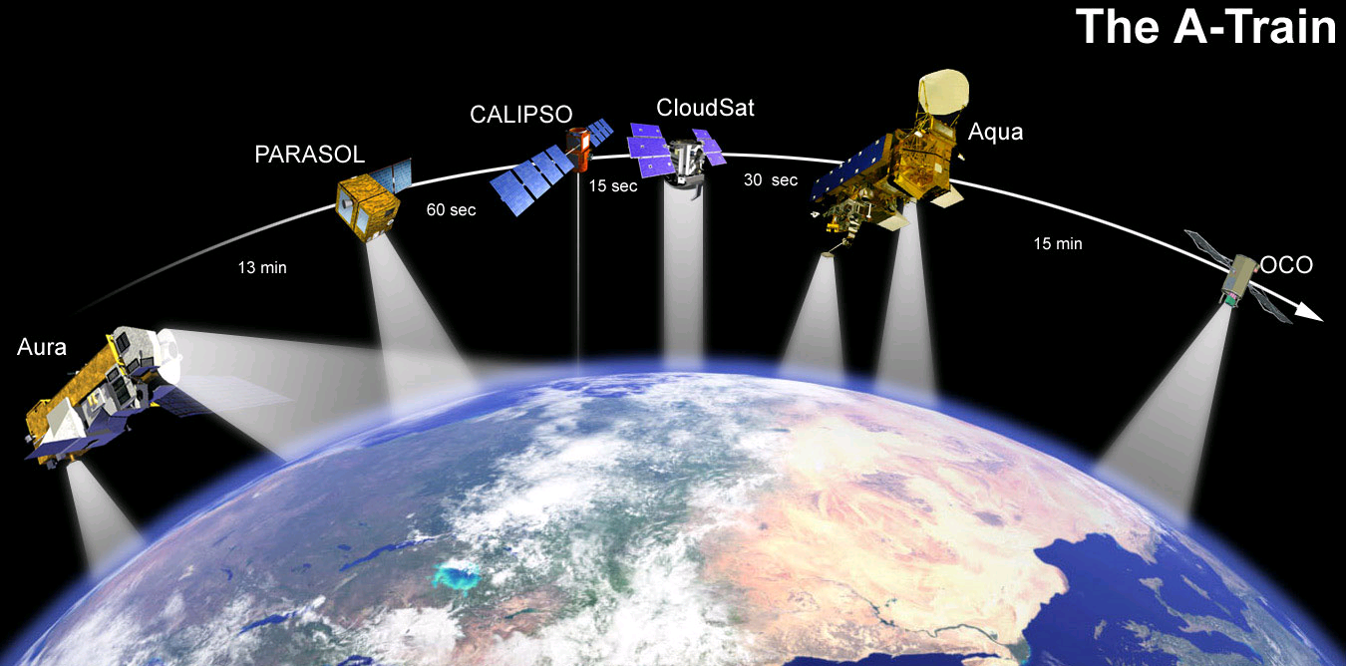
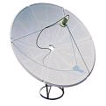
Communication Links
Downlink bottlenecks
Collection Stations not in continuous view throughout orbit
Imager / Radar collection rates >> downlink bandwidth
New sensors (eg Hyperspectral Imaging) increasing trend
Result
Satellites collect data until mass storage full, then beam down data
Impact
Little need to maintain real time processing rates with sensor collection
Use mass storage as buffer
Allows out of order execution
Collection Station
NASA’s A-Train. Image courtesy NASA

Slide 10
Science Application Analysis
Science applications tend to be streaming in nature
Data flows through processing stages
Little iteration or data feedback loops
Impact
Very little ‘state’ of application needs to be protected
Protect constants, program control, and other feedback structures to mitigate persistent errors
Minimal protection of other features assuming single data errors can be corrected in ground based post processing
SAR Dataflow
Global Init
File I/O
Record Init
SAR persistent state:
FFT and Filter Constants, dependencies, etc. ~264KB
FFT
Multiply
File I/O
IFFT

Slide 11
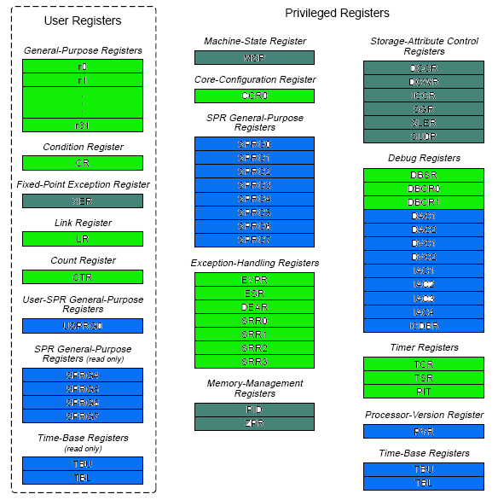
Register Utilization
Analyzed compiled SAR code register utilization for PowerPC405
Green – Sensitive register
Blue – Not sensitive
Grey – Potentially sensitive if OS used
Mitigation routines can be developed for some registers
TMR, parity, or flush
Many registers read-only or not accessible (privileged mode)
Can not rely solely on register-level mitigation

Slide 12
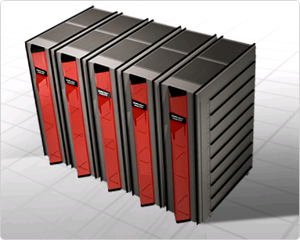
High Performance Computing Insights
HPC community has similar problem
100’s to 1000’s of nodes
Long application run times (days to weeks)
A node will fail over run time
HPC community does not use TMR
Too many resources for already large, expensive systems
Power = $
HPC relies more on periodic checkpointing and rollback
Can we adapt these techniques for embedded computing?
Checkpoint frequency
Checkpoint data size
Available memory
Real-time requirements

Slide 13
Fault Tolerance System Hierarchy
Increasing reaction time
Register Level
Mitigation
(TMR, EDAC)
Increasing Fault Coverage
Application Level Mitigation
(Instruction level TMR, Cache Flushing, BIST, Control Flow Duplication)
Sub-system Level Mitigation
(Checkpointing and rollback, Scheduling, Configuration Scrubbing)

Slide 14
SpaceCube
SpaceCube Processor Slice Block Diagram

Slide 15
SoC Fault Tolerant Architecture
Control Packets
FPGA 0
Implement SIMD model
RadHard controller performs data scheduling and error handling
Control packets from RadHard controller to PowerPCs
Performs traditional bitstream scrubbing
PowerPC node
Performs health status monitoring (BIST)
Sends health diagnosis packet ‘heartbeats’ to RadHard controller
Heartbeat Packets
PowerPC 0
Rad-Hard Micro-controller
Task Scheduler
Event Queue
FPGA 0
PowerPC 1
Shared Memory Bus
Scheduler
T
FPGA 2
Timer Interrupt
PowerPC 2
Application Queue
To Flight Recorder
FPGA N
Memory Guard
PowerPC N
Access Table

Slide 16
SIMD: No Errors
PowerPC
PowerPC
PowerPC
PowerPC
CLB-based Accelerator
CLB-based Accelerator
CLB-based Accelerator
CLB-based Accelerator
SAR Frame 1
SAR Frame 2
Virtex4
SAR Frame 4
Virtex4
SAR Frame 3
Utilization approaches 100%
-Slightly less due to checking overheads
Packet Scheduling
Heartbeat Monitoring
Reboot / Scrub control
Radhard PIC

Slide 17
SIMD: Failure Mode
PowerPC
PowerPC
PowerPC
PowerPC
CLB-based Accelerator
CLB-based Accelerator
CLB-based Accelerator
CLB-based Accelerator
SAR Frame 1
SAR Frame 2
SAR Frame 3
SAR Frame 4
Virtex4
Virtex4
SAR Frame 3
If a node fails, PIC scheduler sends frame data to next available processor
Packet Scheduling
Heartbeat Monitoring
Reboot / Scrub control
Radhard PIC
17

Slide 18
System Level Fault Handling
‘SEFI’ events
Detection: Heartbeat not received during expected window of time
Mitigation: RadHard Controller reboots PowerPC, scrubs FPGA, or reconfigures device
Non-SEFI event
PowerPC tries to self-mitigate
Cache and register flushing, reset SPR, reinitialize constants etc
Flushing can be scheduled as in bitstream scrubbing
Data frame resent to another live node while bad node offline
Scheme sufficient for detecting if PowerPC is hung and general program control flow errors and exceptions
Still requires redundancy of constants to avoid persistent errors

Slide 19
Theoretical Overhead Analysis
Normal Operation
Sub-system mitigation
Heartbeat write time ~100usec
Frequency: 50 – 100ms
Theoretical overhead 0.1-0.2%
Application level mitigation
Cache flushing ~320usec
Frequency: 50 – 100ms
Theoretical overhead 0.3 – 0.6%
Register level mitigation
Selective TMR – highly application dependant
Total overhead: Goal < 5%
Subsystem throughput
SFTA ~1710 MIPs
DMR ~850 MIPs
QMR ~450 MIPs
Error recovery mode
System utilization when one node rebooting?
75% - PowerPC overhead ~= 70% of application peak performance
Set ‘real-time’ performance to account for errors
Still higher system throughput than DMR, QMR
Expected reboot time?
With Linux: ~ 2 minutes
Without OS: < 1 minutes

Slide 20
Status
Initial application analysis complete
Implementing architecture
Using GDB, bad instructions to insert errors
Stay tuned for results
Questions?

