Slide 1
Design of a Radiation Tolerant Computing System Based on a Many-Core FPGA Architecture
Military & Aerospace Programmable Logic Devices Conference (MAPLD)
Session E: PLD Based System Architectures
9/3/09
Presenter: Dr. Brock J. LaMeres Authors: Dr. Brock J. LaMeres, Erwin Dunbar, Pat Kujawa, David Racek, Anthony Thomason, Colin Tilleman and Clint Gauer
Department of Electrical and Computer Engineering
Montana State University Bozeman, MT

Slide 2
Acknowledgements
This work was supported by: Montana Space Grant Consortium (NASA EPSCoR) http://spacegrant.montana.edu NASA Exploration Systems Mission Directorate “Higher Education Program” http://education.ksc.nasa.gov/esmdspacegrant/
Special thanks to our project mentors from NASA’s Advanced Avionics & Processor Systems (AAPS) Project Dr. Robert E. Ray Dr. Andrew S. Keys Dr. Michael A. Johnson Marshall Space Flight Center Marshall Space Flight Center Goddard Space Flight Center Reconfigurable Computing Task AAPS Project Manager High Performance Processor Task

Slide 3
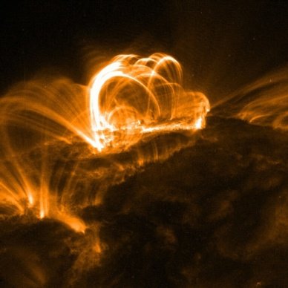
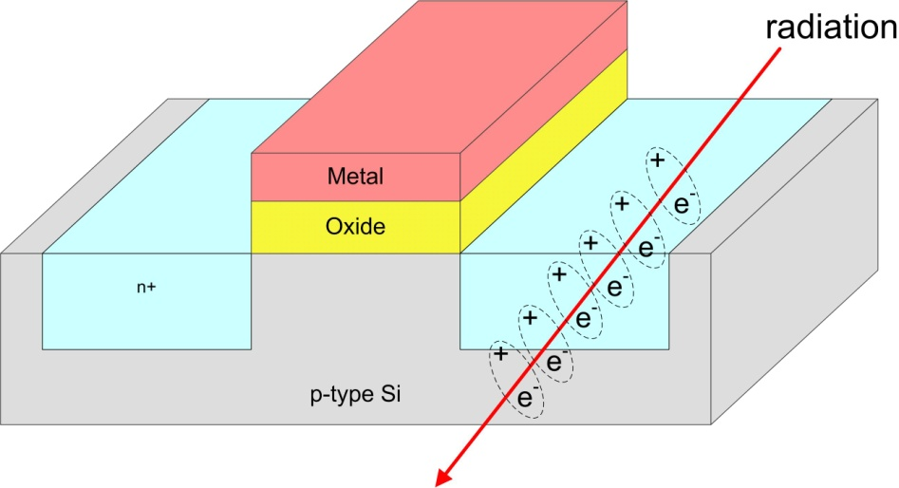
Motivation
Radiation has a detrimental effect on electronics in space environments.
The root cause is from electron/hole pairs creation as the radiation strikes the semiconductor portion of the device and ionizes the material.
Types
alpha particles (Terrestrial, from packaging/doping)
Neutrons (Terrestrial, secondary effect from Galactic Cosmic Rays entering atmosphere)
Heavy ions (Aerospace, direct ionization)
Proton (Aerospace, secondary effect)

Slide 4
Motivation
Two types of failures mechanics are induced by radiation 1) Total Ionizing Dose (TID)
The cumulative, long term ionizing damage to the device materials
Caused by low energy protons & electrons
2) Single Event Effects (SEE)
Transient spikes caused by Heavy Ions and protons
Can be both destructive & non-destructive

Slide 5
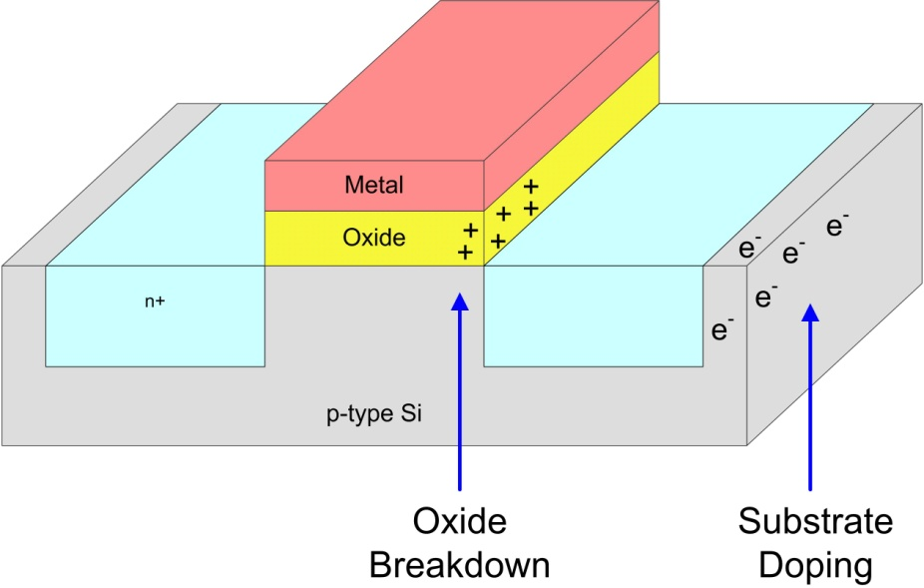
Motivation (TID)
1) Total Ionizing Dose (TID)
As the electron/holes try to recombine, they experience different mobility rates (µ_{n} > µ_{p})
Over time, the ionized particles can get trapped in the oxide or substrate of the device prior to recombination
This can lead to: - Threshold Shifting - Leakage Current - Timing Skew

Slide 6
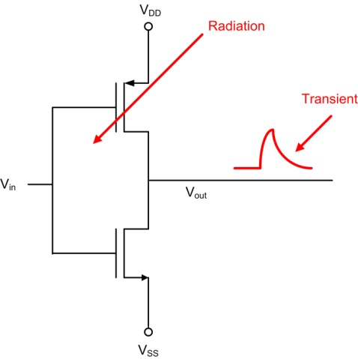
Motivation (SEEs)
2) Single Event Effects (SEEs)
Transient voltage/current induced in devices
This can lead to both Non-Destructive and Destructive effects
Non-Destructive Behavior Single Event Transient (SET) A transient spike of voltage/current noise, can cause gate switching Single Event Upset (SEU) A transient captured in a storage device (FF/RAM) as a state change Single Event Func. Interrupt (SEFI) A fault that cannot be recovered from using a reset. Multi-Bit Upsets (MBU) Multiple, simultaneous SEUs
Destructive Behavior Single Event Latchup(SEL) Transient biases the parasitic bipolar SCR in CMOS causing latchup Single Event Burnout (SEB) Transient causes the device to draw high current which damages part Single Event Gate Rupture (SEGR) The energy is enough to damage the gate oxide

Slide 7
Mitigation of TIDs
1) Current Mitigation Techniques (TID)
- Parts can be “hardened” to TID through: - layout techniques (sizing of Q_{crit}, enclosed layout) - guard rings - substrate doping - redundant circuitry
- Parts are specified in terms of: - “the amount of energy that can be tolerated by ionizing particles before the part performance is out of spec” - units are given in krad (Si), typically 300krad+
- Shielding Does Help
- low energy protons/electrons can be stopped at the expense of weight

Slide 8
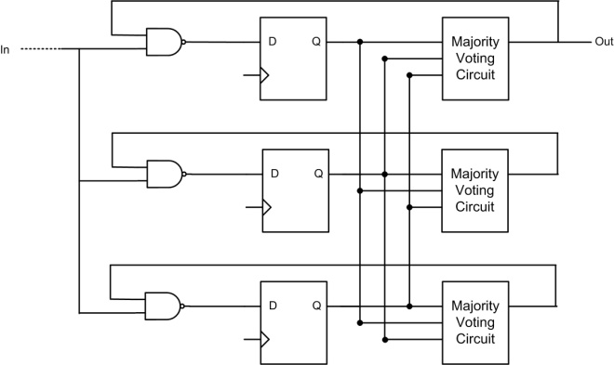
Mitigation of SEEs
2) Current Mitigation Techniques (SEEs)
- Triple Modular Redundancy (TMR)
- Reboot/Recovery Sequences
- Shielding Does NOT eliminate all SEEs - impractical to shield against high energy particles and Heavy Ions due to necessary mass

Slide 9
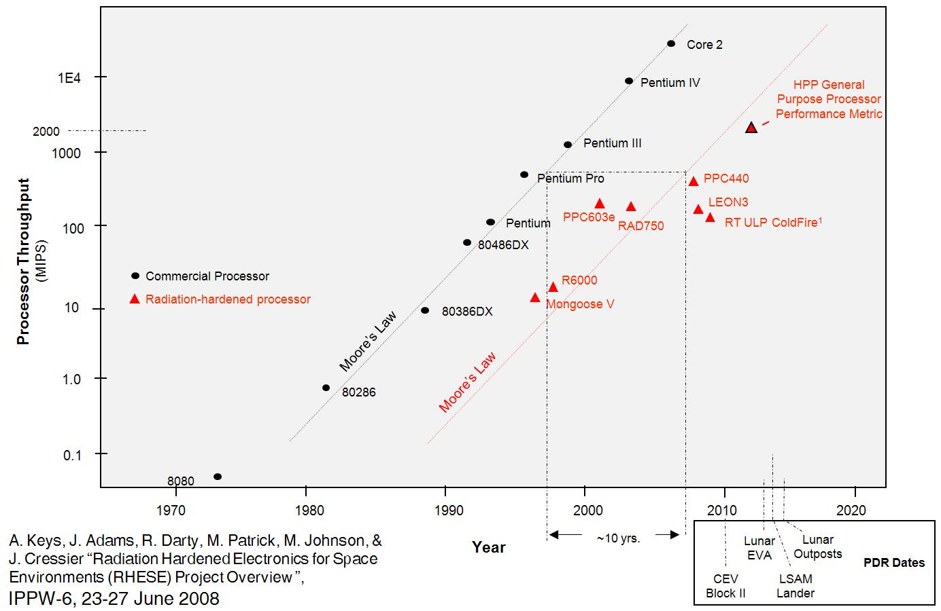
Drawback of Mitigation
Radiation Hardening = Slower Performance
- All TID mitigation techniques lead to slower performance
- TID mitigation DOES NOT prevent SEEs

Slide 10
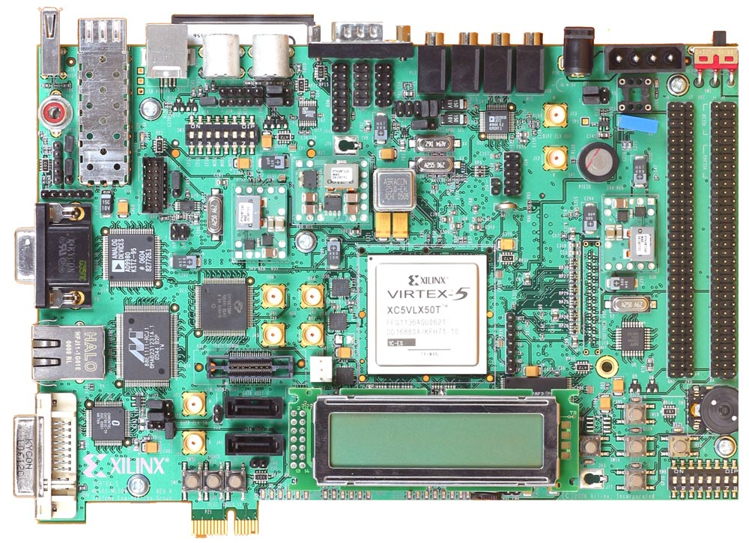
FPGAs & Radiation
Radiation Mitigation in FPGAs
- RAM based FPGAs are traditionally soft to radiation - Fuse-based FPGAs provide some hardness, but give up the flexibility of real-time programmability
Exploiting Reconfiguration
- The flexibility of FPGAs enables novel techniques to radiation tolerant computing ex) Dynamic TMR, Spatial Avoidance of TID failures, - The flexibility of FPGAs is attractive to weight constrained Aerospace applications ex) Reduction of flight spares, internal spare circuitry

Slide 11
FPGAs as a Solution?
Field Programmable Gate Arrays
- FPGAs have followed Moore’s Law and now yield comparable processing power to ASICs
LUT
X
LUT
X
LUT
X
X
X
X
X
LUT
X
LUT
X
LUT
X
X
X
X
X
X
LUT
X
LUT
X
LUT

Slide 12
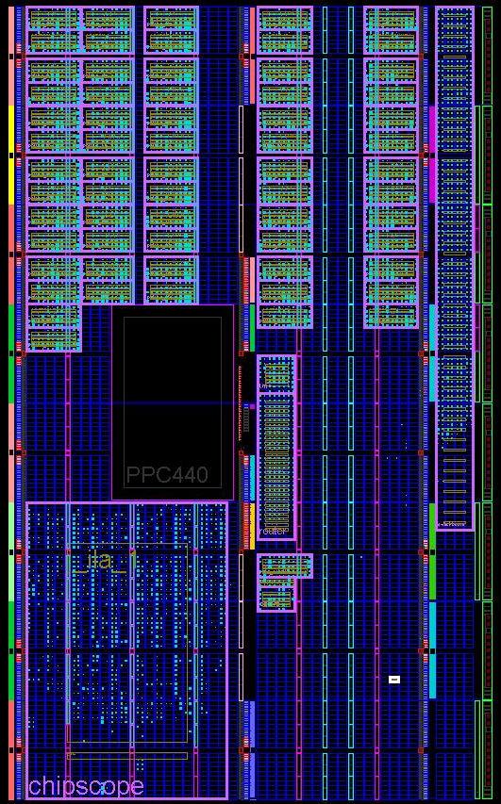
Many-Core Architecture
Radiation Tolerance Through Architecture
- Redundant, Homogenous, Soft Processors - At Any Given Time, 3 are configured in Triple Modular Redundancy (TMR)
TMR
Spare Processors

Slide 13
Many-Core Architecture
Types of Radiation Faults Seen in FPGAs
1) Soft (SEU, SET) - SEUs that can be recovered from using a reset 2) Medium (SEFI) - SEUs in reconfiguration memory, can only be recovered using reconfiguration 3) Hard (TID / Displacement Damage) - Damage to part of the chip due to TID or Displacement Damage

Slide 14
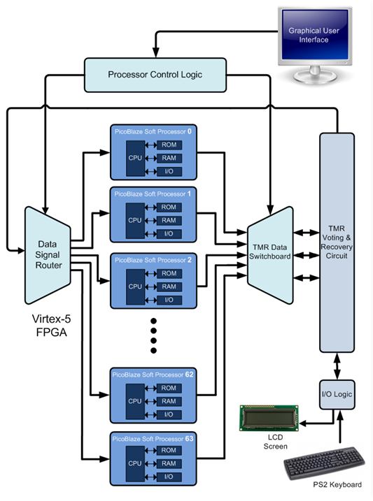
Many-Core Architecture
Fault Recovery Procedures
Fault Type Recovery Action
Soft Faults - TMR Voter detects fault - 2 good processors complete current task - Good 2 processors offload variable data - All 3 processors are reset - All 3 processors re-initialized with variable data - All 3 processors resume operation in TMR
Medium Faults - Same general procedure, except Bad processors is partially reconfigured to reset configuration RAM
Hard Faults - A spare processor is brought online to complete TMR - Bad processor is flagged as “DO NOT USE”

Slide 15
Many-Core Architecture
Advantages of this Approach
1) SEUs mitigated using traditional TMR 2) Partial Reconfiguration technique increases hardness of RAM-based FPGAs 3) Spatial avoidance of damaged regions of FPGA extend system lifetime 4) Logical approach can be applied to RHBD FPGA fabrics (SIRF, etc…) for increased radiation immunity

Slide 16
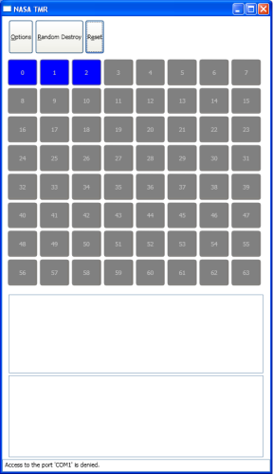
System Prototyping
Many-Core Computing Architecture - 64 picoBlaze Processors (3+61) implement on a Virtex-5 FX50 - The computer system controls basic peripherals - A push button is used to mimic soft SEUs - A PC GUI is created to inject hard failures - HyperTerminal is used to mimic medium severity faults requiring partial reconfiguration - Xilinx ChipScope used to monitor processor operation on all 64 processors
ML507 V5 Platform w 64 pBlaze uPs
PC Gui to induce Hard Failures
ChipScope Internal Logic Analyzer

Slide 17
System Demonstration
Initial Operation - Processors 0, 1, and 2 are active (blue) and operating in TMR - Processors 3-63 provide 61 spare picoBlaze processors (gray)
(showing address lines between uP and memory for all 64 processors)
ChipScope shows uP 1,2,3 are running in synch with no faults
GUI indicates uP 0, 1, and 2 are active (blue)

Slide 18
System Demonstration
Soft Fault Recovery - Processors 0, 1, and 2 are active (blue) operating in TMR - Processors 0 undergoes a soft fault and then recovers and resynchronizes
System initialized and running normally in TMR mode.
Processor 0 has been corrupted by an SEU. The TMR detects the failure.
Processor 0 brought back into synch with other two processors.
GUI indicates uP 0, 1, and 2 are active (blue)

Slide 19
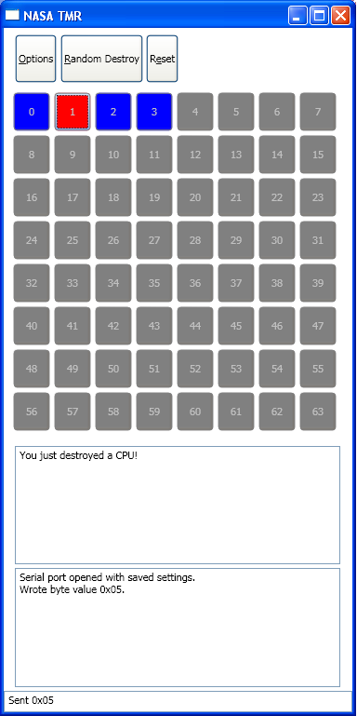
System Demonstration
Hard Fault Recovery - Processors 1 undergoes hard fault (induced by GUI, red) - The system shuts down uP #1 and brings on spare processor uP #3 into TMR
Processor 1 has hard fault so is shut down
Spare processor 3 is brought online, resynchronized, and reinitialized to form TMR
GUI indicates uP 1 is in hard fault (red). uP 0,2,3 form TMR (blue).

Slide 20
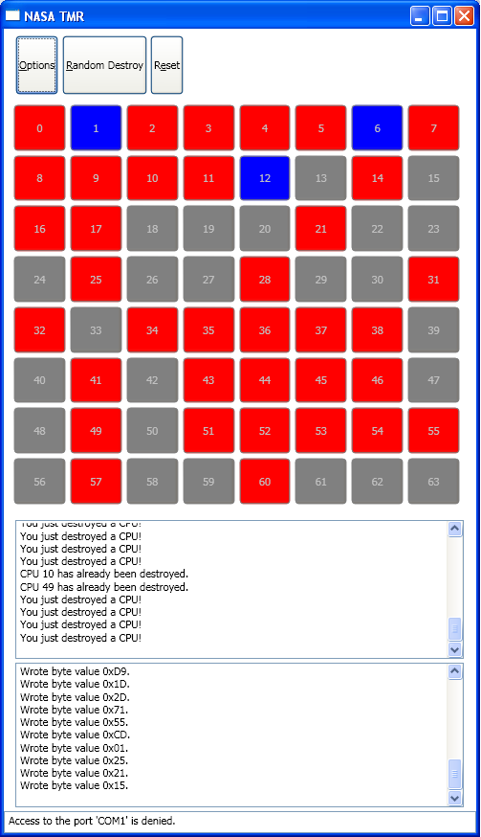
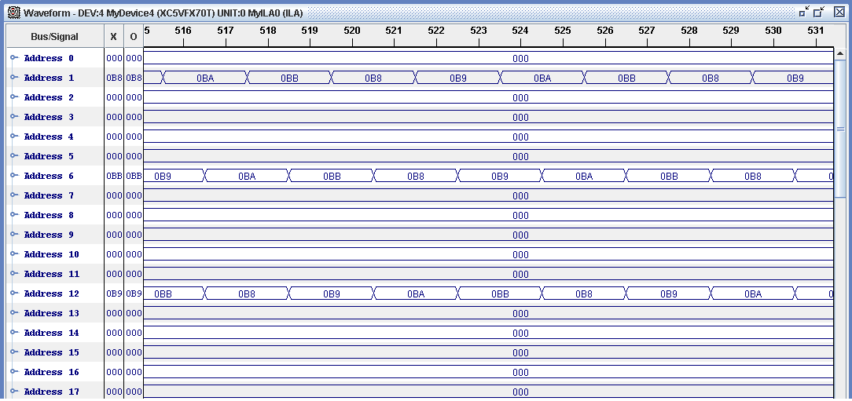
System Demonstration
Multiple Hard Faults - Multiple hard faults are present - uPs 1, 6, and 12 form TMR
Processor 1, 6, & 12 are active
GUI indicates uP 1 , 6, & 12 are active. Multiple hard faults are present

Slide 21
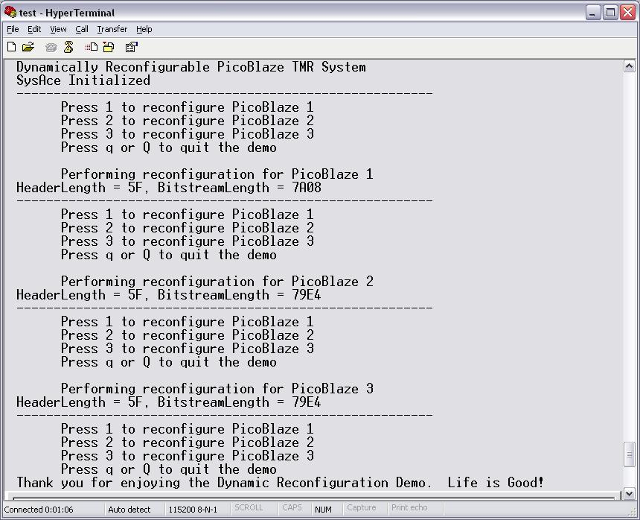
System Demonstration
Medium Severity Fault Recovery (PR) - An initial hard failure can be repaired by going back to the effected processor and reconfiguring it. - This handles the situation where an SEU occurred in the configuration RAM - For this type of fault, a simple reset will not recover the processor BUT the processor hardware is still usable. - Logistics: a MicroBlaze soft processor is used to read the PR bit streams through the SystemACE and write to the ICAP port of the Virtex-5.

Slide 22
Timing/Area Impact
Soft Fault Recovery (reset, reload variable information)
Timing Overhead - TMR interrupt 2 clocks
- Reset 2 clocks
- Read variable data from good processors: 128 clocks (2 clks/inst, 64 bytes of RAM)
- Write variable data to reset processor: 128 clocks (2 clks/inst, 64 bytes of RAM) __________________ Total 260 clocks = 2.6 us (100 MHz V5 Clock)

Slide 23
Partial Reconfiguration Constraints
For our V5, the smallest quantum that can be partially reconfigured is 20 CLBs - 1 CLB contains: 2 Slices - 1 Slice contains: - four LUTs
- four storage elements
- wide-function multiplexers
- carry logic
If you use BRAM in your design, 4 BRAMs must be partially reconfigured together
Care must be given to placing circuitry within the smallest partially reconfigured tile
Bus Macros are used to provided fixed routing channels between tiles.

Slide 24
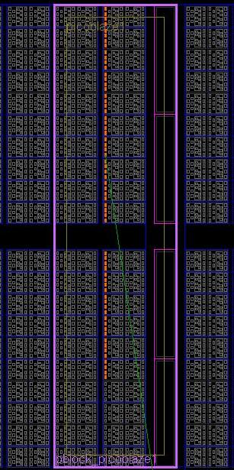
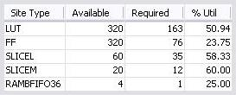
PR of a picoBlaze Core
Physical picoBlaze resource estimation:
- 24 CLBs, 1 BRAM
PR region resource use:
- 2 columns of 20 CLBs
- 1 column of BRAM
Bitstream file size(LX50T):
- Partial bitstream for one PicoBlaze: 31.2 KB
- Full bitstream: 1,716 KB
Reconfiguration time:
- Roughly 200 clks/Byte (measured)
- Measured time: 66ms (100 MHz clk)
- Using MicroBlaze driven ICAP processor
Smallest picoBlaze PR Tile
=
40 CLB + 4BRAM
A single PicoBlaze PR region

Slide 25
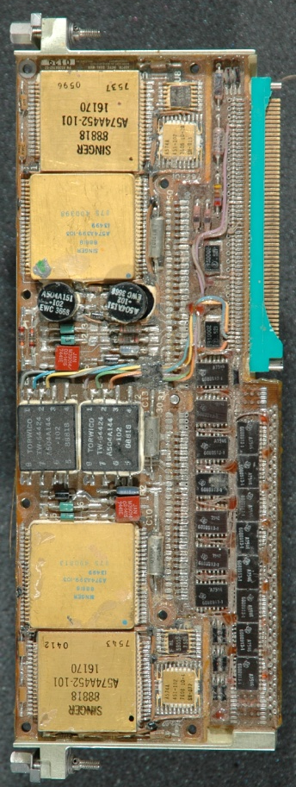
Next Step
Chamber Testing
microBlaze Soft Processor
Shuttle Processor Board Virtex-5/6/7
1
2
3
spare

Slide 26
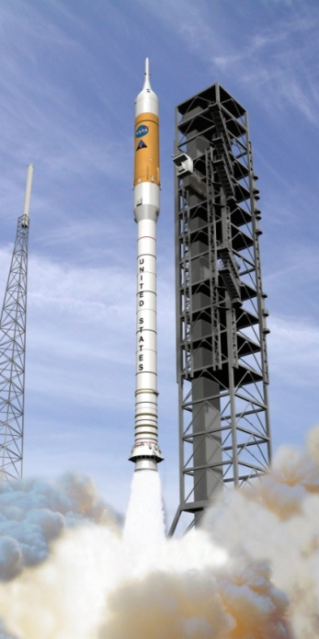
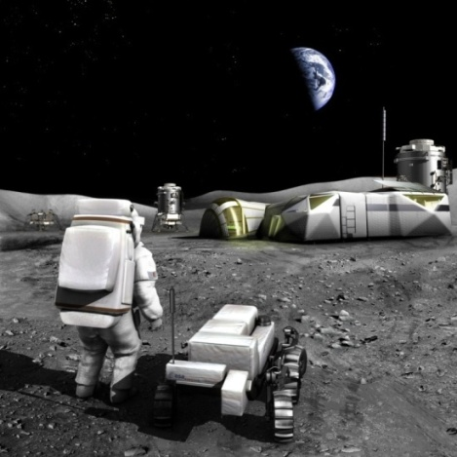
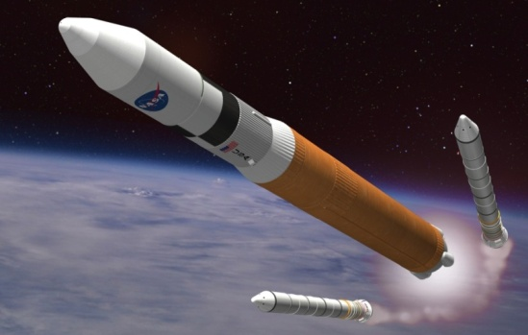
Future Work
Questions?

