Slide 1
SpaceCube: Current Missions and Ongoing Platform Advancements
Dave Petrick
T. Flatley, A. Geist, D. Espinosa, G. Crum, M. Lin, J. Hosler, M. Buenfil, K. Blank
NASA/GSFC
Code 587
9/3/2009
Notes:
-Various work at Goddard from IRADs to flight missions
-two upcoming missions
-two new processors

Slide 2
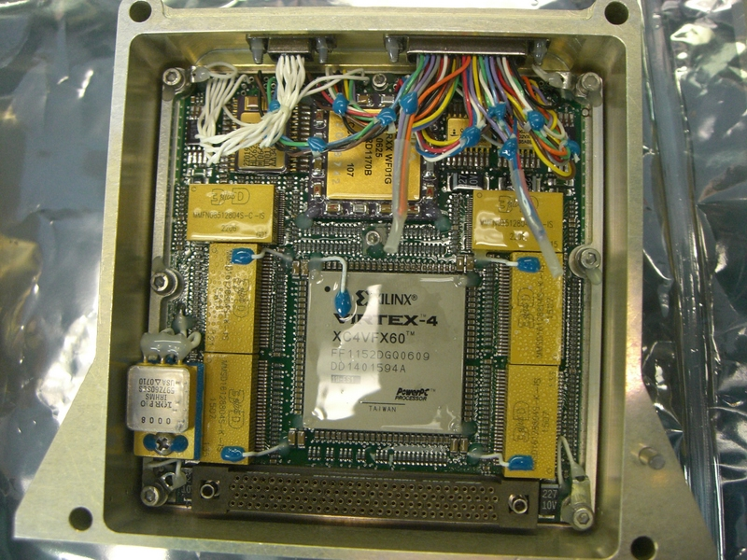
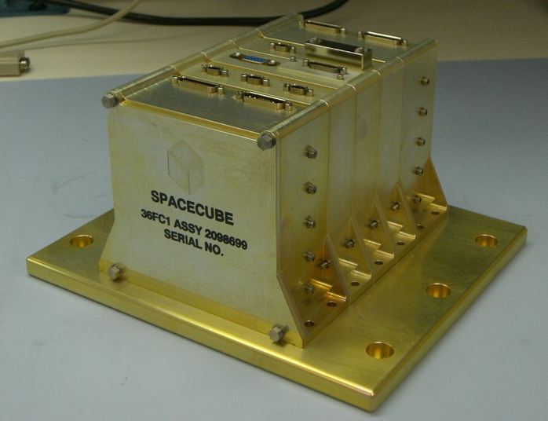
GSFC SpaceCube
Small, light-weight, reconfigurable multi-processor platform for space flight applications demanding extreme processing capabilities
Stackable architecture
Based on Xilinx Virtex 4 FX60 FPGAs, 2 per processor card
Successful flight demonstration on STS-125
Processor Card
Flight Box
2 Xilinx FPGAs, 2 Aeroflex FPGAs
1GB SDRAM, 1GB Flash
Mechanical: 7.5-lbs, 5”x5”x7”
Power: 37W (STS-125 Application)
Notes:
-Picture of flight board, configurable I/O, stacked memory
-Session A, I presented the details of our mission on the HST servicing mission as part of the RNS system
-Ideal system to show off the processing power of the SpaceCube

Slide 3
Current Tasks
SpaceCube 1.0: RNS flight spare to ISS (Nov 09)
Platform for testing radiation mitigation techniques starting with Rad-Hard by Software (RHBS)
Collaborating with industry and universities
SpaceCube 1.5: Sounding Rocket Avionics
DoD Operationally Responsive Space payload funding
Feature Xilinx Virtex 5 FX100 with gigabit interfaces
SpaceCube 2.0: Increased performance over SC1.X
ESTO funding → Prototype FY10, Engineering Unit FY12
For missions requiring high data rates and/or onboard science data processing
Notes:
-Outline
-Sounding rocket requiring small, but powerful processing
-SC2.0: increased performance w/ high reliability

Slide 4
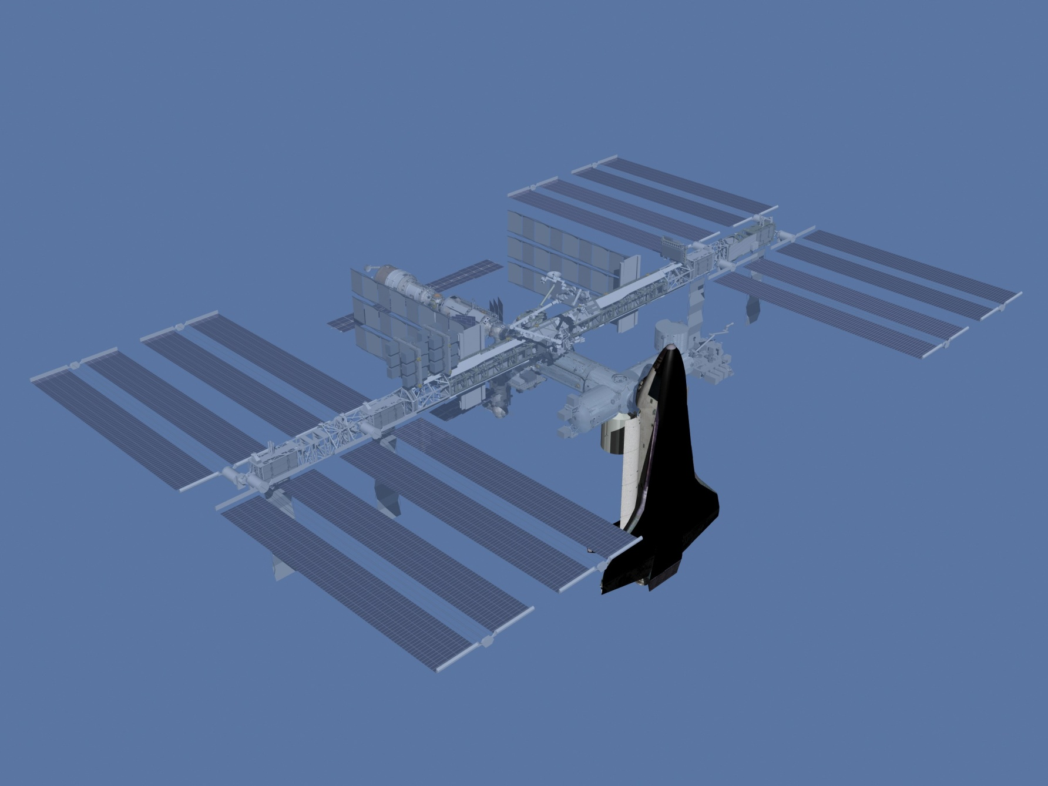
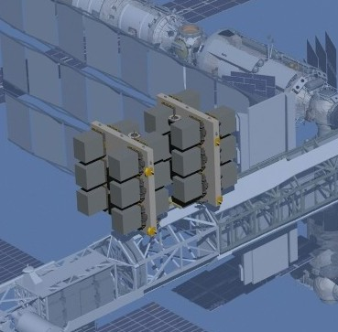
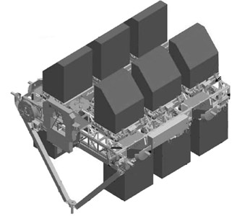
MISSE-7 Overview
Materials International Space Station Experiment
Payload Lead: Naval Research Lab
STS-129 Shuttle Atlantis, November 12, 2009
MISSE-7
Notes:
-MISSE is a series of experiments flown on the ISS
-ELC decks will be installed outside the ISS on a truss
-MISSE-7 is one of the experiments on ELC-1

Slide 5
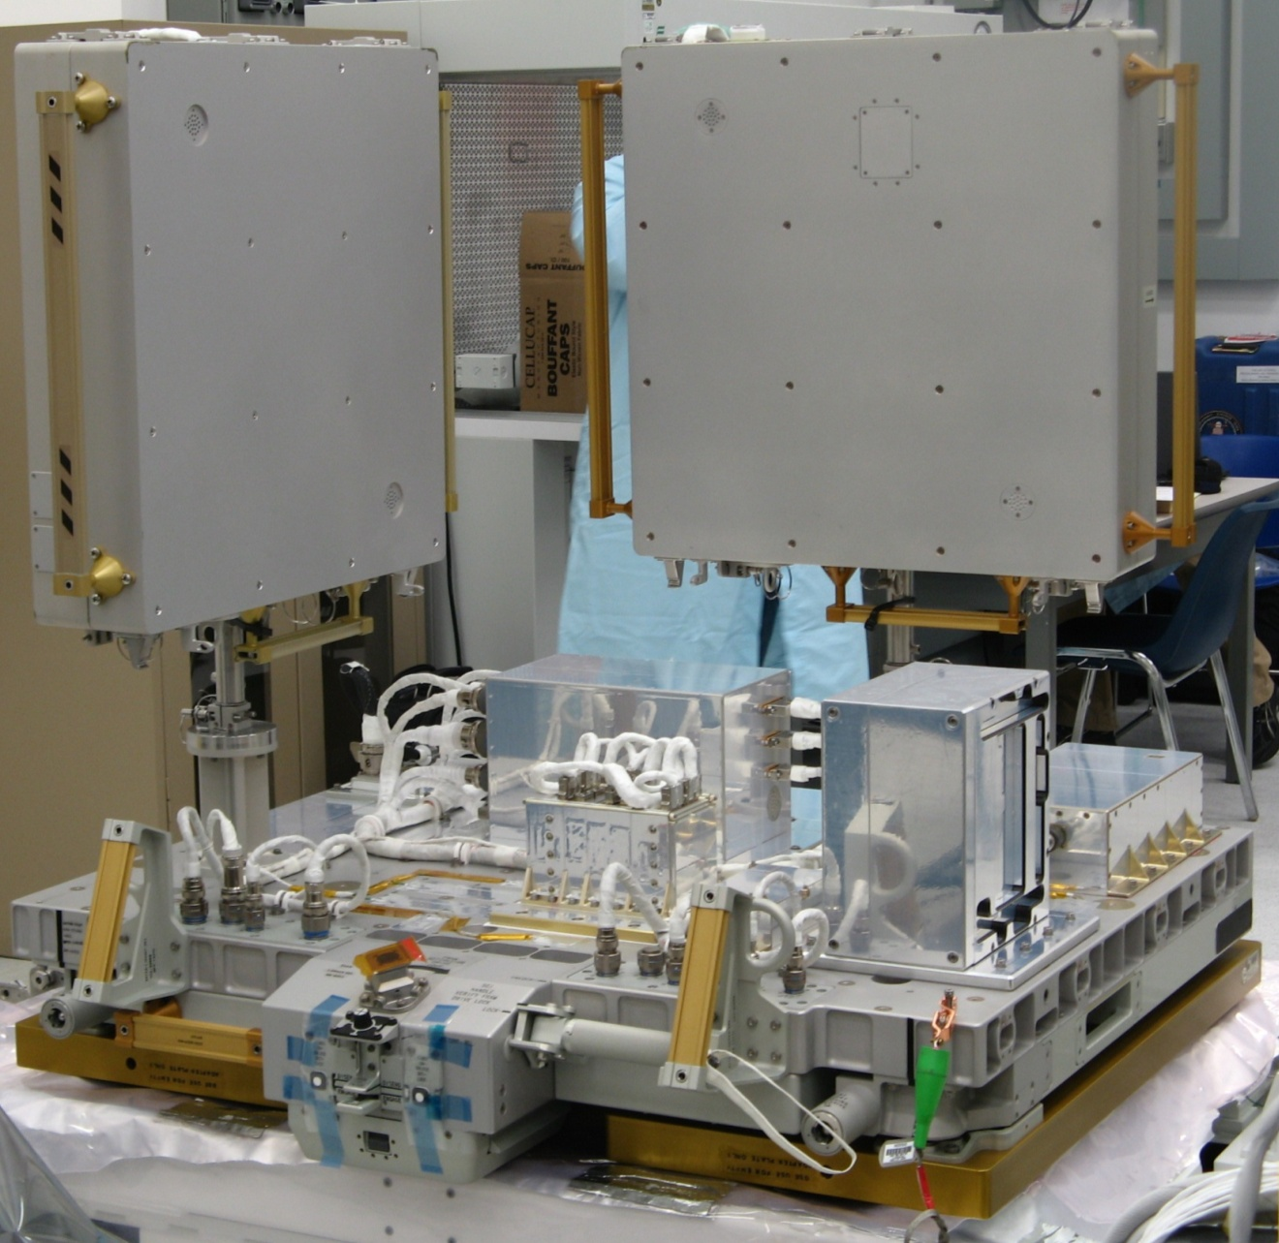
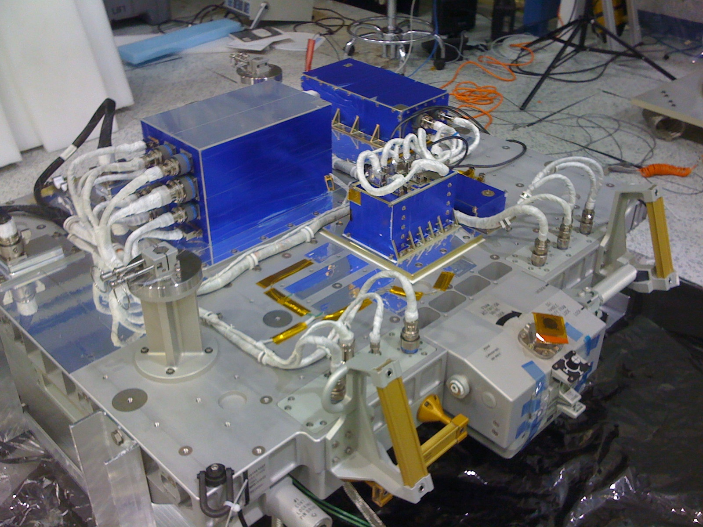
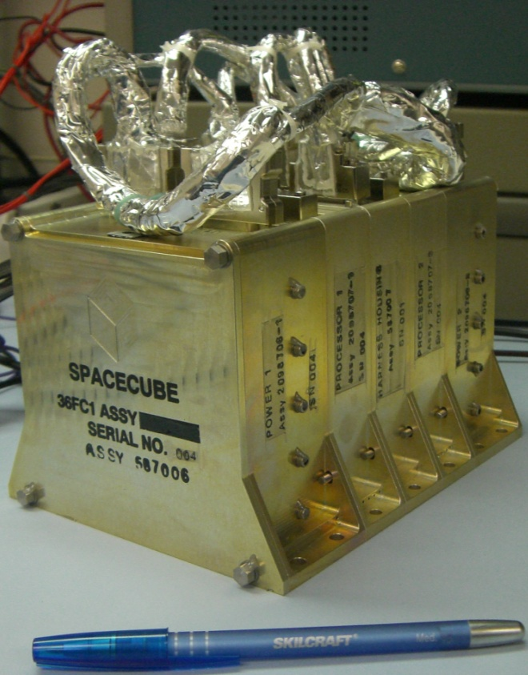
MISSE-7 SpaceCube
Flight spare SpaceCube from HST SM4, STS-125
Re-engineered box for MISSE-7/ELC interface
Built adapter plate, custom harness, new software
Delivered box to NRL in 9 months!
Test bed for radiation mitigation techniques
Start with “Radiation-Hardened by Software”
Supports compressed file uploads
Operations from a laptop
MISSE-7 Express Pallet Integration
MISSE-7 Express Pallet Ready to Fly
Notes:
-Picture of MISSE-7 during integration at NRL, EVA handles
-Our small team took the pieces of the unbuilt flight spare from HST, electrical testing, mechanical integration, lots of new software/FPGA code, and delivered to NRL in 9 months on a shoe-string budget
-proven very reliable on the MISSE-7 pallet
-compressed file uploads

Slide 6
MISSE-7 SpaceCube Block Diagrams
MISSE-7
ISS
ELC
Avionics
Power 1
Comm Interface
Processor 1
MISSE-7
New Interfaces
Power
New Comm/Power Adapter
Video Interface (STS-125)
CMD/TLM
SpaceCube
Other Experiments
Processor 2
New Interfaces
GROUND
Power 2
Notes:
-comm box supports ~20 experiments
-SpaceCube setup as 2 experiments
-Center Slice: Custom card, SWAP OUT for new function
-new adapter slice connects power/comm to both processor cards

Slide 7
MISSE-7 SpaceCube Block Diagrams
TMR SCRUBBER
PLB_0
CODE BRAM
Processor Card
Xilinx 1
CMD_TLM BRAM
Spare PPC_1
Aeroflex
DCM
PPC
CDH App
RHBS App
FPGA Cores
8-bit uP
H/S App
RHBS App
RedundantDCM
MAIN CDH PPC_0
PLB_1
Data In
GPIO
Data Out
BOOT BRAM
DCM RST/STAT
FPGA Cores
RedundantDCM
Xilinx 2
SDRAM
PLB_2
PPC
CDH App
RHBS App
FPGA Cores
CIB UART
MicroBlaze
PIC USRT
CMD_TLM BRAM
CODE BRAM
Notes:
-Each Xilinx identical, run a CDH task and RHBS task on canned data
-send data to 8-bit uP in Aeroflex, supports different voting modes
-H/S = Health and Safety
-High-level FPGA diagram
-dropped in extra processors to get more data
-EDAC SDRAM core

Slide 8
MISSE-7 SpaceCube Future Work
Enjoy the Space Shuttle launch!!
Conduct ops and analyze radiation data
Improve RHBS algorithms and incorporate OS
Collaboration with industry partners and universities
Upload improved FPGA/SW designs
Notes:
-Have a task to improve on algorithms, test on ground, then upload

Slide 9
SpaceCube 1.5 Overview
SpaceCube 1.5 Processor Card
Collaboration with DoD Operationally Responsive Space (ORS)
COTS components
Targets small-scale, responsive missions
Short-duration suborbital, near-space, and orbital flights
Features inherited from SpaceCube 1.0
4” x 4” Form-Factor
Stackable Architecture
Legacy flight interfaces (RS-422/LVDS)
Power card compatibility
Bridge to SpaceCube 2.0
Transition to Xilinx Virtex-5 FPGA
“Plug and Play” Gigabit interfaces (SATA, Ethernet)
High-speed DDR2 SDRAM memories
Notes:
-ORS has a list of objectives
-Incorporate new version of SpaceCube to help meet these objectives
-Reconfigurability and size is most appealing
-same form-factor → 1.0 and 1.5 are stackable

Slide 10
SpaceCube 1.5: Processor Card
Notes:
-Block diagram
-4 Gigabit connections, 32 A/D channels
-20 differential interfaces, ~40 single-ended

Slide 11
SpaceCube 1.5: SMART/ORS
Small Rocket/Spacecraft Technologies (SMART)
Joint program between NASA and ORS
Objectives
Develop faster, leaner, and more efficient approach to space flight
Maturation of miniaturized avionics for small launch vehicles, flight safety, and spacecraft applications
Reconfigurable payload structure for accommodating various subsystems
Demonstration of technologies applicable to future rocket balloon flights
Series of sounding rocket flights
First launch: Summer 2010 on a Terrier Improved-Orion sounding rocket
Micro-satellite platform with SpaceCube 1.5 as payload avionics
Ingest data from
RocketCam
2 x GigE Industrial Cameras
Inertial Measurement Unit (IMU)
GPS
Sensors (pressure, thermal, acceleration)
Cameras validate interfaces and document flight and deployment of parachute
Record data telemetry on two commercial SATA Solid State Drives (SSD)
Downlink reduced telemetry through transponder (10Mb/s)
Notes:
-SMART is our first sounding rocket mission
-List of objectives set forth by ORS
-SpaceCube 1.5 will control all satellite instruments
-Record our video and telemetry on two SATA drives
-also downlink images/telemetry to ground station

Slide 12
SMART System
SpaceCube 1.5
in sounding rocket payload
Notes:
-Block diagram of SMART system and high-level FPGA design
-Mechanical cut-out showing SpaceCube in SMART payload

Slide 13
SpaceCube 1.5 Status
Challenges:
Small Form Factor requires careful device selection and constrains I/O resources
Finding SATA solution (chose SATA IP Core)
Improvements:
Compact/Rugged gigabit connectors capable of meeting ALL SATA specifications
Status:
Completing schematic phase, initiating layout phase
FPGA/Software implementation of key interfaces proceeding on development boards
Notes:
-Tough to find a small, rugged connector that would meet all of our requirements
-Integration and Test of most instruments in the lab

Slide 14
SpaceCube 2.0 Overview
cPCI / SATA / PCIe
Power Card
SpaceCube2 Processor Card
Memory Card
Mission Unique
Mission Unique
Flight Processor Comparison
Mission Unique High-speed
MIPS
Cost
Power
MIPS/W
MIL-STD-1750A
3
-
15W
0.2
RAD6000
35
$250K
10-20W
2.33¹
RAD750
< 500
$200K
10-20W
30²
Notes:
1 – typical, 35 MIPS at 15 watts
2 – typical, 450 MIPS at 15 watts
3 – 3000 MIPS at 7.5 watts (measured)
4 – 5000 MIPS at 10 watts (calculated)
SpaceCube 1.0
3000
$60K
5-15W
400³
SpaceCube 2.0
5000
$75K
10-20W
500⁴
Notes:
-simple block diagram
-comparison chart
-SC2.0 low cost for what you get. Reconfigurable, plug-n-play interfaces.

Slide 15
SpaceCube 2.0 Processor Interfaces
SpaceCube 2.0 Processor
cPCI
LEON 3FT
LVDS/SpaceWire
SATA
2.0 GB FLASH
Ethernet
SIRF Virtex 5 FX130T
Multi-Gbps Transceivers
2.0 GB RAM
Multi-Gbps Transceivers
PCIe/x8
SIRF Virtex 5 FX130T
I2C/CAN/GPIO
JTAG/Serial Debug
Notes:
-High-level diagram of processor card
-Based on SIRF chip from Xilinx
-Plug-n-play interfaces

Slide 16
SpaceCube 2.0 Development Paths
RNS Cube
-Lessons Learned
-Flight Heritage
ISS Cube
-Radiation Results
-Years of Ops
Rocket Cube
-Xilinx V5FX Design
-Gigabit Interfaces
Xilinx SIRF Chip
- SEE Immune Reconfigurable FPGA
- XRTC participation
SpaceCube 2.0 Processor
Based on cPCI form factor
LEON 3FT Rad-Hard Processor
GBs of memory
2x logic of SC1.0
More I/O including gigabit capability
Apprx 2-lbs, 10-W
Leveraging Other Work
Instrument data processing
Industry/Univ SC1.0 users
Main Goals:
Retain processing power of SpaceCube 1.0
Add gigabit interfaces
Improving overall reliability
Notes:
-Little bit of flight heritage
-use radiation results from MISSE7
-SC1.5 using V5/gigabit interfaces
-Numerous IRADs using SpaceCube for data processing (RADAR, LIDAR, Hyperspectral)

Slide 17
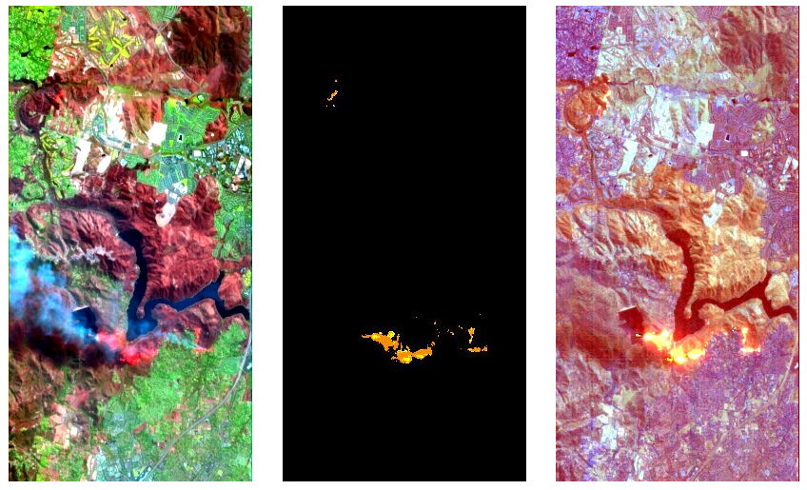
SpaceCube On-Board Data Processing
On-Board HyperSpectral Data Processing IRAD --- Left: California Wildfire Scene, Center: On-Board Wildfire Detection and Temperature Characterization, Right: On-Board Product Generation for Direct Downlink to Emergency Services Personnel
Notes:
-Example of what SC2.0 would be used for
-Scientists like the idea of getting more of their data down to the ground, which require on-board processing
-Many IRADs w/ science instruments to prove these techniques

