Slide 1

SpaceCube:
Current Missions and
Ongoing Platform Advancements
Dave Petrick
NASA/GSFC
Code 587
9/3/2009
NOTE: Handout Version

Slide 2
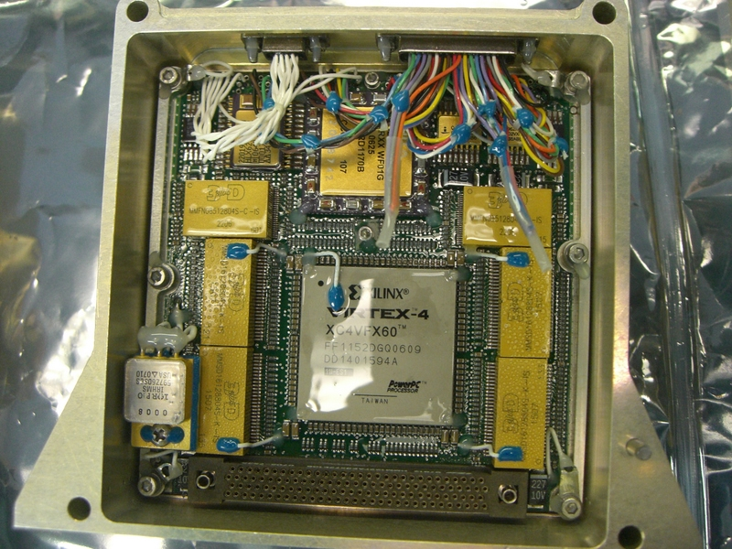
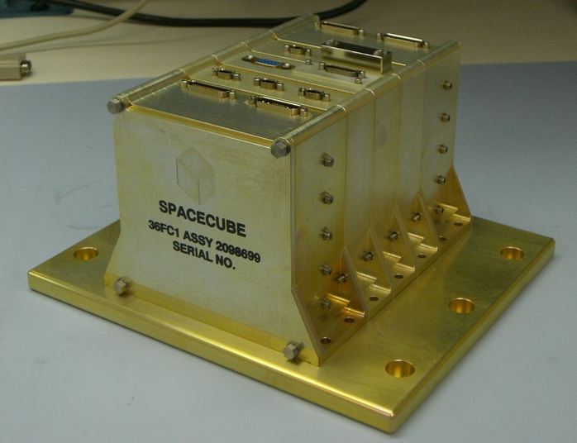
GSFC SpaceCube
Small, light-weight, reconfigurable multi-processor platform for space flight applications demanding extreme processing capabilities
Stackable architecture
Based on Xilinx Virtex 4 FX60 FPGAs, 2 per processor card
Successful flight demonstration on STS-125
Processor Card
Flight Box
2 Xilinx FPGAs, 2 Aeroflex FPGAs
1GB SDRAM, 1GB Flash
Mechanical: 7.5-lbs, 5”x5”x7”
Power: 37W (STS-125 Application)

Slide 3
Current Tasks
SpaceCube 1.0: RNS flight spare to ISS (Nov 09)
  Platform for testing radiation mitigation techniques starting with Rad-Hard by Software (RHBS)
  Collaborating with industry and universities
SpaceCube 1.5: Sounding Rocket Avionics
  DoD Operationally Responsive Space payload funding
  Feature Xilinx Virtex 5 FX100 with gigabit interfaces
SpaceCube 2.0: Increased performance over SC1.X
  ESTO funding → Prototype FY10, Engineering Unit FY12
  For missions requiring high data rates and/or onboard science data processing

Slide 4
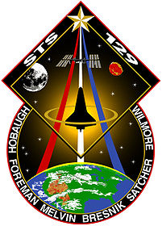
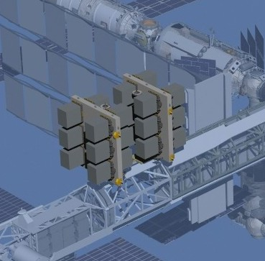
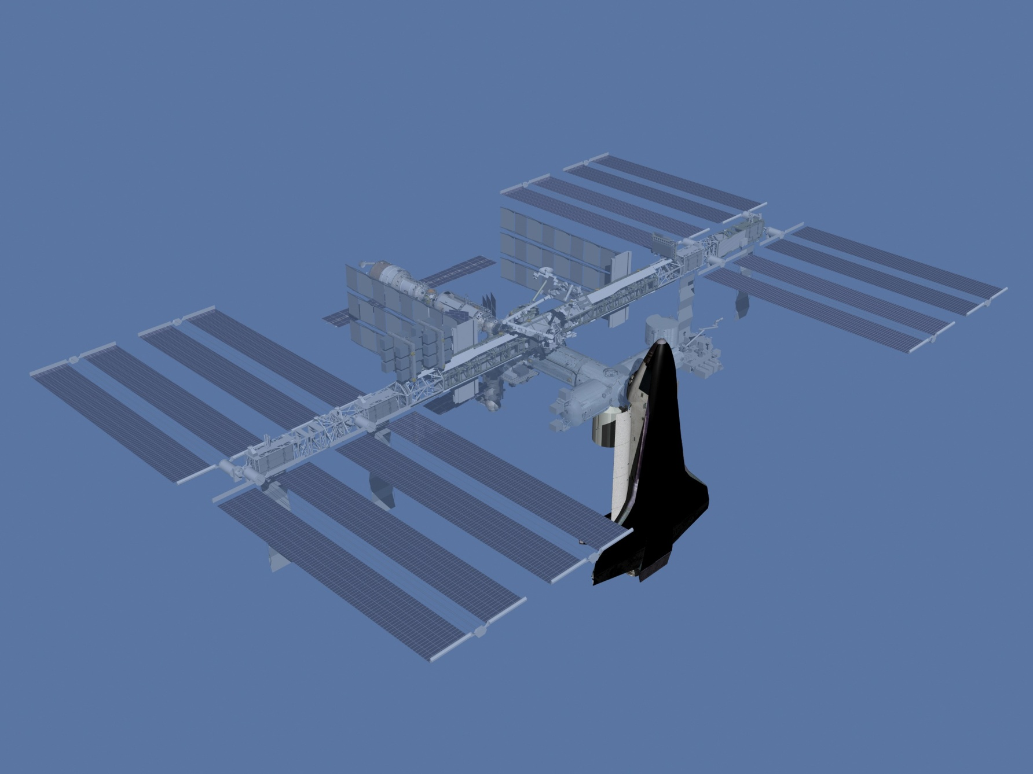
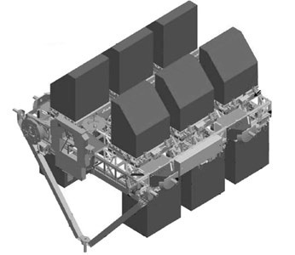
MISSE-7 Overview
Materials International Space Station Experiment
Payload Lead: Naval Research Lab
STS-129 Shuttle Atlantis, November 12, 2009
MISSE-7
Notes:
http://commons.wikimedia.org/wiki/Category:Diagrams_of_the_International_Space_Station

Slide 5
MISSE-7 SpaceCube
Flight spare SpaceCube from HST SM4, STS-125
  Re-engineered box for MISSE-7/ELC interface
  Built adapter plate, custom harness, new software
  Delivered box to NRL in 9 months!
Test bed for radiation mitigation techniques
  Start with “Radiation-Hardened by Software”
Supports compressed file uploads
Operations from a laptop

Slide 6
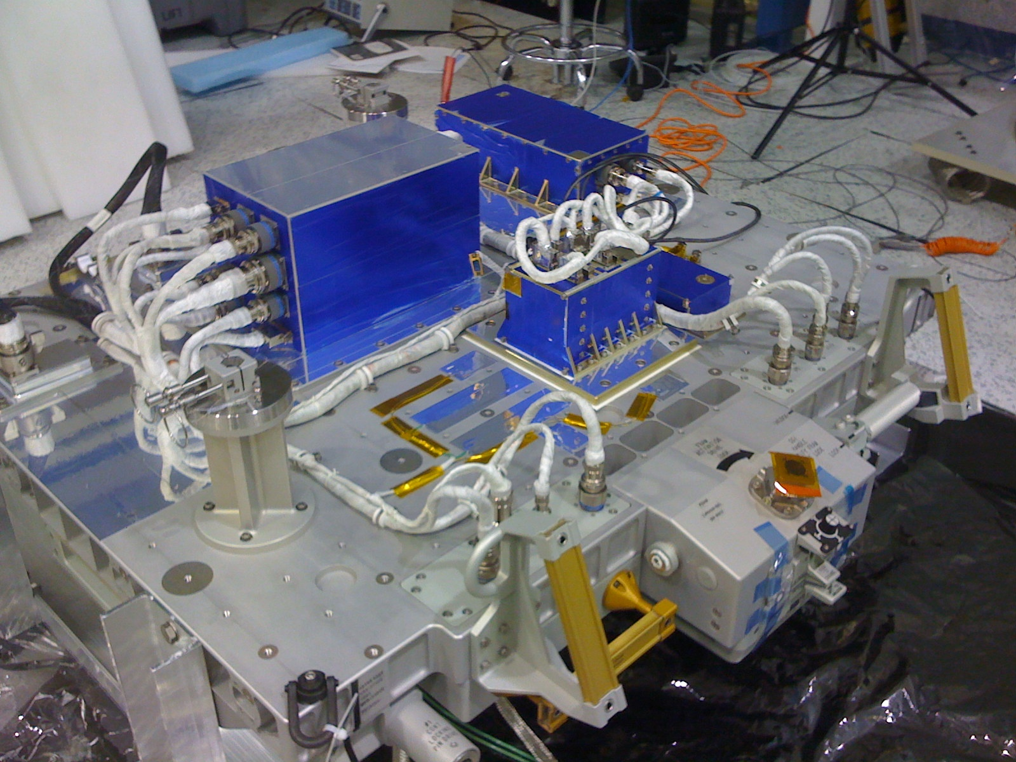
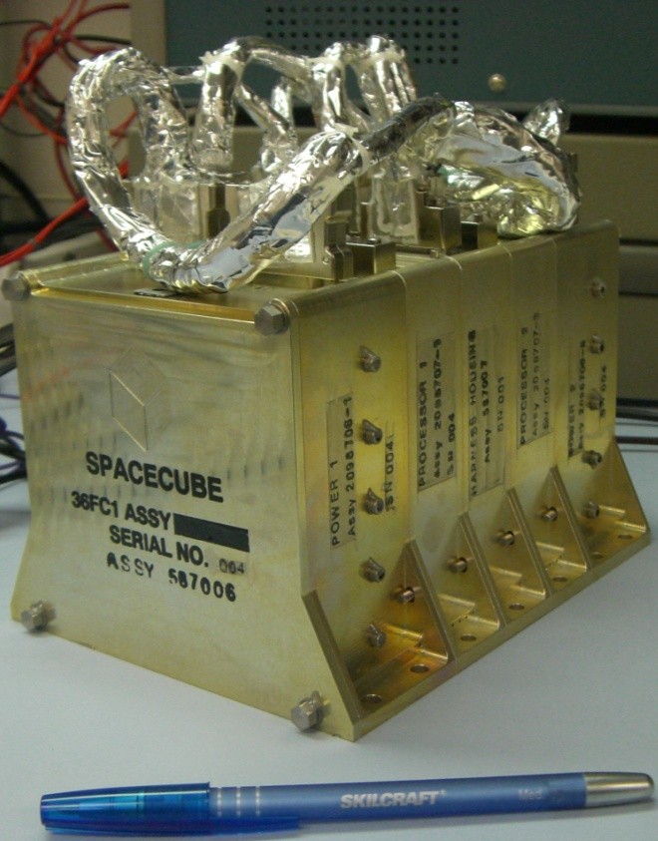
MISSE-7 SpaceCube
MISSE-7 Express Pallet Integration

Slide 7
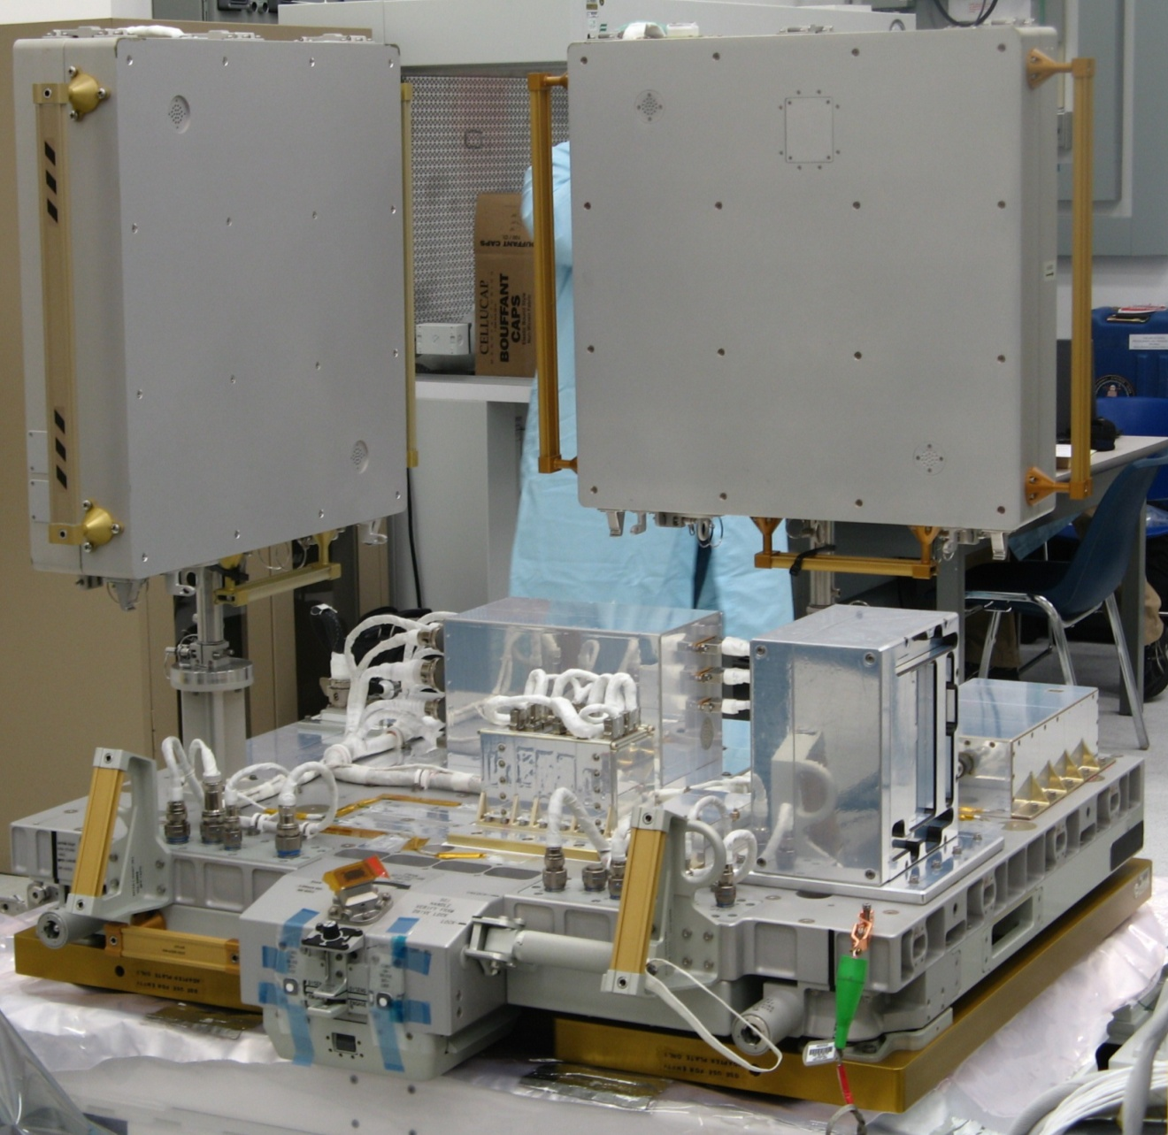
MISSE-7 SpaceCube
MISSE-7 Express Pallet Ready to Fly

Slide 8
MISSE-7 SpaceCube Block Diagrams
MISSE-7
ISS
ELC
Avionics
Comm Interface
SpaceCube
Other Experiments
GROUND

Slide 9
MISSE-7 SpaceCube Block Diagrams
Power 1
Processor 1
MISSE-7
New Interfaces
Power
Video Interface (STS-125)
New Comm/Power Adapter
CMD/TLM
Processor 2
New Interfaces
Power 2

Slide 10
MISSE-7 SpaceCube Block Diagrams
Processor Card
Xilinx 1
Aeroflex
PPC
CDH App
RHBS App
FPGA Cores
8-bit uP
H/S App
RHBS App
Data In
Data Out
FPGA Cores
Xilinx 2
PPC
CDH App
RHBS App
FPGA Cores

Slide 11
MISSE-7 SpaceCube Block Diagrams
TMR SCRUBBER
PLB_0
CODE BRAM
CMD_TLM BRAM
Spare PPC_1
DCM
PLB_1
RedundantDCM
MAIN CDH PPC_0
GPIO
BOOT BRAM
DCM RST/STAT
RedundantDCM
SDRAM
PLB_2
CIB UART
MicroBlaze
PIC USRT
CMD_TLM BRAM
CODE BRAM

Slide 12
MISSE-7 SpaceCube Future Work
Enjoy the Space Shuttle launch!!
Conduct ops and analyze radiation data
Improve RHBS algorithms and incorporate OS
Collaboration with industry partners and universities
Upload improved FPGA/SW designs

Slide 13
SpaceCube 1.5 Overview
SpaceCube 1.5 Processor Card
  Collaboration with DoD Operationally Responsive Space (ORS)
  COTS components
    Targets small-scale, responsive
    Short-duration suborbital, near-space, and orbital flights
  Features inherited from SpaceCube 1.0
    4” x 4” Form-Factor
    Stackable Architecture
    Legacy flight interfaces (RS-422/LVDS)
    Power card compatibility
  Bridge to SpaceCube 2.0
    Transition to Xilinx Virtex-5 FPGA / PowerPC 440
    “Plug and Play” Gigabit interfaces (SATA, Ethernet)
    High-speed DDR2 SDRAM memories

Slide 14
SpaceCube 1.5: Processor Card

Slide 15
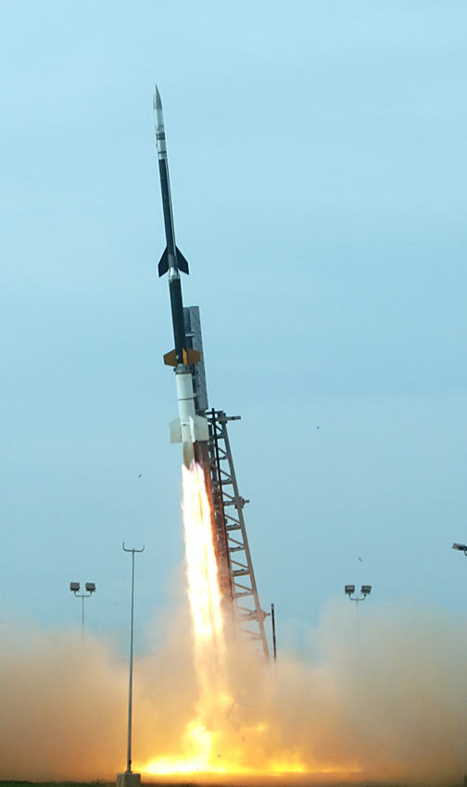
SpaceCube 1.5: SMART/ORS
Small Rocket/Spacecraft Technologies (SMART)
  Joint program between NASA and ORS
Objectives
  Develop faster, leaner, and more efficient approach to space flight
  Maturation of miniaturized avionics for small launch vehicles, flight safety, and spacecraft applications
  Reconfigurable payload structure for accommodating various subsystems
  Demonstration of technologies applicable to future rocket balloon flights
Series of sounding rocket flights
  First launch: Summer 2010 on a Terrier Improved-Orion sounding rocket
Micro-satellite platform with SpaceCube 1.5 as payload avionics
  Ingest data from
    RocketCam
    2 x GigE Industrial Cameras
    Inertial Measurement Unit (IMU)
    GPS
    Sensors (pressure, thermal, acceleration)
  Cameras validate interfaces and document flight and deployment of parachute
  Record data telemetry on two commercial SATA Solid State Drives (SSD)
  Downlink reduced telemetry through transponder (10Mb/s)

Slide 16
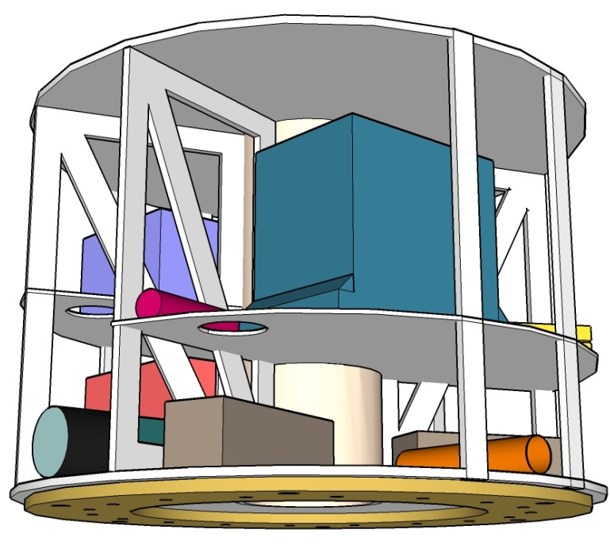
SMART System
SpaceCube 1.5
in sounding rocket payload

Slide 17
SpaceCube 1.5: Status & Future Work
Challenges:
  Small Form Factor requires careful device selection and constrains I/O resources
  Finding SATA solution (chose SATA IP Core)
Improvements:
  Compact/Rugged gigabit connectors capable of meeting ALL SATA specifications
Status:
  Completing schematic phase, initiating layout phase
  FPGA/Software implementation of key interfaces proceeding on development boards

Slide 18
SpaceCube 2.0 Overview
cPCI / SATA / PCIe
Power Card
SpaceCube2 Processor Card
Memory Card
Mission Unique
Mission Unique
Mission Unique High-speed
Flight Processor Comparison
MIPS
Cost
Power
MIPS/W
MIL-STD-1750A
3
-
15W
0.2
RAD6000
35
$250K
10-20W
2.33¹
RAD750
< 500
$200K
10-20W
30²
Notes:
1 – typical, 35 MIPS at 15 watts
2 – typical, 450 MIPS at 15 watts
3 – 3000 MIPS at 7.5 watts (measured)
4 – 5000 MIPS at 10 watts (calculated)
SpaceCube 1.0
3000
$60K
5-15W
400³
SpaceCube 2.0
5000
$75K
10-20W
500⁴

Slide 19
SpaceCube 2.0 Processor Interfaces
SpaceCube 2.0 Processor
cPCI
LEON 3FT
LVDS/SpaceWire
SATA
2.0 GB FLASH
Ethernet
SIRF Virtex 5 FX130T
Multi-Gbps Transceivers
2.0 GB RAM
Multi-Gbps Transceivers
PCIe/x8
SIRF Virtex 5 FX130T
I2C/CAN/GPIO
JTAG/Serial Debug

Slide 20
SpaceCube 2.0 Development Paths
RNS Cube
-Lessons Learned
-Flight Heritage
ISS Cube
-Radiation Results
-Years of Ops
Rocket Cube
-Xilinx V5FX Design
-Gigabit Interfaces
Xilinx SIRF Chip
- SEE Immune Reconfigurable FPGA
- XRTC participation
SpaceCube 2.0 Processor
Based on cPCI form factor
LEON 3FT Rad-Hard Processor
GBs of memory
4x 450-MHz PowerPC, 2x logic of SC1.0
More I/O including gigabit capability
Apprx 2-lbs, 10-W
Leveraging Other Work
Instrument data processing
Industry/Univ SC1.0 users
Main Goals:
Retain processing power of SpaceCube 1.0
Add gigabit interfaces
Improving overall reliability
Notes:
Mention numerous in-house IRADs involving science instruments, interfacing and on-board processing

Slide 21
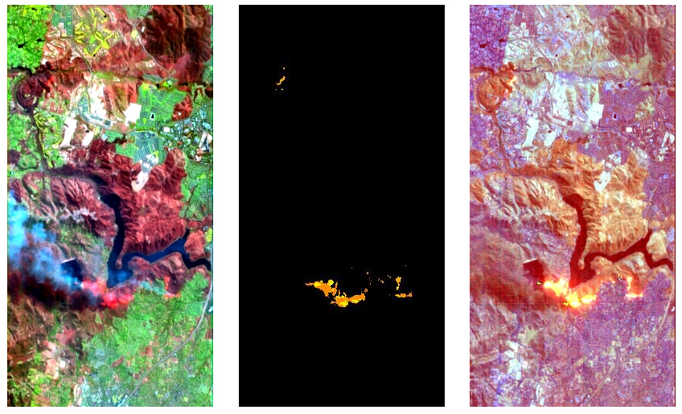
SpaceCube On-Board Data Processing
On-Board HyperSpectral Data Processing IRAD --- Left: California Wildfire Scene, Center: On-Board Wildfire Detection and Temperature Characterization, Right: On-Board Product Generation for Direct Downlink to Emergency Services Personnel
Notes:
Example of what SC2.0 would be used for
Scientists like the idea of getting more of their data down to the ground, which require on-board processing. Many IRADs w/ science instruments to prove these techniques.

Slide 22
Acronyms
CDH: Command and Data Handling
ELC: Express Logistics Carrier
ESTO: Earth Science Technology Office
FPGA: Field Programmable Gate Array
IRAD: Internal Research and Design
ISS: International Space Station
MISSE: Materials ISS Experiment
NRL: Naval Research Laboratory
ORS: Operationally Responsive Space
OS: Operating System
PCI: Peripheral Component Interconnect
PPC: PowerPC
RHBS: Radiation-Hardened By Software
RNS: Relative Navigation Sensors
SATA: Serial Advanced Technology Attachment
SEE: Single Event Effect
TMR: Triple Module Redundancy

