Slide 1
Application of SpaceCube in a Space Flight System
Dave Petrick
NASA/GSFC
9/1/2009
Notes:
-A payload on the Space Shuttle mission to service the Hubble Space Telescope

Slide 2
SpaceCube Development Team
Mike Lin
Walt Bradley
Dave Petrick
Gordon Seagrave
John Godfrey
Beverly Settles
Tracy Price
Gary Crum
Robin Ripley
Dan Espinosa
Alessandro Geist
Dorian Seagrave
Wayne Greenwood
Frank Cepollina
Tom Flatley
Giri Nadendla
Madhu Kadari
Bo Naasz
Will Clement
Steve Queen
John Vaneepoel
Dwaine Molock
Jane Marquart
Dan Grogan
Clara Hollenhorst
Terecita Mayorga
Varsha Patel
Krystal Kennedy
Miles Newman
Jack Lorenz
Quang Nguyen
Matt Owens
Pietro Sparacino
Darryl Younger
Richard Hicks
Ed Hicks
Steve Judy
GSFC Radiation Group
GSFC Parts Group
Orbital Sciences
Northrup Grumman
Jackson and Tull
Advanced Optical Systems
SEAKR
CRI
Notes:
-Team of a few dozen engineers and supporting contractors at Goddard worked tirelessly for 3 years to make this happen.
-Took a lot of people
-team to get the box ready for flight delivery

Slide 3
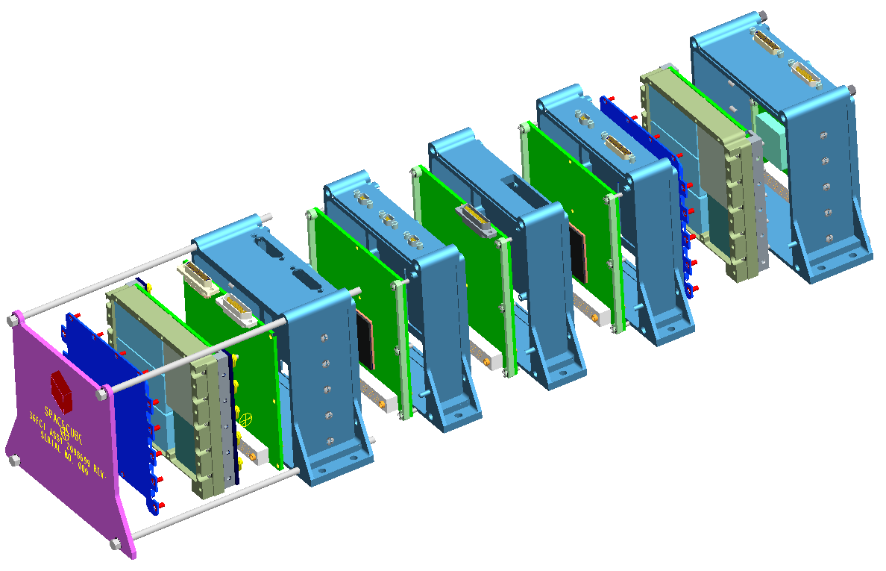
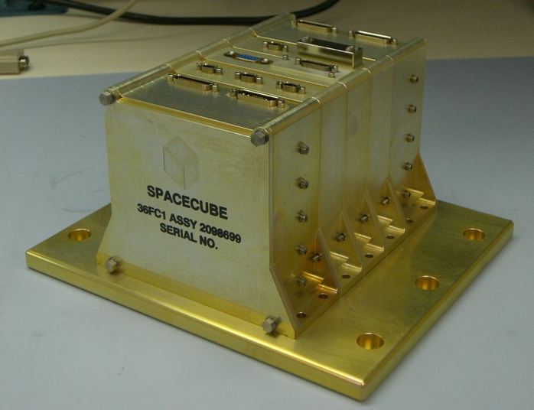
GSFC SpaceCube
Small, light-weight, reconfigurable multi-processor platform for space flight applications demanding extreme processing capabilities
Based on Xilinx Virtex 4 FX60 FPGAs, 2 per processor card
Stackable architecture
Flight Box
Mechanical: 7.5-lbs, 5”x5”x7”
Power: 37W (HST Application)
Notes:
-Each card has 4 PowerPCs
-Base system is power card and processor card. ~4”x4”x4”
-Stackable → make custom cards → VIM
-27-months from concept to flight delivery. Our team worked extremely hard, building 4 dozen or so cards, prototypes, engineering units, application developers

Slide 4
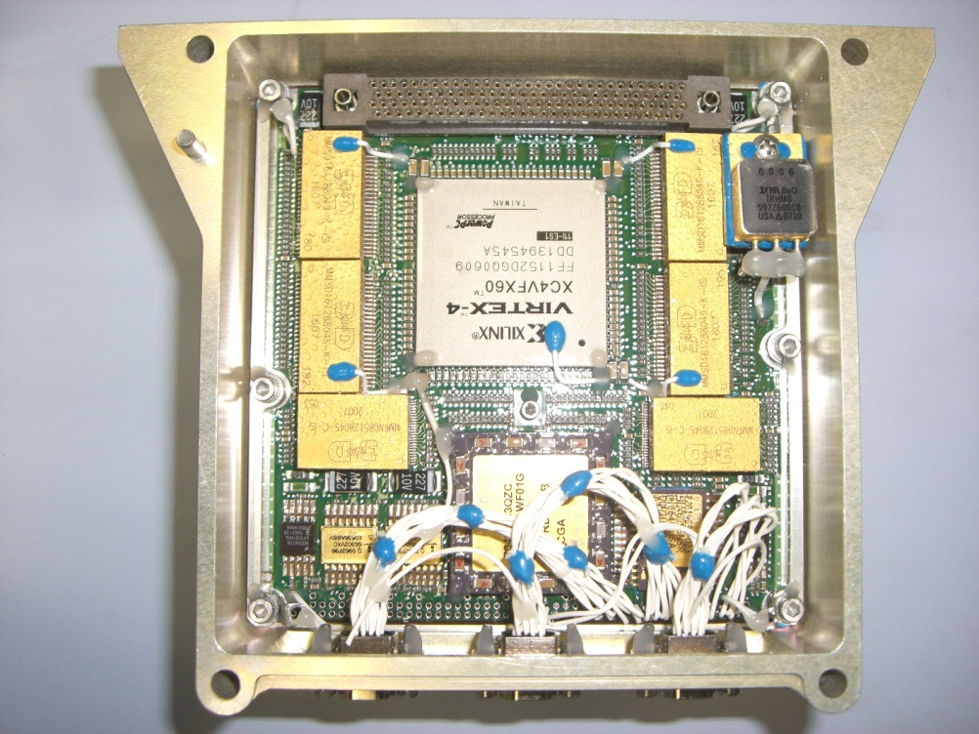
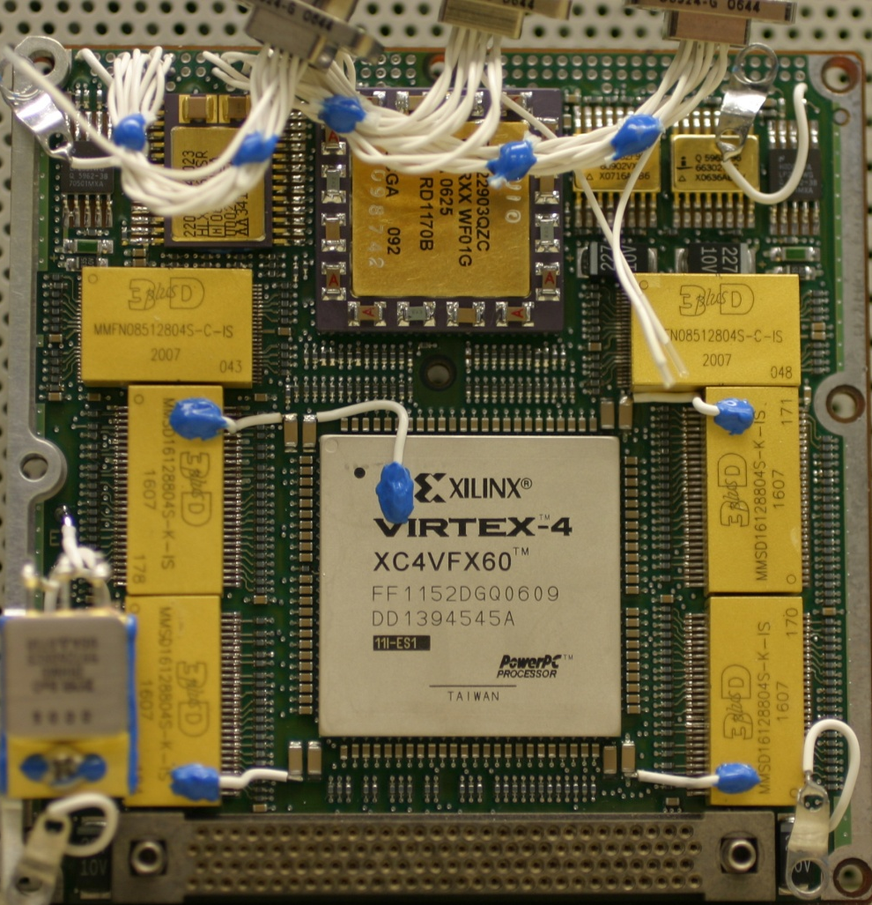
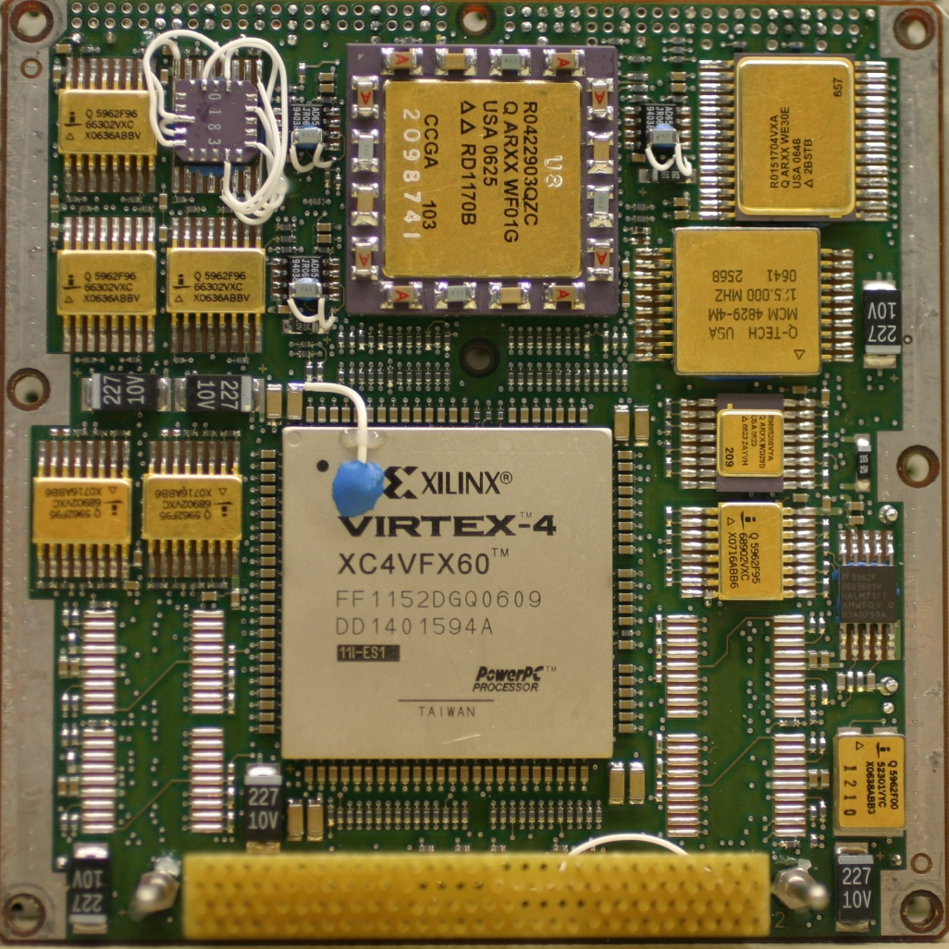
SpaceCube Processor Card
General: 4”x4” card, Back-to-Back FPGAs (x2), 7W typical power
Memory: 1GB SDRAM, 1GB Flash, 16KB SRAM, 16KB PROM
Interfaces: 20 bi-dir differential signals, JTAG
Backplane: Power, 42 single-ended, 8 LVDM, 2 I2C, POR
SDRAM
Diff RX
SDRAM
Diff RX
256MB SDRAM
QuadRX
512MB
FLASH
QuadTX
LVDM
Xilinx
V4FX60
Aeroflex UT6325
LVDM
Xilinx
V4FX60
Aeroflex UT6325
QuadTX
Stacking Connector (122 pin)
LVDM
QuadRX
LVDM
SDRAM
Diff RX
16K
PROM
16KB
SRAM
Diff RX
256MB
SDRAM
QuadRX
QuadTX
Notes:
-Aeroflex: service FPGA for board and Xilinx, 8-bit uP w/ peripherals
-Redundant FPGA/software code in Flash
-Flight boards assembled by SEAKR
-Goal: No green space! Might be able to fit a few more caps

Slide 5
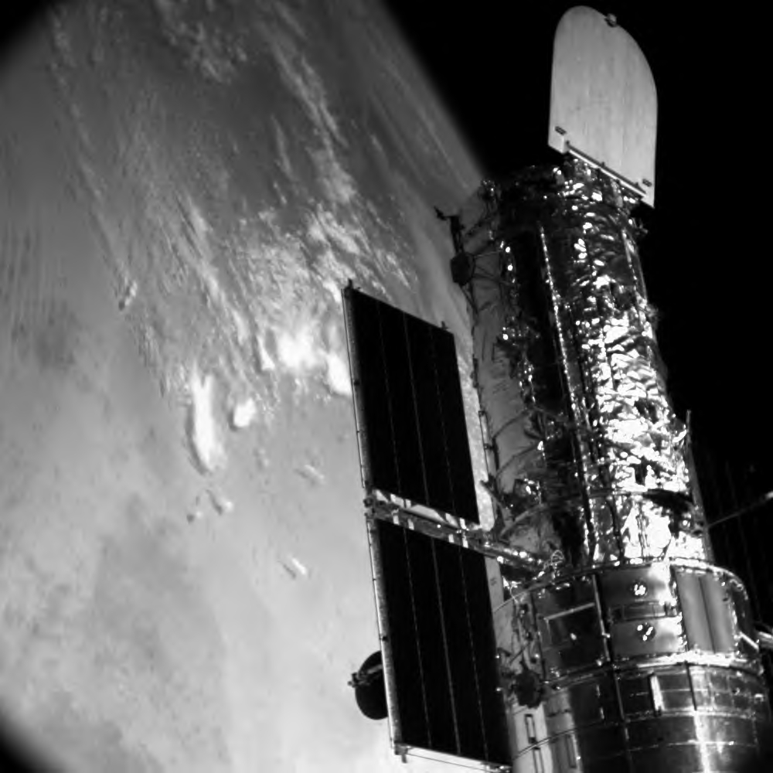
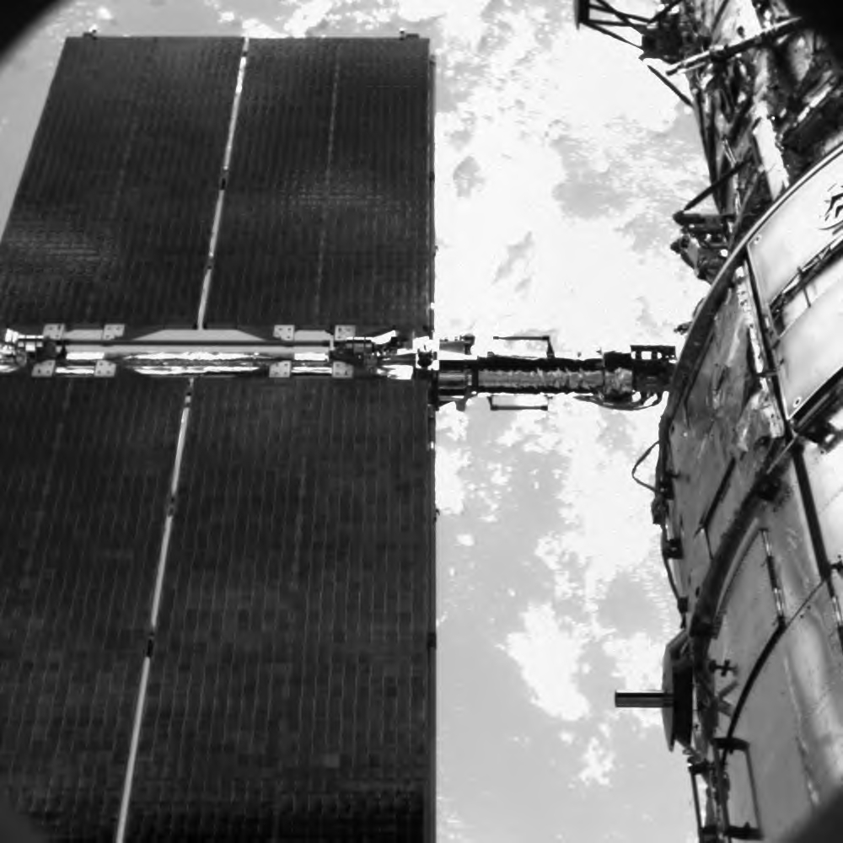
Hubble Servicing Mission 4 (STS-125)
Relative Navigation Sensors (RNS) – HST Payload
Record images of HST during docking and release, in particular the Soft Capture Mechanism
Perform on-orbit position and attitude estimation (Pose)
RNS SpaceCube: Main Avionics Box
Controlled 3 cameras, GPS, 960GB memory, telemetry module, shuttle Ku downlink
Hosted Linux, VxWorks, C&DH, Automatic Gain and Integration Control, 2 pose image processing algorithms, TMR’d self-configuration scrubber using ICAP
Recorded GPS/AGC/POSE flight logs to flash
Consisted of 2 processors, 2 low-voltage power cards, 2 digital control cards, 1 JPEG2000 compression card
Notes:
-SCM docking mechanism, installed during EVA to enable robotic mission
-Teaser images, recorded on board, compressed and sent down to our ground terminal during mission
-RNS had the best seat in the house for viewing the telescope
-SpaceCube: Brain of RNS, various operations, complex system
-POSE: 3D Images tracking using 2D images,
1 developed at GSFC, other delivered from AOS in Huntsville

Slide 6
Relative Navigation Sensors
RNS originated from HST robotic service mission
RNS Hardware
3 1024x1024 cameras
GPS Navigator
SpaceCube
Telemetry Module
Recorder (8 120GB hard drives)
Power Module
Ground Terminal
RNS operations conducted from JSC Space Shuttle Mission Control Center, Houston TX
FPGAs
3
4
11
4
2
0
4
Xilinx | 11
Actel | 11
Aeroflex | 6
TOTAL: 28
Notes:
-Ops: full commanding, record, playback compressed, download raw images at GSFC
-Since this is MAPLD, I should highlight # of FPGAs in the system

Slide 7
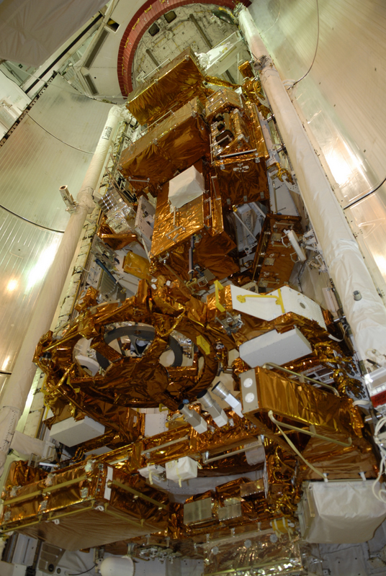
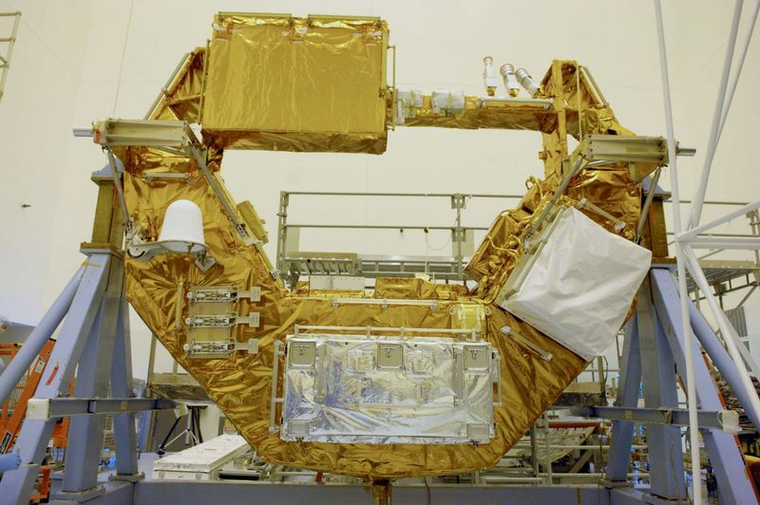
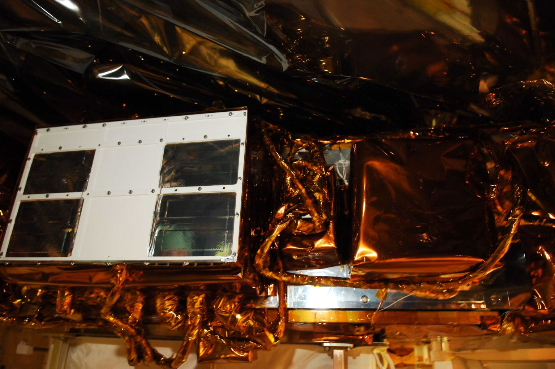
RNS Hardware
MULE Carrier
RNS Avionics Panel
STS-125 Payload Bay
Notes:
-Hardware visible in one of our cleanrooms
-Back of the shuttle, by the docking ring

Slide 8
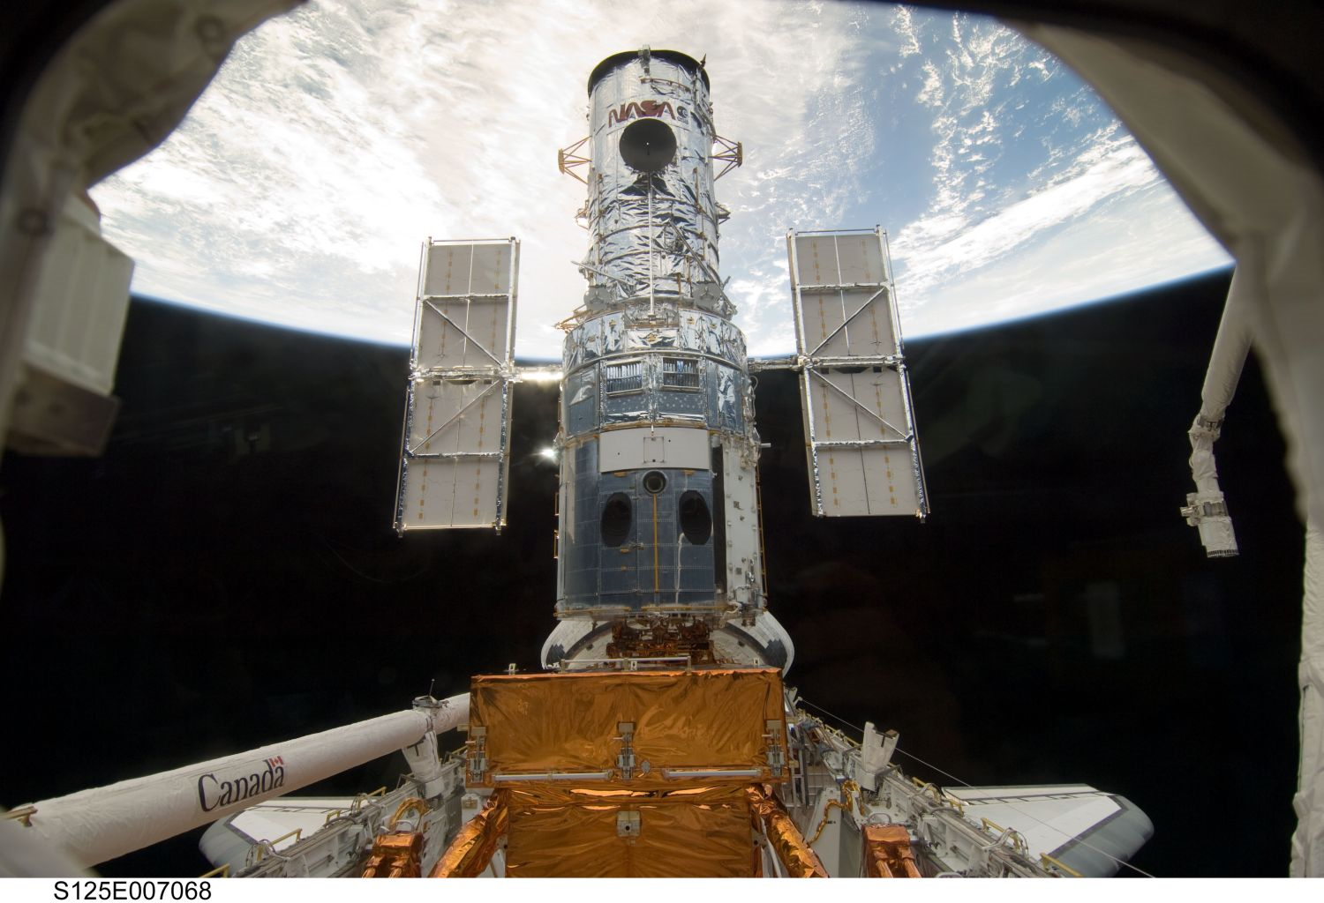
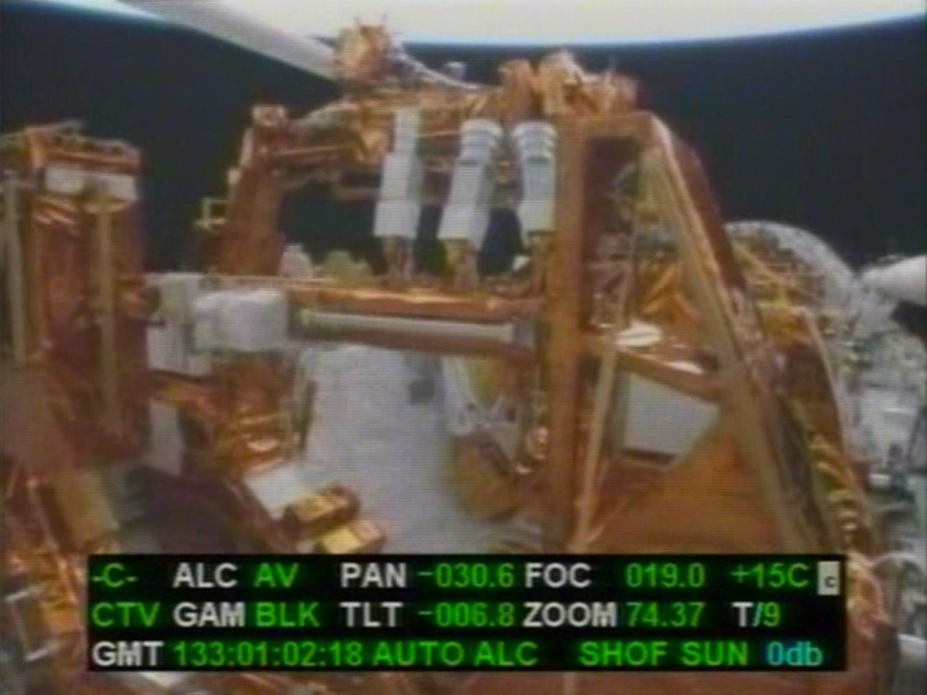
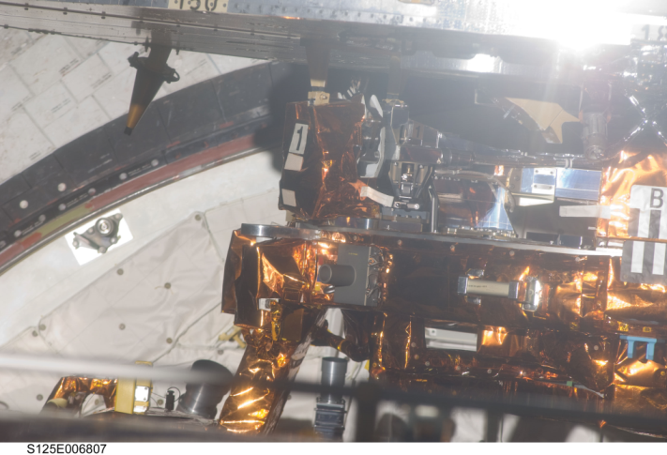
On Orbit
RNS Cameras
Tough to see, but our cameras and SpaceCube are watching
Notes:
-Crew picture
-Payload bay camera during payload surveys

Slide 9
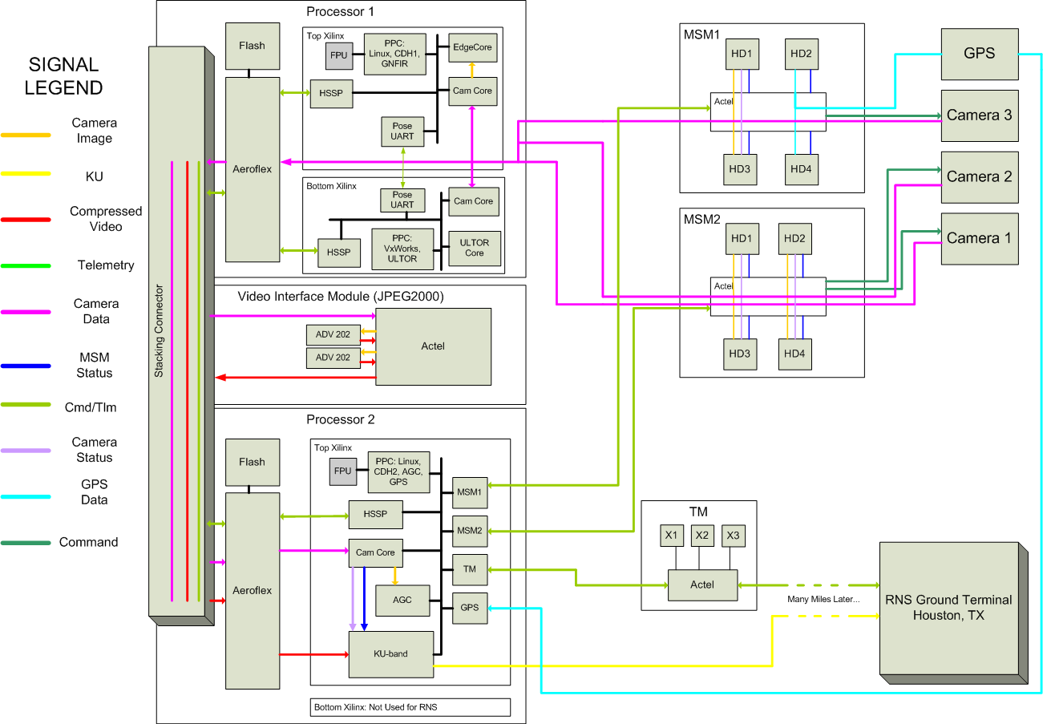
SpaceCube Functional Block Diagram
Notes:
-Lot going on here, SpaceCube on the left
-Showing the various data paths for the system
-Explain camera images:
-Image tracking on Processor 1
-Recorded to HDs
-Compression on VIM, also has recording feature
-AGC on Processor 2, also has KU downlink for playback

Slide 10
Xilinx FPGA Design(s)
Heavy PowerPC usage
Logic: 62.5-125MHz, Processor: 250MHz
Used 3 of 4 Xilinxs at 60-80% resource utilization
High-Level Example Xilinx Design (POSE #1 FPGA on Processor Card 1)
OPB
FPU
FCB
PowerPC
INTC
POSE UART
Debug UART
62.5-MHz USRT
PLB
Self-Scrubber
(XTMR)
Clock/Reset Manager
Camera Core
Edge Core
BRAM
SDRAM
Notes:
-Example FPGA design
-Using hardware Floating Point Unit
-Custom Cores: Cam, Edge (hardware acceleration), USRT
-In this case, POSE UART talked w/ other POSE algorithm, traded solutions
-Internal Scrubbing, watch in telemetry

Slide 11
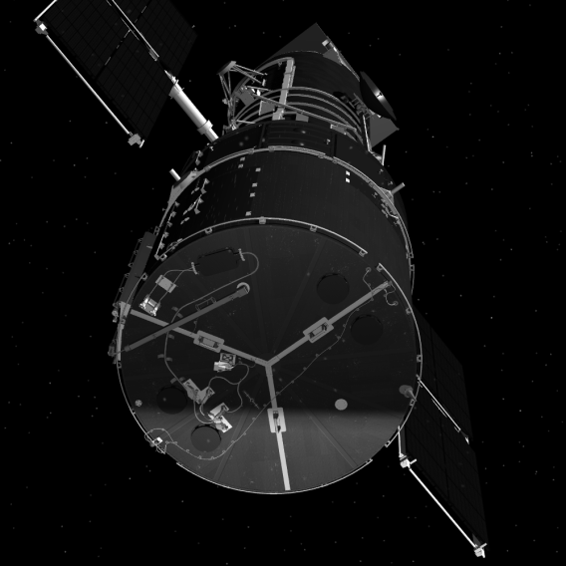
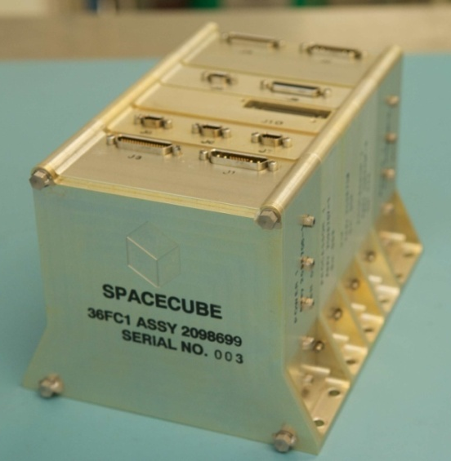
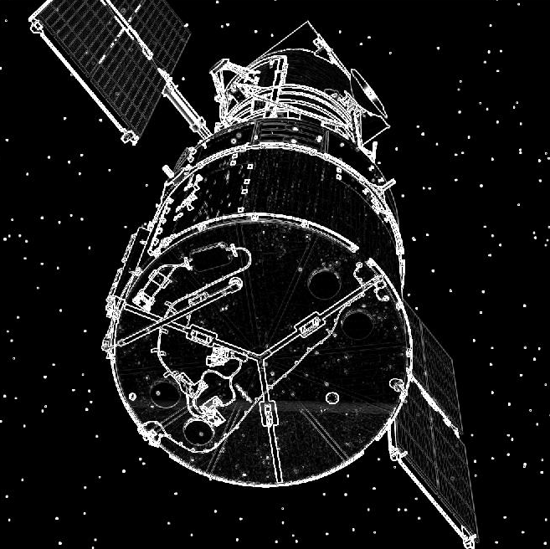
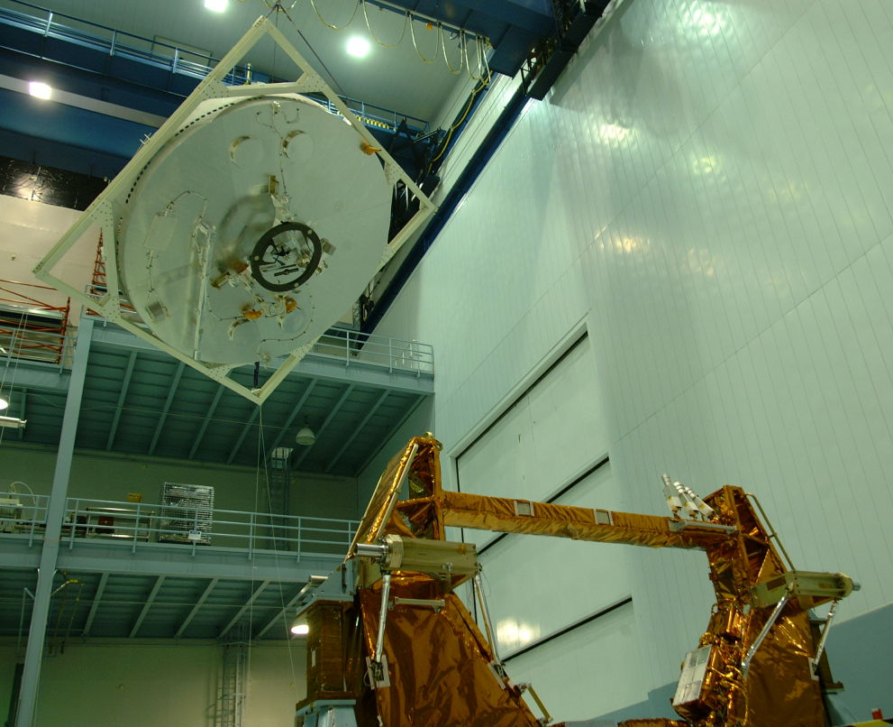
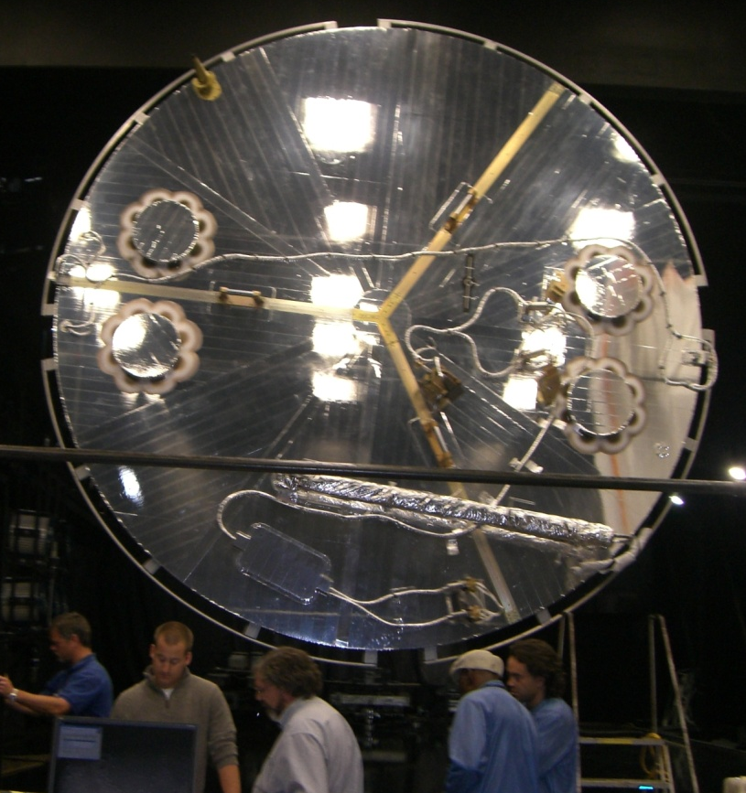
Barrage of System Testing
Simulation
Testing
MSFC Flight Robotics Lab Testing
High Bay Testing
Notes:
-Developers did tremendous amount of simulation testing
-Spent a few months in Alabama testing w/ Engineering RNS system
-Hubble Aft bulk head shown, used 1/10th scale model for rendezvous testing
-Testing w/ flight system in our clean room. SCM installed

Slide 12
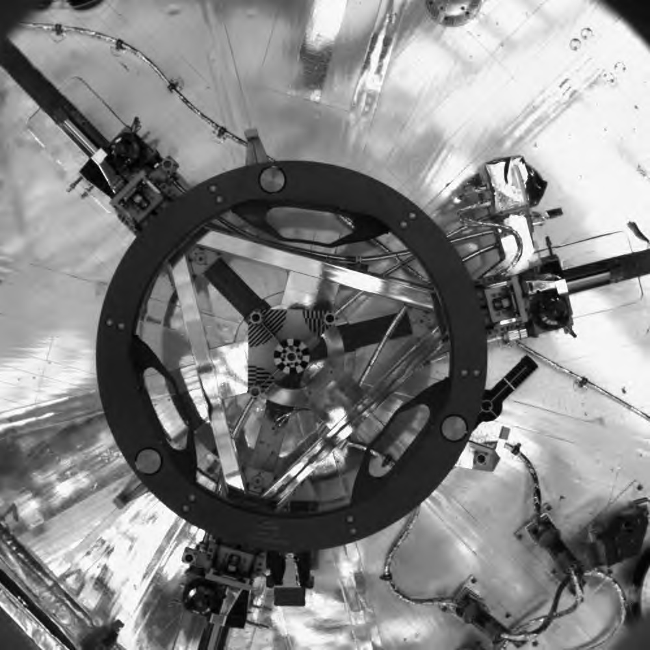
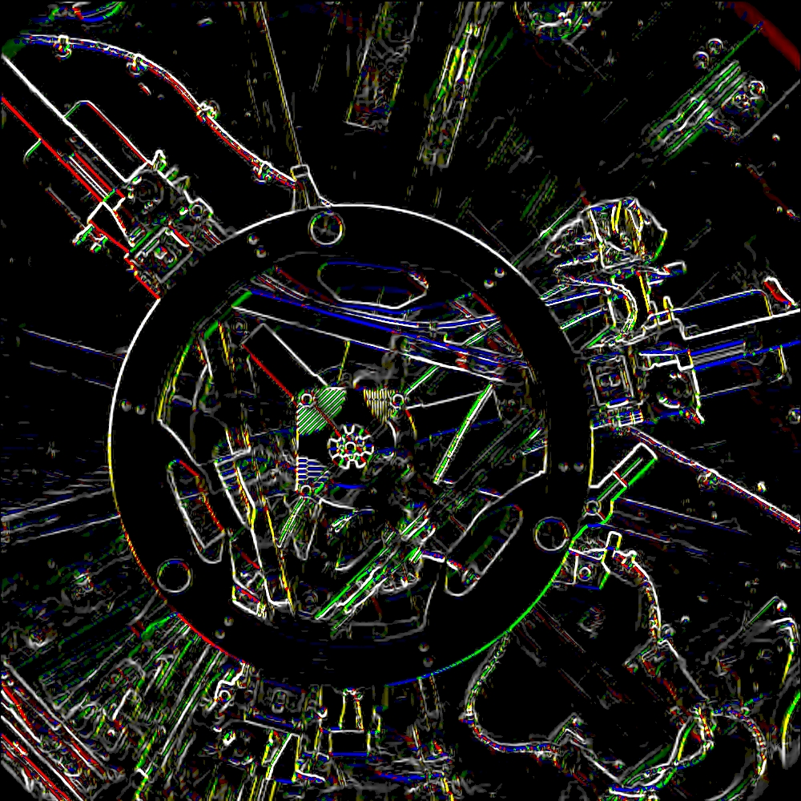
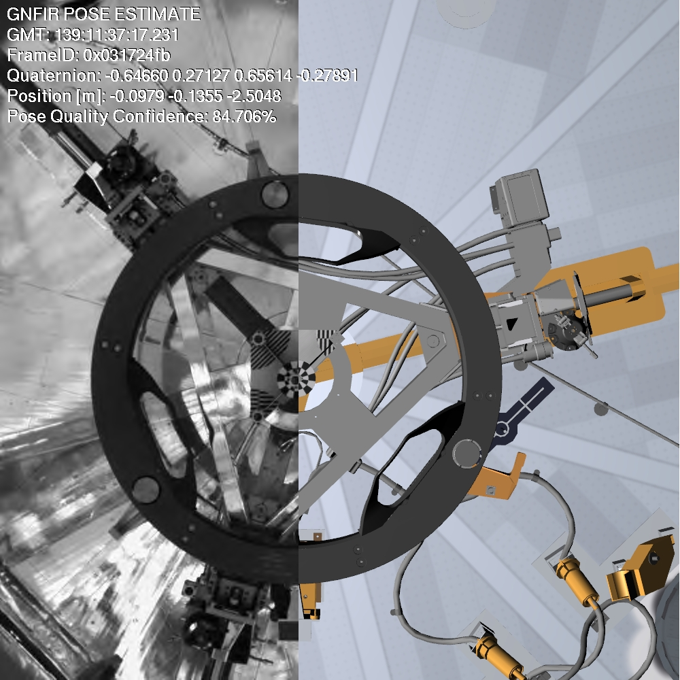
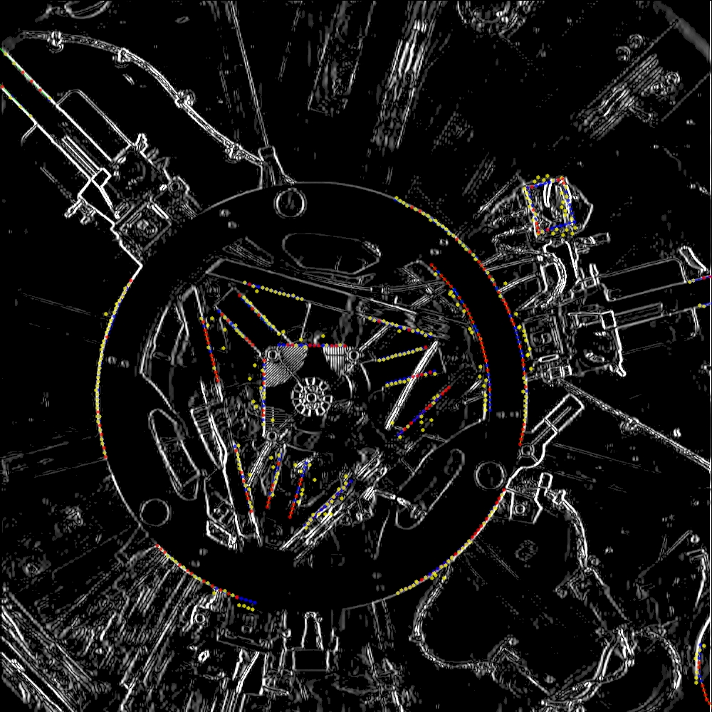
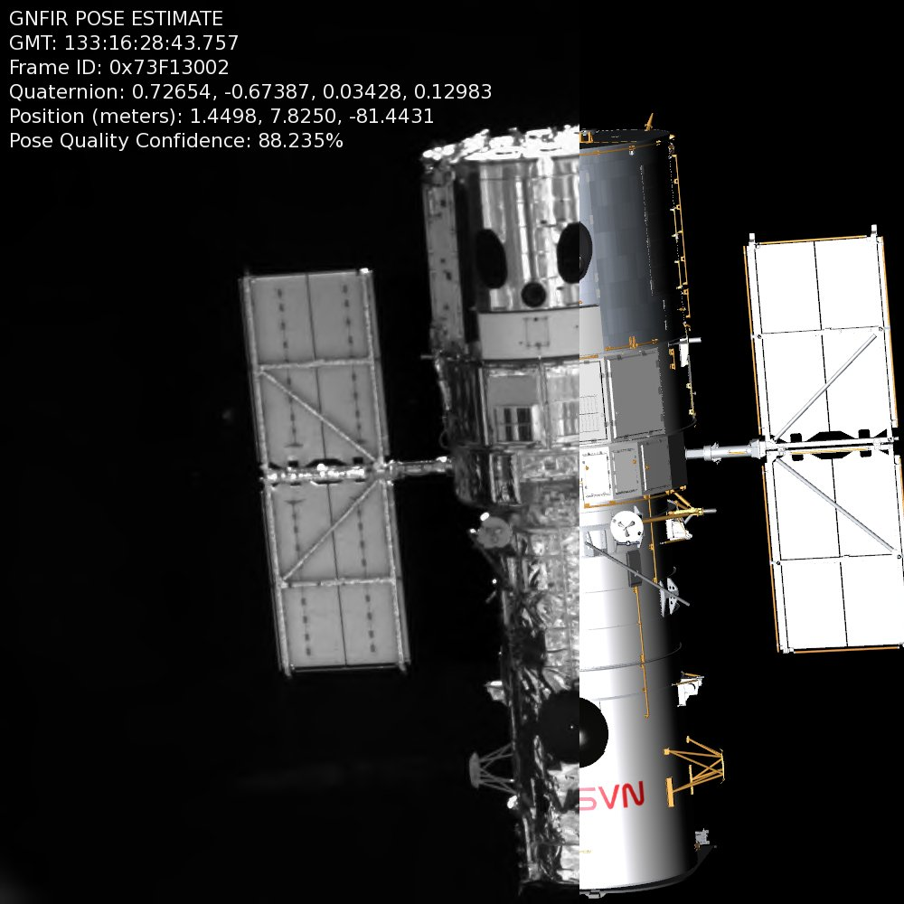
Tracking Algorithms on SpaceCube
Long Range Camera on Rendezvous
Short Range Camera on Deploy
Flight Image
RNS Tracking Solution
Flight Image
RNS Tracking Solution
Notes:
-Image w/ SCM installed, during deploy.
-Image → Cube → Hardware Edge Detection → PPC searches for known edges using internal models
-Once acquired, receive relative position and orientation
-Flight image overlaid with position estimate at this exact time. Tracking solutions sent down in telemetry. 80-90%
-Dead On

Slide 13
RNS Results Summary
SpaceCube enabled RNS to meet all objectives
Recorded 6 hours of camera and GPS data
Successfully tracked HST during rendezvous for 21 minutes and deploy for 15 minutes
Sent 100,000+ compressed images to ground
SpaceCube powered for 60 hours (8 in SAA)
2 configuration SEUs in SAA scrubbed out
1 PowerPC SEE that watchdog repaired
Notes:
-No other processor available would have been able to support the huge on-board processing demands of RNS
-SpaceCube was easy for the SW developers to use, rapid development
-FPGA hardware acceleration of the tracking algorithms was key in achieving our 3-Hz goal

Slide 14
HST Tracking
Rendezvous
Deploy
Notes:
-created with compressed images with our tracking solution superimposed
~20-30x speed-up
-Red lines are edges we are looking for
-Deploy video shows telescope being moved by the crew member over the RNS cameras.
-Watch it reacquire

Slide 15
What’s Next?
Just completed raw imagery downloads at GSFC
Looking for another flight for RNS hardware
Possible ISS flight for robotic demonstration
Hubble Robotic De-orbit Mission?
Flight spare SpaceCube going to ISS (STS-129)
Serve as NASA test bed for radiation mitigation
Building two new versions of SpaceCube
Covered in Session E presentation
Notes:
-Analyze all data, improve the system.
-Possible flight to ISS in the works
-ISS cube → Session E
-Shows the flexibility of SpaceCube. Reconfigure, ready for launch in 9 months

Slide 16
Questions?
Notes:
50 seconds until release
Apprx 4 minutes long
-Amazing footage.
-From mid-range camera during the release of the telescope.
-This is what we saw in mission control right after release. Needless to say, we were pretty excited.

