Slide 1
FPGAs, Scaling and Reliability
Douglas Sheldon
Parts Engineering
Jet Propulsion Laboratory
California Institute of Technology
Copyright 2009 California Institute of Technology
May be published with permission by MAPLD 2009

Slide 2
Overview
Introduction
Scaling Overview
Scaling examples:
  Hot Carrier
  Negative Bias Temperature Instability
  Package
  ESD
  FPGA Resources
  FPGA Costs

Slide 3
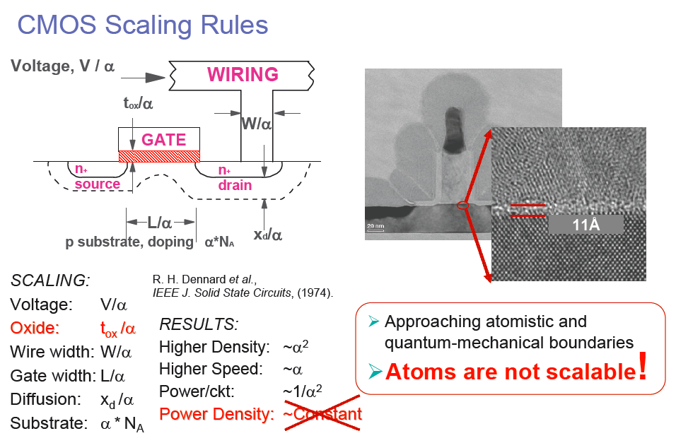
What do we mean by scaling?
Chen IBM 2006

Slide 4
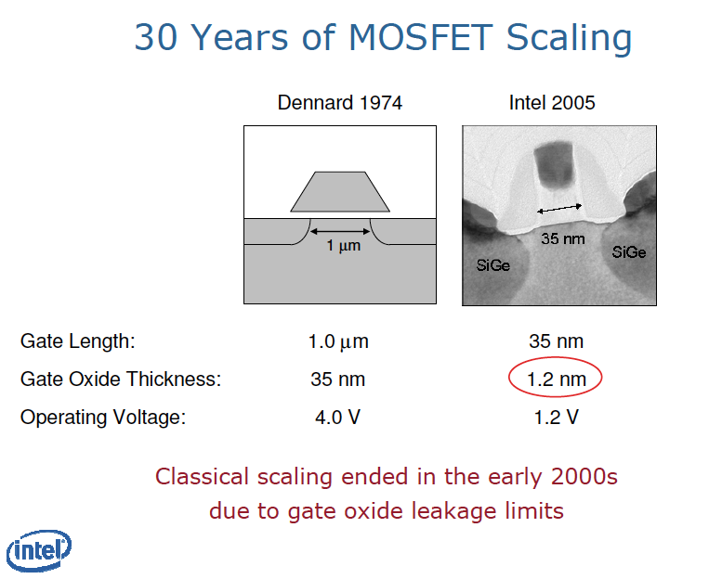

Slide 5
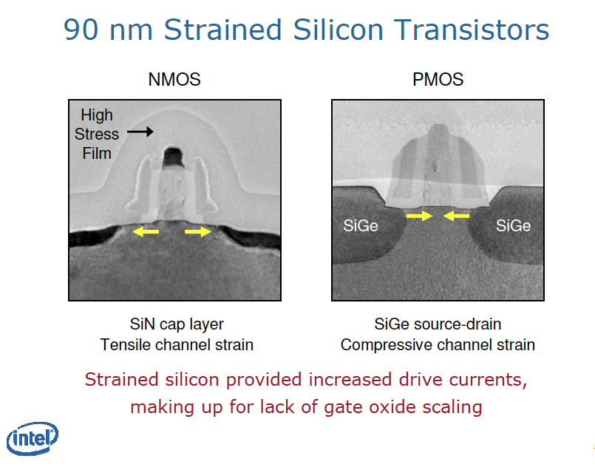

Slide 6
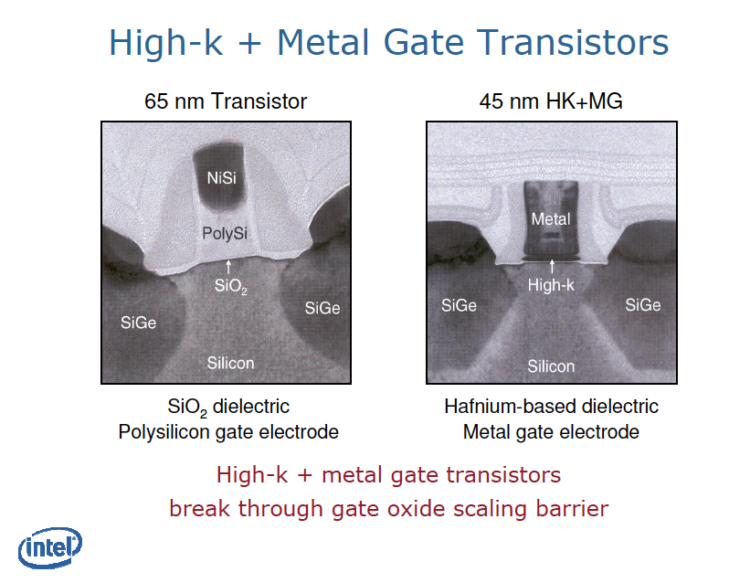

Slide 7
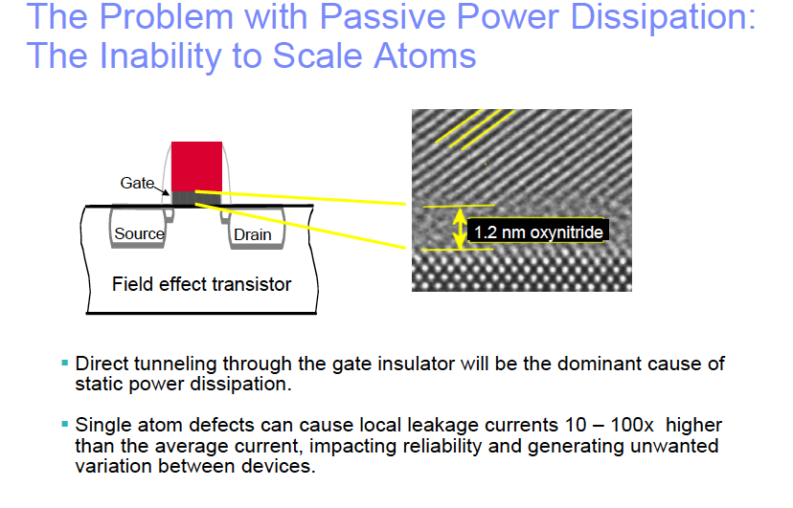
Static/Passive Power Problem
T. N. Theis IBM 2007

Slide 8
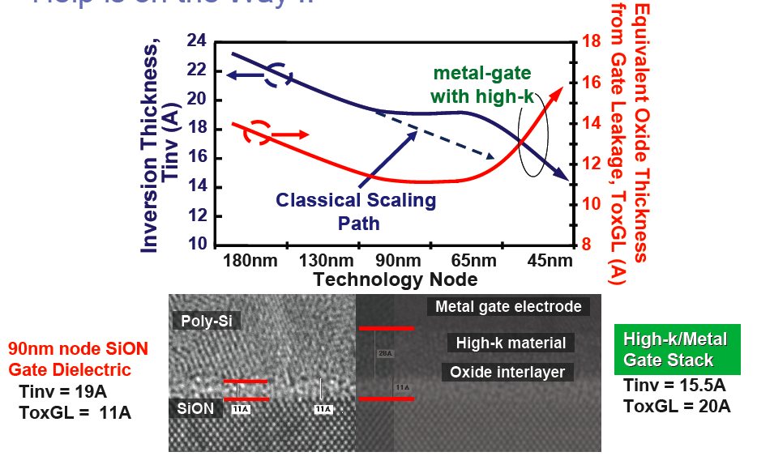
Fundamental change over to metal gate devices
Chen IBM 2006

Slide 9
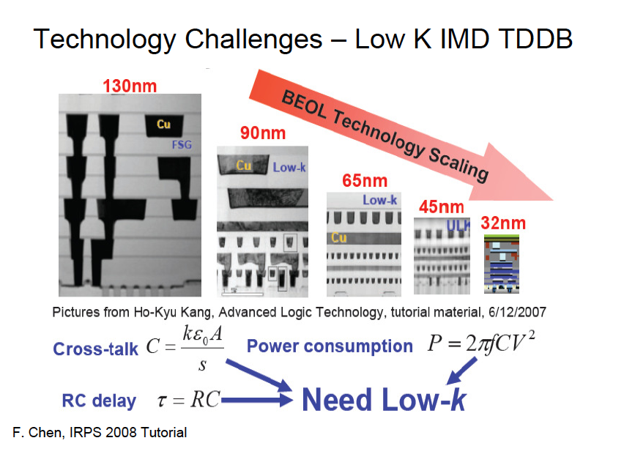

Slide 10
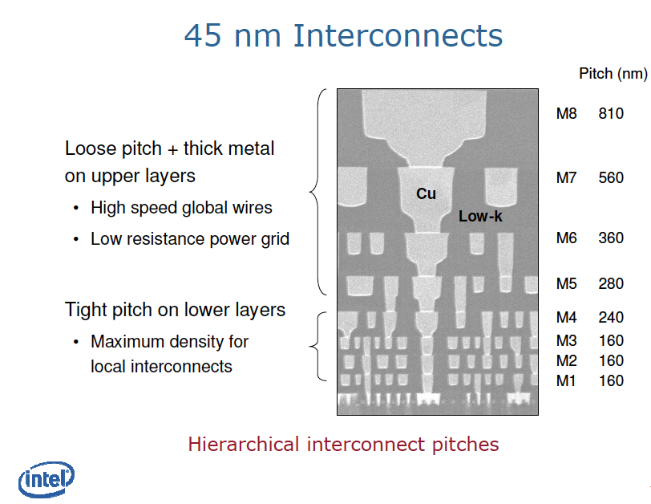
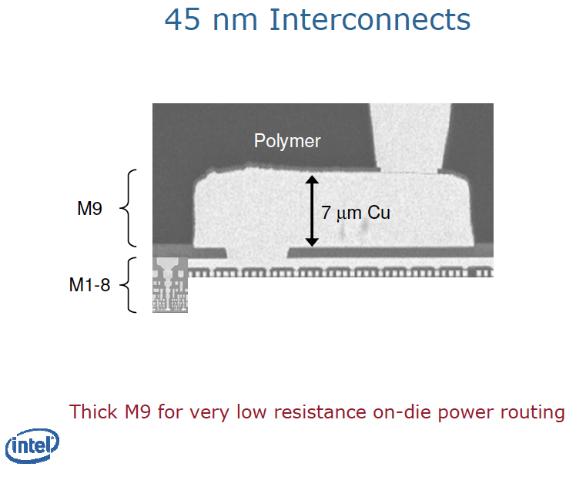

Slide 11
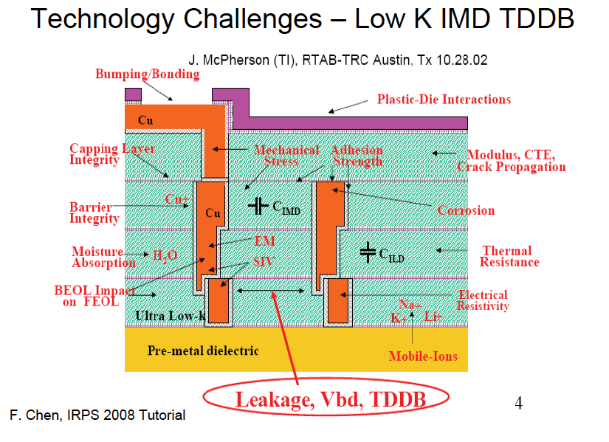

Slide 12
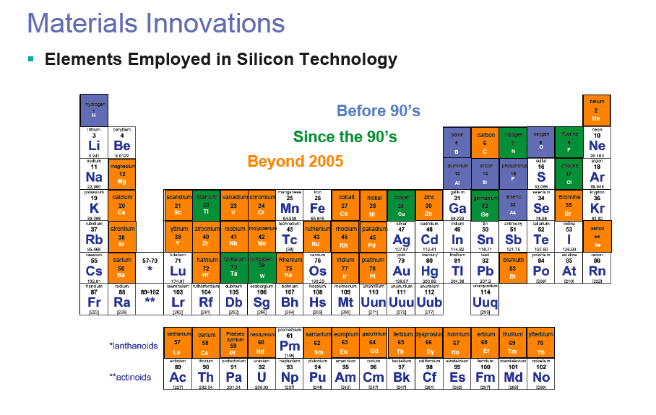
Scaling also means new materials => new reliability challenges

Slide 13
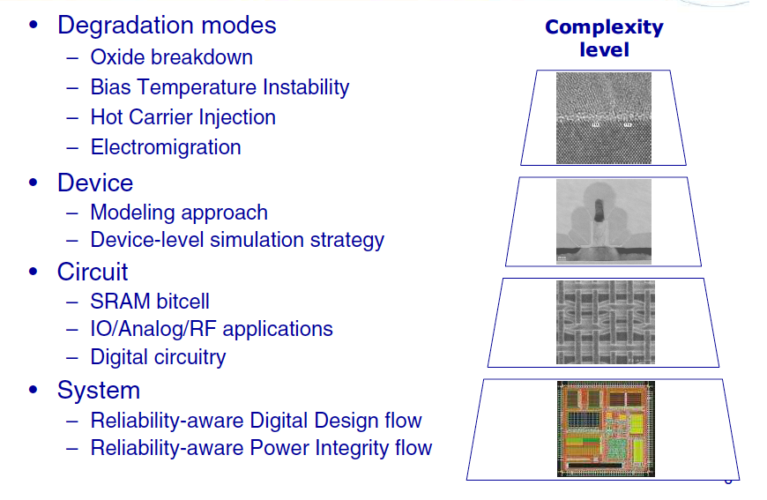
Modern approach to reliability in scaled devices like FPGAs
Foundry & FPGA vendor
FPGA vendor & User
V. Huard IRPS 2009 tutorial

Slide 14
Scaling Examples

Slide 15
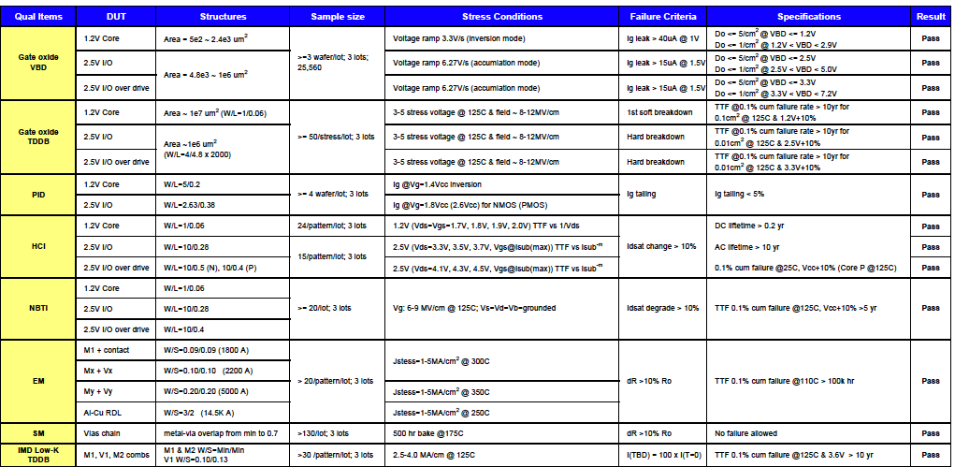
SiliconBlue FPGAs – NVM via
Conductivity Modification – TSMC 65nm
DC lifetime for Hot Carrier = 0.2yr
http://www.siliconbluetech.com/media/downloads/SBT_65LP_Process_Qual_v0.1.pdf

Slide 16
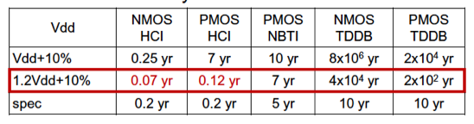
Is it ok to run my FPGA at a higher than nominal Vdd?
Example data and models from foundry:
This example shows a clear reliability issue for that condition.
Manufacturer did additional functional and large sample size HTOL at 1.2Vdd ± 10% and confirmed 5 year acceptance.
Not acceptable for long term, high reliability space mission.
Scaled technologies have reduced tolerance for “relatively” small increases in voltage. Designs must have tighter control.
IRPS Tutorial 2009 E. Hnatek and Y.W. Yau

Slide 17
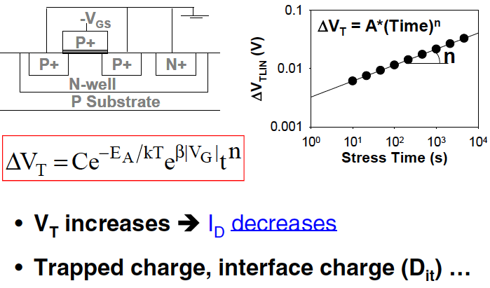
Negative Bias Temperature Instability - NBTI
Complex electro-chemical degradation effect
Interface trap generation and increased hole trapping mechanisms.
Some of the degradation is recoverable after the stress is stopped.
Magnitude of impact depends on circuit topology.
Digital circuits most effected
  Analog circuits will experience some mismatch
Both static and dynamic mitigation schemes to compensate for.
A. Krishnan IRPS tutorial 2009

Slide 18
NBTI with Xilinx Virtex 4
DCM (digital clock management) circuits for managing clock skews and delays.
  Designed to provide zero propagation delay and low clock skew.
Accelerated life test show DCM maximum operating frequency will decline if DCM is held in a persistent (non) operating condition.
  May not achieve lock at maximum frequency
  Static stress creates small variations in duty cycle precision of multi tap delay lines
Xilinx solutions involve:
  Null designs
  Drop in macros for long duration operation
  Automatic continuous configuration with updated ISE software
Device level ageing effects can indeed impact system performance.
http://www.xilinx.com/support/answers/21127.htm
http://www.xilinx.com/support/documentation/white_papers/wp224.pdf

Slide 19
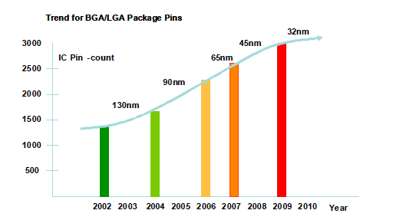
Scaling and Packages
Scaling has significantly increased the the number of pins on modern IC packages.
Wire bonding has given way to flip chip and wafer bump technologies for increased packing densities

Slide 20
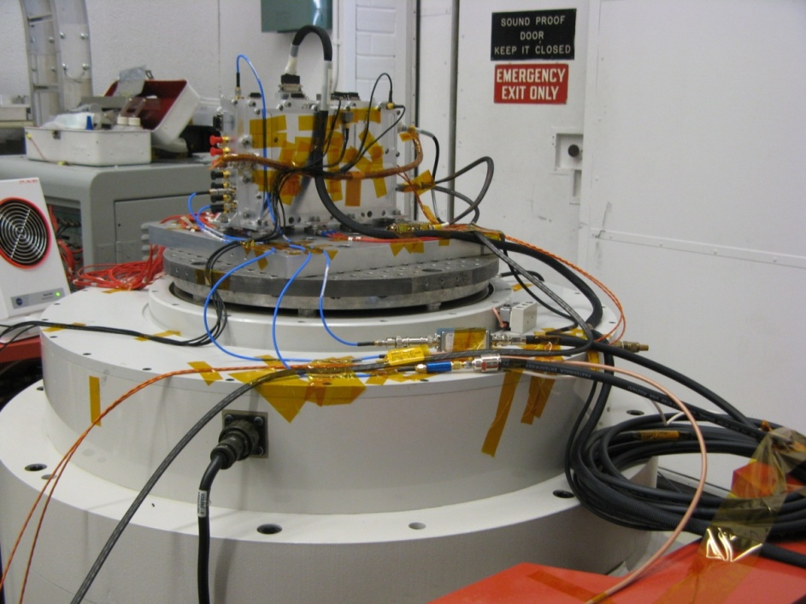
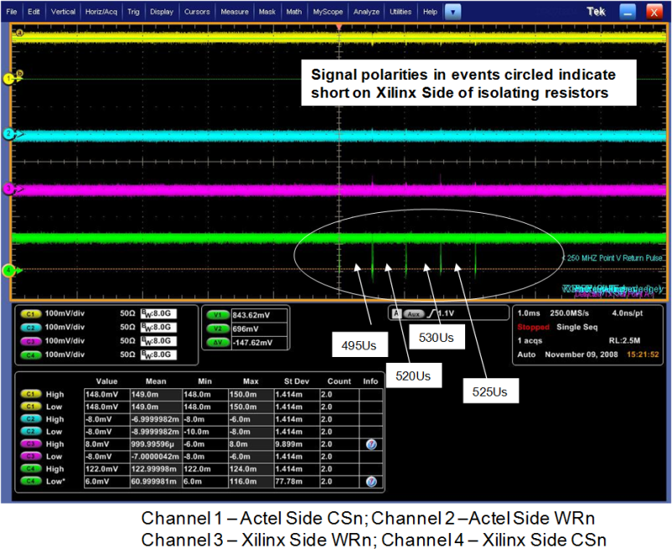
Xilinx Virtex 2 Package Scaling Anomaly
Anomaly occurred 28 times during launch level vibration on Y-axis only and did not at levels lower than launch levels
After much detailed analysis fault identified as CS and RW shorting to together
Work done by JPL Tiger Team with Xilinx support
Scope Trace of Event Occurrences

Slide 21
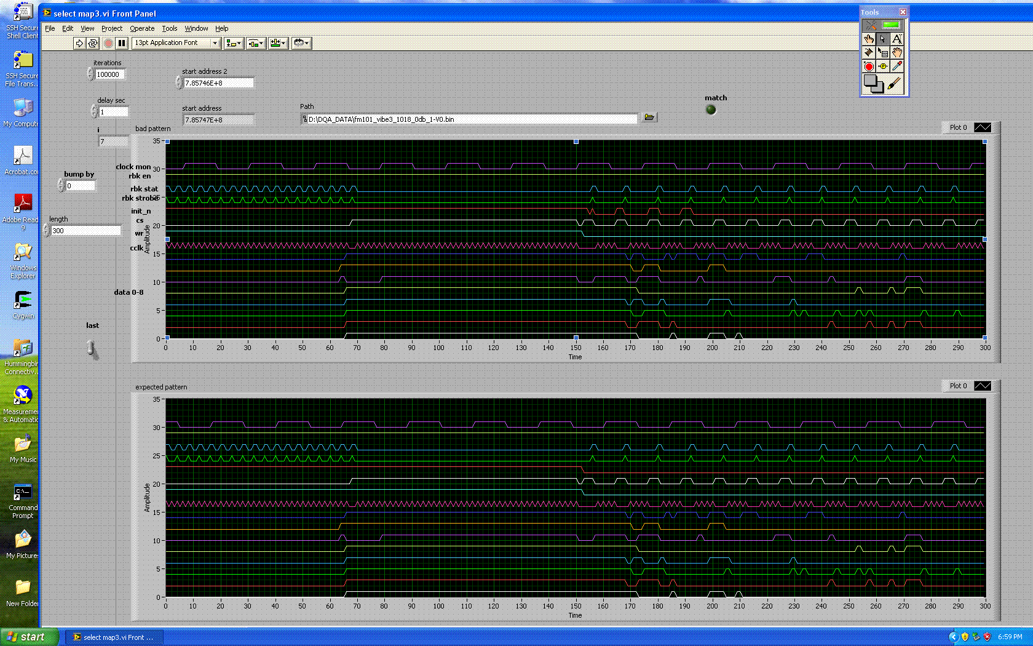
Sample Error Pattern for
Anomalous Event
Anomalous Pattern
Expected Pattern

Slide 22
Bond wire locations for shorting signals

Slide 23
Root Cause – Bond Wire Vibration
Fundamental mode is a bending side-to-side of the loop
Depends upon:
  Bond wire diameter
  Wire to wire spacing
  Modulus of Elasticity and density of material
High Q~300 can lead to peak-to-peak displacements of a few wire diameters
Original NASA related work:
  M. Blakely, JPL & H. Leidecker, GSFC - 1998
Observed f

Slide 24
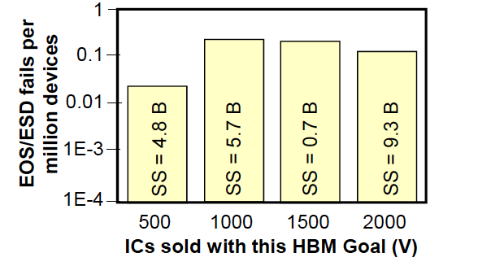
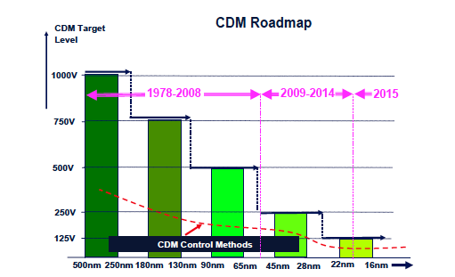
ESD and scaling
ESD failures seem independent of HBM performance and device scaling (to first order).
However scaling (higher speed, lower Vcc, lower breakdown V) makes same historical ESD requirements harder and harder to meet.
Are historical standards still required?
Industry council white paper recommends that reduced CDM goals must be adopted to adapt to scaling restrictions.
R. Kwasnick, IRPS Tutorial , 2009
White paper 2: Industry Council on ESD Target Levels, 2009

Slide 25
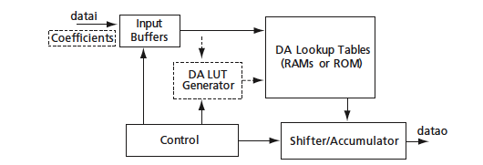
FPGAs and Scaling Resources
Actel A54SX72
Actel DirectCore© CoreFIR Finite Impluse Response Filter Generator downloadable IP design
Three different design resource utilizations: 10%/50%/80%
Three different temperatures: -40C/25C/85C
Credence D10 Tester – JPL VLSI Lab
Data taken by Greg Allen and James Skinner, JPL

Slide 26
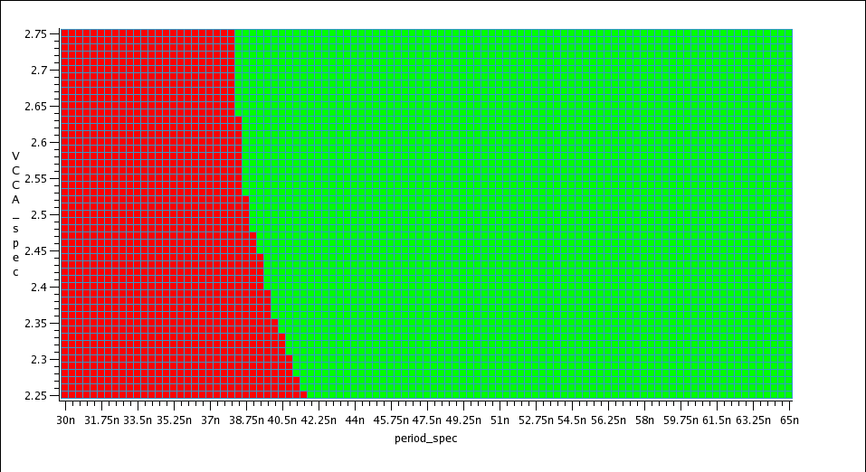
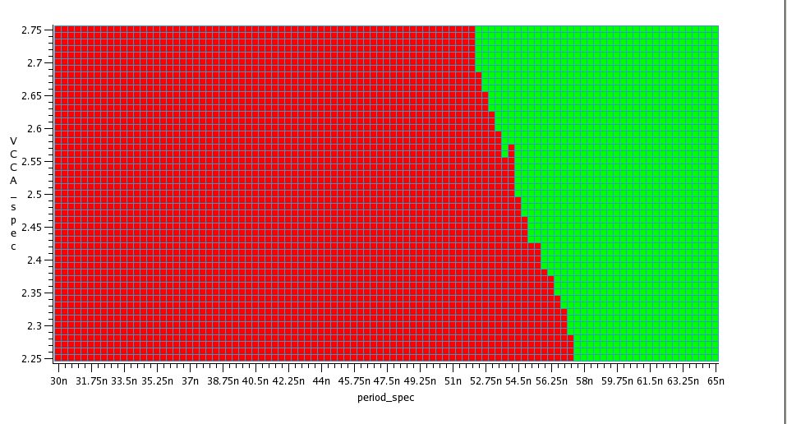
Vcca Comparison Schmoos
(same scale)
50%/25C
80%/85C

Slide 27
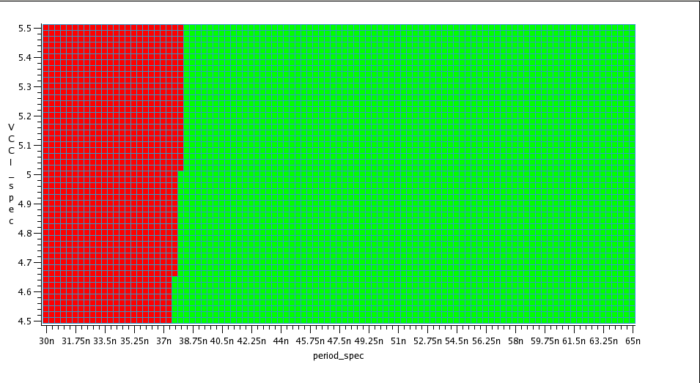
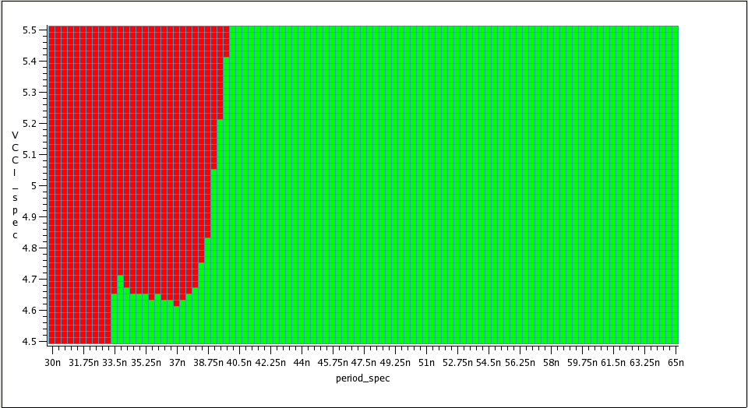
Vcci Comparison Schmoos
(same scale)
50%/-40C
10%/85C

Slide 28
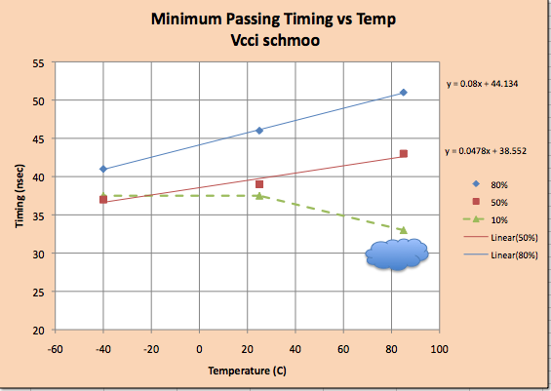
Timing vs. Temperature - Vcci
Nonlinear data
Failing time increases linearly with temperature for designs ≥ 50%
Increasing % resources used increases the slope of the temperature effect

Slide 29
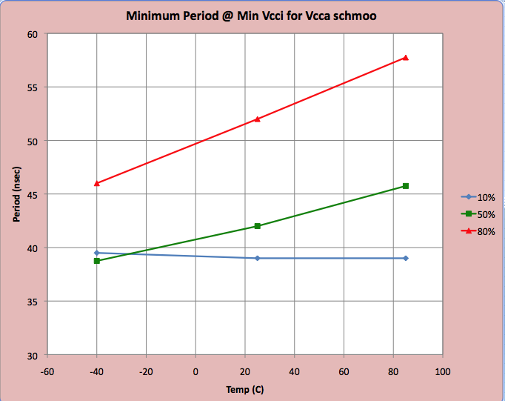
Timing vs. Temperature - Vcca
Increasing utilization increases sensitivity to temperature
10% design performance temperature independent
  More robust from reliability/mission assurance
  Small resource (array) contribution to total
Need to trade mission requirements with reliability requirements

Slide 30
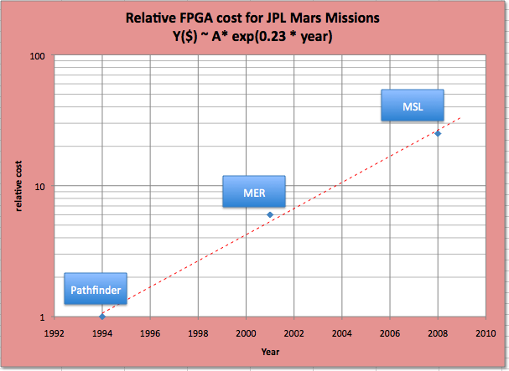
Scaling and JPL Mars FPGA Cost
Space FPGA cost increase 10X in 10 years

Slide 31
Thank you

