Slide 1
Fault-Tolerant Softcore Processors Part I: Fault-Tolerant Instruction Memory
Nathaniel Rollins
Brigham Young University

Slide 2
Overview
Strong interest in FT softcore processors in space
LEON processor used by European space program
Microblaze, PicoBlaze, 8051, ERC32, etc.
Rad-hard processors are expensive, big, and slow
Softcore processors are flexible, fast, and cheap
Overall Goal: identify low cost SEU mitigation techniques for softcore processors
Goal of Part I study: Identify low cost SEU mitigation techniques for softcore processor instruction memories

Slide 3
Approach
BRAM1
TMR is the most common mitigation technique
Expensive and slow
Other hardware techniques
Detection isn’t good enough – must correct
DWC alone isn’t good enough
EDC alone isn’t good enough
BRAM2
voter
BRAM3
ECC
EDC with DWC
Scrubbing
ECC BRAM1
Decode / Parity
ECC BRAM
Decode & Correct
ECC BRAM
do
Decode / Parity
Compare
di
WE
Study Approach
Compare different softcore processor instruction memory fault-tolerant techniques in terms of:
Area, speed, power, reliability
Remaining processor protection: plain TMR
FSM
BRAM2
ECC BRAM
do
Decode / Parity
di
WE

Slide 4
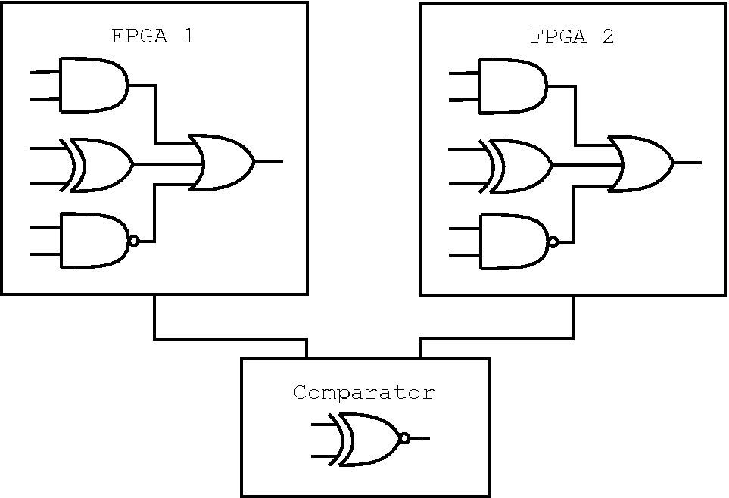
Fault Model
BYU/LANL SLAAC1V fault injection tool used to insert single bit upsets into Virtex FPGAs
BRAM bits in Virtex bitstream are treated differently
Task: upgrade fault injection tool to support:
Upsets in BRAM
Readback of BRAM bits
Next studies use SEAKR XRTC board with
Virtex4 FPGA
SEAKR board borrowed from LANL
Fault injection tool also upgraded to upset BRAMs and
detect critical failures

Slide 5
Critical Failures
Critical Failures: upsets that cannot be fixed with a reset (lead to a SEFI)
Different memory structures are susceptible to critical failures:
BRAMs
LUTRAMs
SRLs
Registers that are not tied to a global reset
Example: WE port on a BRAM
BRAM
Data In
Addr
Data Out
WE

Slide 6
Critical Failures
Critical Failures: upsets that cannot be fixed with a reset (lead to a SEFI)
Example: WE port on a BRAM
BRAM
0x0000
0x07
AF01E32D
39A13AA1
00305D10
210F3111
0498100F
64D1234D
. . .
0x3111
0
Instruction memory should never be written to → BRAM is treated as a ROM
input data lines tied low
WE tied low

Slide 7
Critical Failures
Critical Failures: upsets that cannot be fixed with a reset (lead to a SEFI)
Example: WE port on a BRAM
BRAM
0x0000
0x07
AF01E32D
39A13AA1
00305D10
210F0000
0498100F
64D1234D
. . .
0x0000
1
Upsetting the WE port overwrites the BRAM contents

Slide 8
Critical Failures
Critical Failures: upsets that cannot be fixed with a reset (lead to a SEFI)
Example: WE port on a BRAM
BRAM
0x0000
0x1D
AF01E32D
39A13AA1
00305D10
210F0000
00000000
00000000
. . .
0x0000
1
Especially bad for processors since BRAM address continually increments

Slide 9
Critical Failures
Critical Failures: upsets that cannot be fixed with a reset (lead to a SEFI)
Example: WE port on a BRAM
Mitigation techniques need to eliminate critical failures
BRAM
0x0000
0x00
00000000000000000000000000000000
00000000
00000000
. . .
0x0000
0
Resetting the device will restart the processor, but will not restore the BRAM contents (program is lost)!

Slide 10
Fault-Tolerant Techniques
Original processor design: Xilinx PicoBlaze
Instruction
ROM
PicoBlaze
Output
Fault-tolerance determined by examining the PC and current instruction as faults are injected
Address
Processor
Instruction memory fault-tolerant techniques:
TMR:
Single voter
Triple voter
Feedback
BLTMR
Scrubber
ECC:
SEC/DED
SEC/DED with DWC
SEC/DED with DWC and scrubbing
EDC & DWC:
CD with DWC
CD with DWC and scrubbing

Slide 11
Fault-Tolerant Techniques: TMR
Top-Level TMR – 1 voter
Top-Level TMR – 3 voters
Processor
Processor
voter
Processor
voter
Processor
voter
Processor
Processor
voter
Feedback TMR
BYU/LANL TMR Tool
ROM
v
ROM
v
BLTMR
ROM
v
ROM
v
Pico
Pico
v
Pico
v
Pico

Slide 12
FT Techniques: TMR with Scrubbing
BYU/Sandia BRAM scrubber with TMR
Each BRAM scrubbing WE must be independent of other BRAM WEs
Scrubbing address counters MUST be kept in sync
Scrubbing counter must be 2x slower than BRAM clock
Must prevent read/write address conflicts
BRAM
v
PicoBlaze
v
Without scrubbing overlapping errors will cause TMR to fail
a
do
di
do
v
FSM
a
WE
Triplicated counter
BRAM
v
PicoBlaze
v
a
do
di
v
FSM
Eliminating critical failures is difficult when BRAM WEs are upset
a
do
WE
EN
BRAM
v
PicoBlaze
v
a
do
di
do
v
FSM
a
WE

Slide 13
FT Techniques: SEC/DED
SEC/DED on 16-bit word:
Use (22, 6) code on 16-bit word
Use 2 BRAMS:
1 for top half encoded word (11 bits)
1 for bottom half encoded word (11 bits)
Complete fault tolerance difficult when crossing from triplicated to non-triplicated
Logic and routing coming into and out of BRAMs are single point of failure
encoded ROM
(top half)
SEC/DED:
Detects and corrects any single-bit upset
Detects any double-bit upset
Triple+ upsets may or may not be detected
Decode
v
PicoBlaze
v
Decode
v
PicoBlaze
v
encoded ROM
(bottom half)
Decode
v
PicoBlaze
v

Slide 14
FT Techniques: SEC/DED with DWC
Improve SEC/DED reliability with DWC
Still susceptible to critical failures when BRAM WE is upset
encoded ROM
(top half)
Decoder
v
0
v
PicoBlaze
v
1
encoded ROM
(bottom half)
Decoder
Decoder
0
v
PicoBlaze
v
SEC/DED Module
1
BRAM
a
do
0
v
PicoBlaze
v
1

Slide 15
FT Techniques: SEC/DED DWC Scrub
Scrubbing uses dual ported BRAMs
Scrub address counter runs ½ speed of BRAM clock
Scrubbing cannot fix all errors (only single-bit/double-bit guaranteed)
Scrub trigger: single error correction(SEC) or double error detection (DED) on current instruction – more than 2 errors may or may not be caught
When triggered, a scrub copies entire BRAM contents of good BRAM into bad BRAM
encoded ROM
0
v
PicoBlaze
v
Triple
CNT
a
do
Decoder
1
EN
a
di
do
we
Decoder
0
v
PicoBlaze
v
1
encoded ROM
a
do
Decoder
a
0
v
PicoBlaze
v
di
do
FSM x3
1
we
we
err
scrubData
SEC/DED Module
instruction0
scrubAddr
instruction1
addr
instruction2

Slide 16
FT Techniques: CD with DWC
Complement Duplicate (CD) duplicates and inverts (complements) the original BRAM contents
Detects errors by comparing the original with the complemented CD
CD only detects upsets so DWC is used to correct upsets
BRAM
a
do
CD check
0
v
PicoBlaze
v
1
CD check
CD detects:
Any single-bit upset
66% double-bit upsets
Any multiple adjacent unidirectional upset
CD BRAM
0
a
do
CD check
v
PicoBlaze
v
1
CD Module
BRAM
0
v
PicoBlaze
v
a
do
1

Slide 17
FT Techniques: CD DWC Scrub
Scrubbing uses dual ported BRAMs
Scrub address counter runs ½ speed of BRAM clock
Scrubbing will fix critical failures
Scrubbing trigger: inverse of current instruction doesn’t match CD contents
When triggered, a scrub copies entire BRAM contents of good BRAM into bad BRAM
There are other scrubbing design strategies with CD – but this one removes all critical failures
BRAM
0
v
PicoBlaze
v
Triple
CNT
a
do
CD Check
1
EN
a
di
do
we
CD Check
0
v
PicoBlaze
v
1
CD BRAM
a
do
CD Check
a
0
v
PicoBlaze
v
di
do
FSM x3
1
we
we
err
scrubData
CD Module
instruction0
scrubAddr
instruction1
addr
instruction2

Slide 18
FT Techniques: Results
Design | Slices |  | BRAM Bits |  | Clock Rate (MHz) |  | Power (mW) |  | Sensitive Bits |  | Critical Failures
Original | 70 |  | 560 |  | 65.5 |  | 49 |  | 2881 |  | 3
1 voter | 227 | 3.2x | 1680 | 3x | 67.5 | 1.03x | 66 | 1.35x | 847 | 3.4x | 3
3 voters | 252 | 3.6x | 1680 | 3x | 71.4 | 1.09x | 75 | 1.53x | 36 | 80.0x | 3
Feedback | 250 | 3.6x | 1680 | 3x | 66.1 | 1.01x | 73 | 1.49x | 68 | 42.4x | 3
BLTMR | 297 | 4.2x | 1680 | 3x | 63.9 | 1.03x | 76 | 1.55x | 52 | 55.4x | 3
TMR Scrub | 348 | 5.0x | 1680 | 3x | 58.4 | 1.12x | 82 | 1.67x | 28 | 102.9x | 0
SEC/DED | 340 | 4.9x | 770 | 1.4x | 43.4 | 1.51x | 82 | 1.67x | 711 | 4.1x | 16
SEC/DED DWC | 373 | 5.3x | 1540 | 2.8x | 42.7 | 1.53x | 89 | 1.82x | 473 | 6.1x | 3
SEC/DED DWC Scrub | 545 | 7.8x | 1540 | 2.8x | 32.4 | 2.02x | 105 | 2.14x | 326 | 8.8x | 0
CD DWC | 235 | 3.4x | 2240 | 4x | 47.9 | 1.37x | 72 | 1.47x | 1034 | 2.8x | 2
CD DWC Scrub | 395 | 5.6x | 2240 | 4x | 29.7 | 2.21x | 90 | 1.84x | 231 | 12.5x | 0
Clock and reset lines are NOT triplicated

Slide 19
Conclusions
Reliability
For instruction memories, TMR with scrubbing provides the best protection
Fewest sensitivities
Eliminates critical failures
Scrubbing is required to eliminate critical failures
Costs
TMR is more effective than SEC/DED and CD with DWC
Better protection
Lower area, speed, and power costs
SEC/DED and CD with DWC scrubbers are very expensive

Slide 20
FT Softcore Processors: Moving Forward
Next General Studies:
Memory Study: BRAMs & LUTRAMs
Software fault-tolerant techniques study
Create different fault models for SEAKR board
Multi-bit upset model
Temporal fault-tolerant techniques model
Combinations of different fault-tolerant techniques
Memory
Memory
PC
Reg File
PC
Reg File
SEC/DED
Control Logic
Control Flow
Monitoring
Control Logic
DWC & Scrubbing
TMR & Scrubbing
Checkpointing
IR
CC
ALU
Stack
IR
CC
ALU
Stack
PicoBlaze
PicoBlaze

